Slide 1
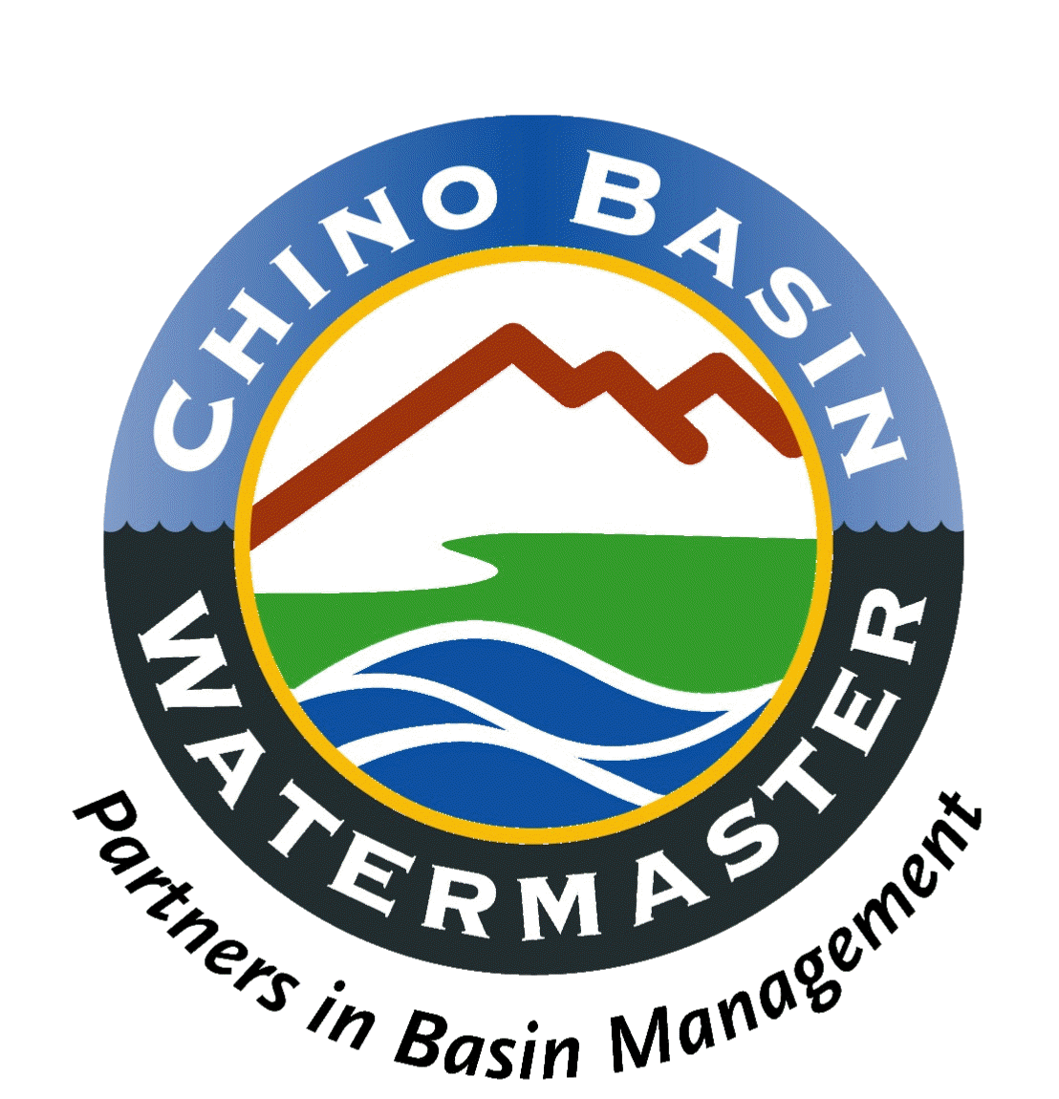
CHINO BASIN WATERMASTER
Presentation to Southern California Dialog
October 22, 2014

Slide 2
How and Why does the Pavley/Dickinson legislation treat adjudicated basins?

Slide 3
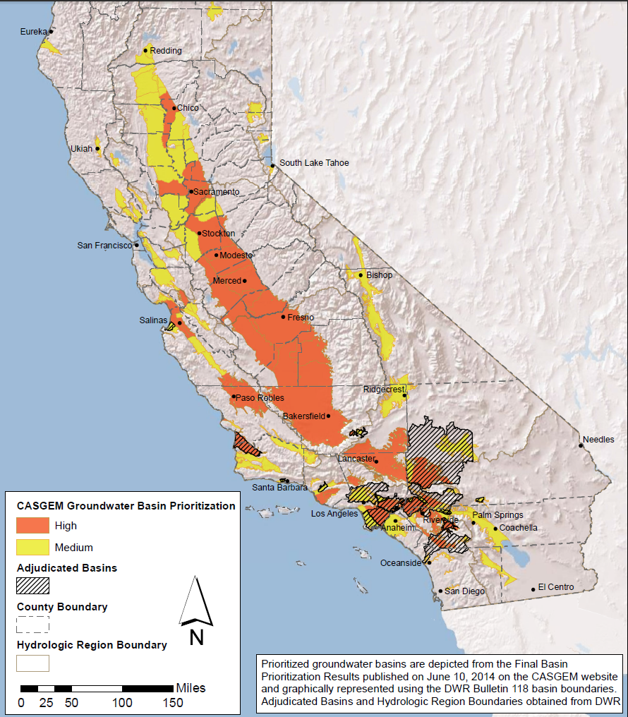

Slide 4
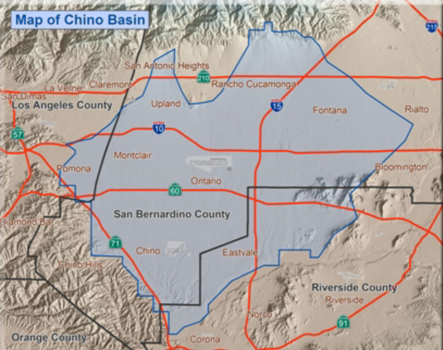

Slide 5
Land use has changed over time

Slide 6
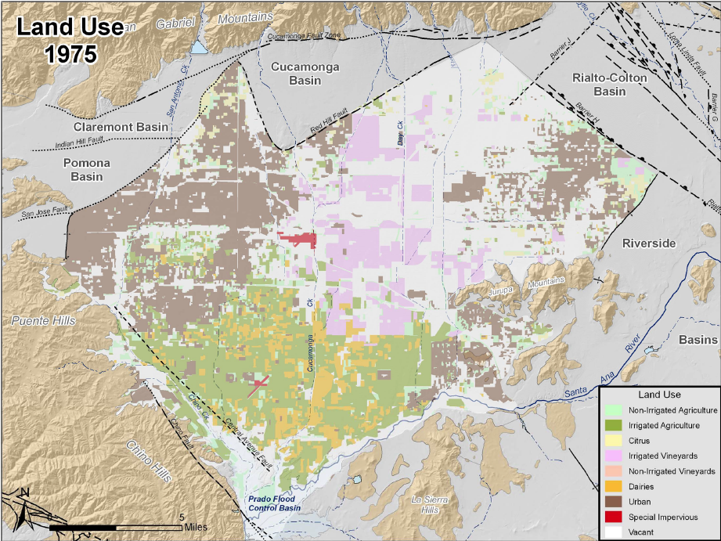

Slide 7
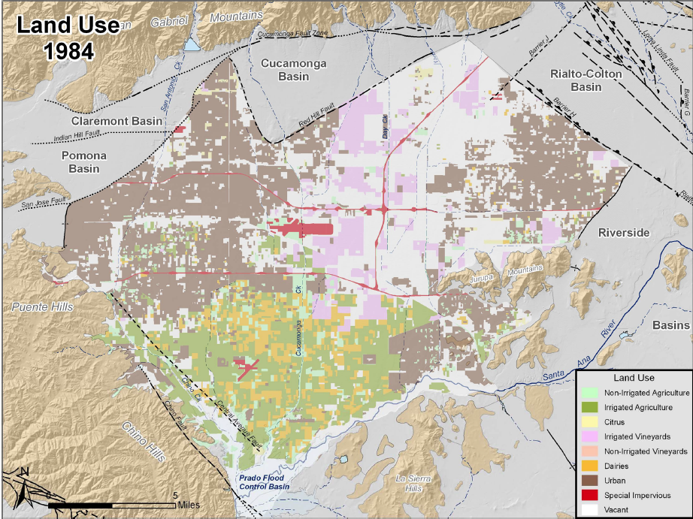

Slide 8
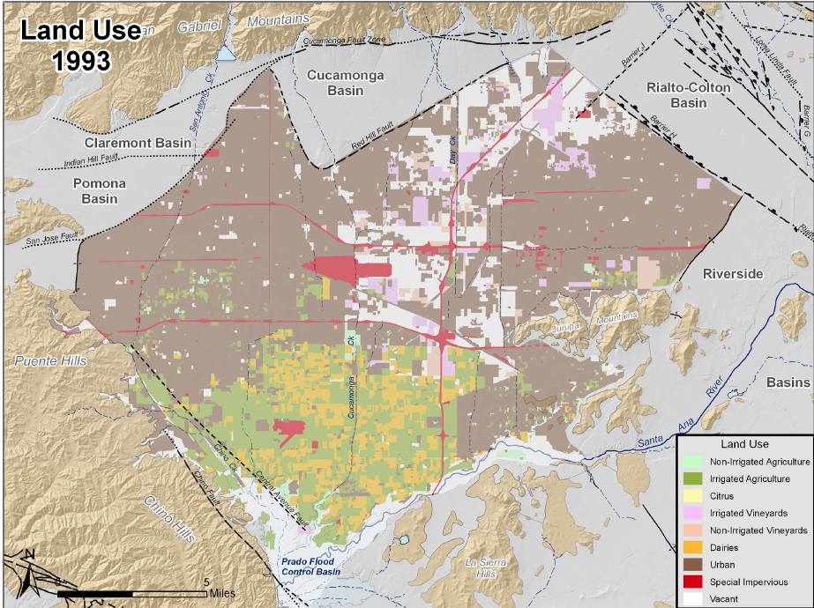

Slide 9
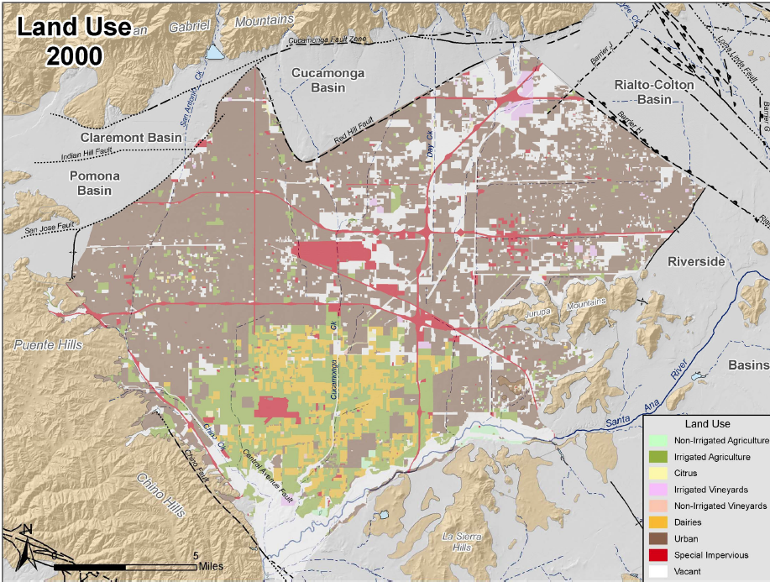

Slide 10
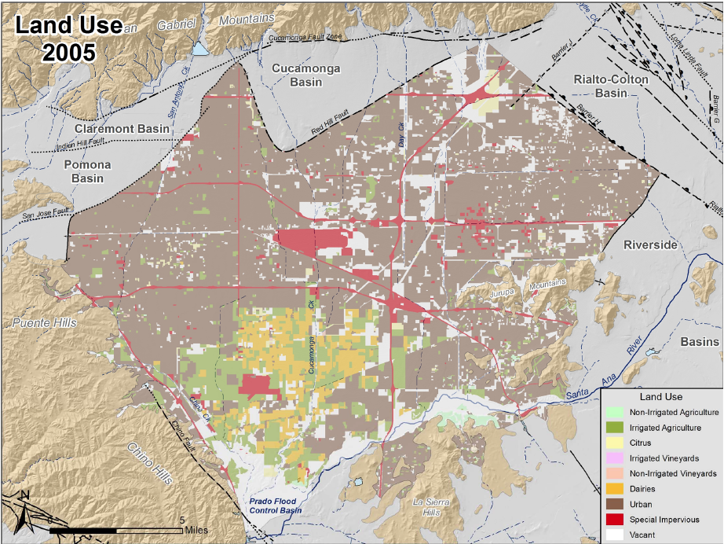

Slide 11
Safe Yield has changed

Slide 12
Water Quality Challenge: Salinity Industrial Contamination

Slide 13
Land Subsidence Challenge

Slide 14
1978 Judgment
Established the Safe Yield of the Basin
Allocated rights according to priority
Overlying land owners
Appropriators
Created Physical Solution
Provided for orderly transfer of agricultural rights to appropriators
Allows water transfers among producers
Created a Watermaster

Slide 15
2000 Optimum Basin Management Program (OBMP)
Created in the late 1990’s as a result of growing dissatisfaction with results of basin management
Identified essential goals for management of the Basin:
Enhancement of water supplies
Protection/enhancement of water quality
Protection against further land subsidence
Equitable financing

Slide 16
General Basin management philosophy
Increase production near the Santa Ana River:
Extract high-TDS water from the Basin and remove the salt
Prohibit high TDS water from entering the river and flowing downstream
Induce underflow from the river
Enhance the ability to recycle water

Slide 17
OBMP Elements
Basin-wide study; identification of impaired areas
Integration of water supply sources and demand
Established common goals for those with pumping rights
Established extensive monitoring
Foundation for salinity management and recycled water use
Study of conjunctive use possibilities

Slide 18
SGMA Requirements

Slide 19
SGMA Requirements

Slide 20
Some thoughts
Adjudications, though far from perfect, give certainty on water rights and a quick way to resolve disputes
Groundwater basin management of any form needs to integrate production rights with:
Water quality
Surface water interaction with groundwater
Interaction with adjacent basins
Land Subsidence

Slide 21
Some thoughts
Groundwater needs to be managed, not in an abstract sense, but as an integral part of water supplies for a region, storm water, recycled, imported water, water use efficiency, to meet the total demands of that region.

Slide 22
Thank You

