Slide 1
Southern Nevada Water Challenges and Solutions
Bruce Moore, Manager
Colorado River Division
Southern Nevada Water Authority
July 28, 2010

Slide 2
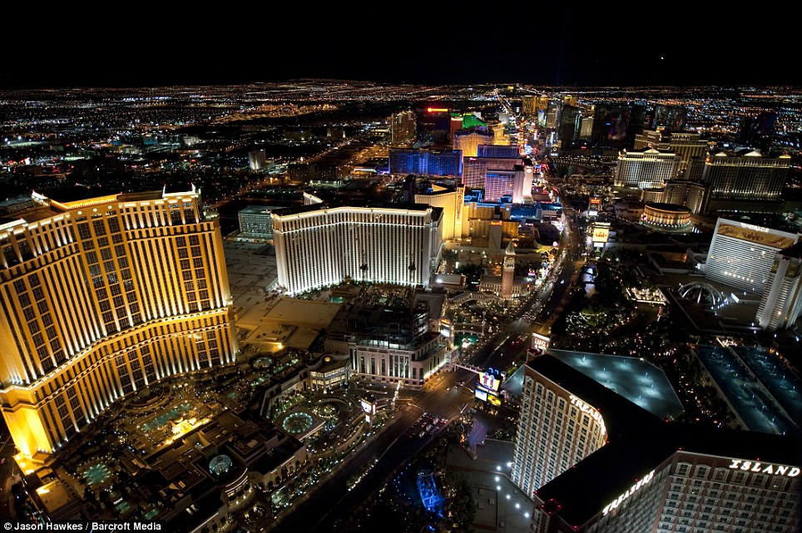
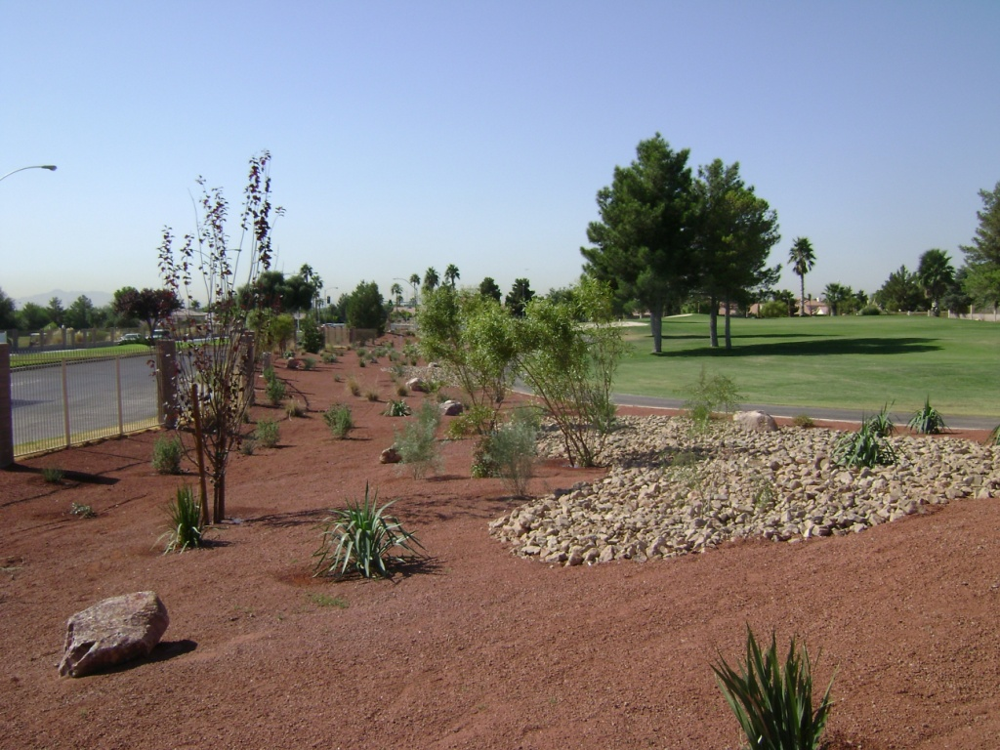
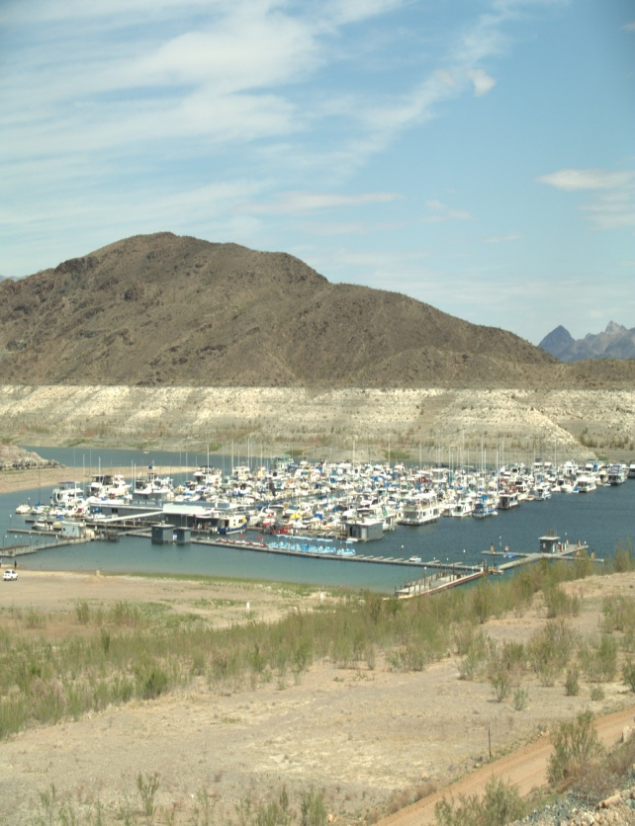
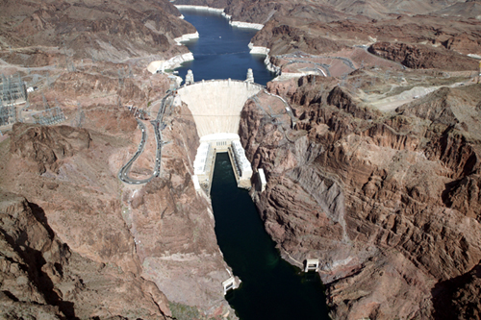
WELCOME TO LAS VEGAS

Slide 3
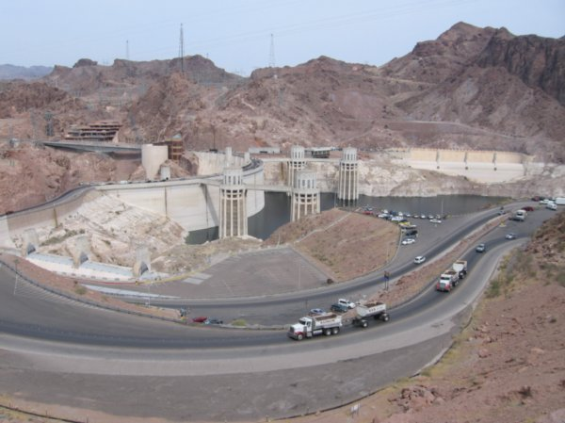
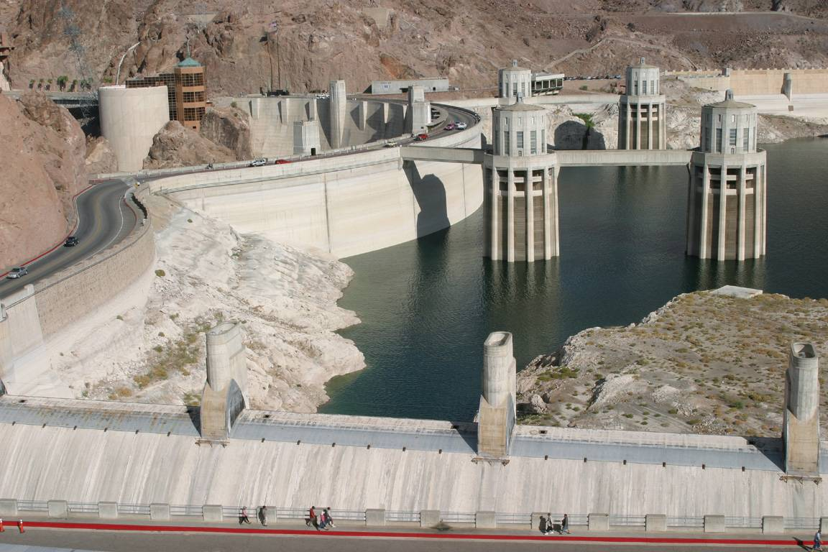
Hoover Dam
1983
2009
Notes:
Pagina con animaciones. La única vez que la presa reboso fue en el 1983.

Slide 4
Topics
Background
A Dropping Lake Mead
SNWA Groundwater Development Project
Desalination

Slide 5
Since 2000, average historical inflows have been only 66% of normal.
Normal

Slide 6
2009 Water Resource Plan
Projected Water Demands and Future Resources (under normal Colorado River Conditions)
1,400,000
1,200,000
Arizona Bank and Augmentation
In-State Groundwater
1,000,000
Drop 2
800,000
Water Demands (acre-feet)
600,000
ICS
(Muddy/Virgin Rivers and Coyote Spring)
400,000
Colorado River and
Las Vegas Valley Groundwater
200,000
0
2010
2020
2030
2040
2050
2060

Slide 7
Background
Pop. approx. 2 million (currently modest growth)
14.2 % Unemployment
Demand down 6%
Conservation 20 billion gallons
Lake down 100+ feet to elev. 1087, first intake 1050

Slide 8
Intake No. 1 is operational to a depth of 1,050 feet
Jan. 2000 water level: 1,214 ft.
1,200’
1,150’
Current water level: 1,103 ft.
1,100’
1,050’
INTAKE NO. 1
Intake No. 1
Is inoperable
1,000’
INTAKE NO. 2

Slide 9
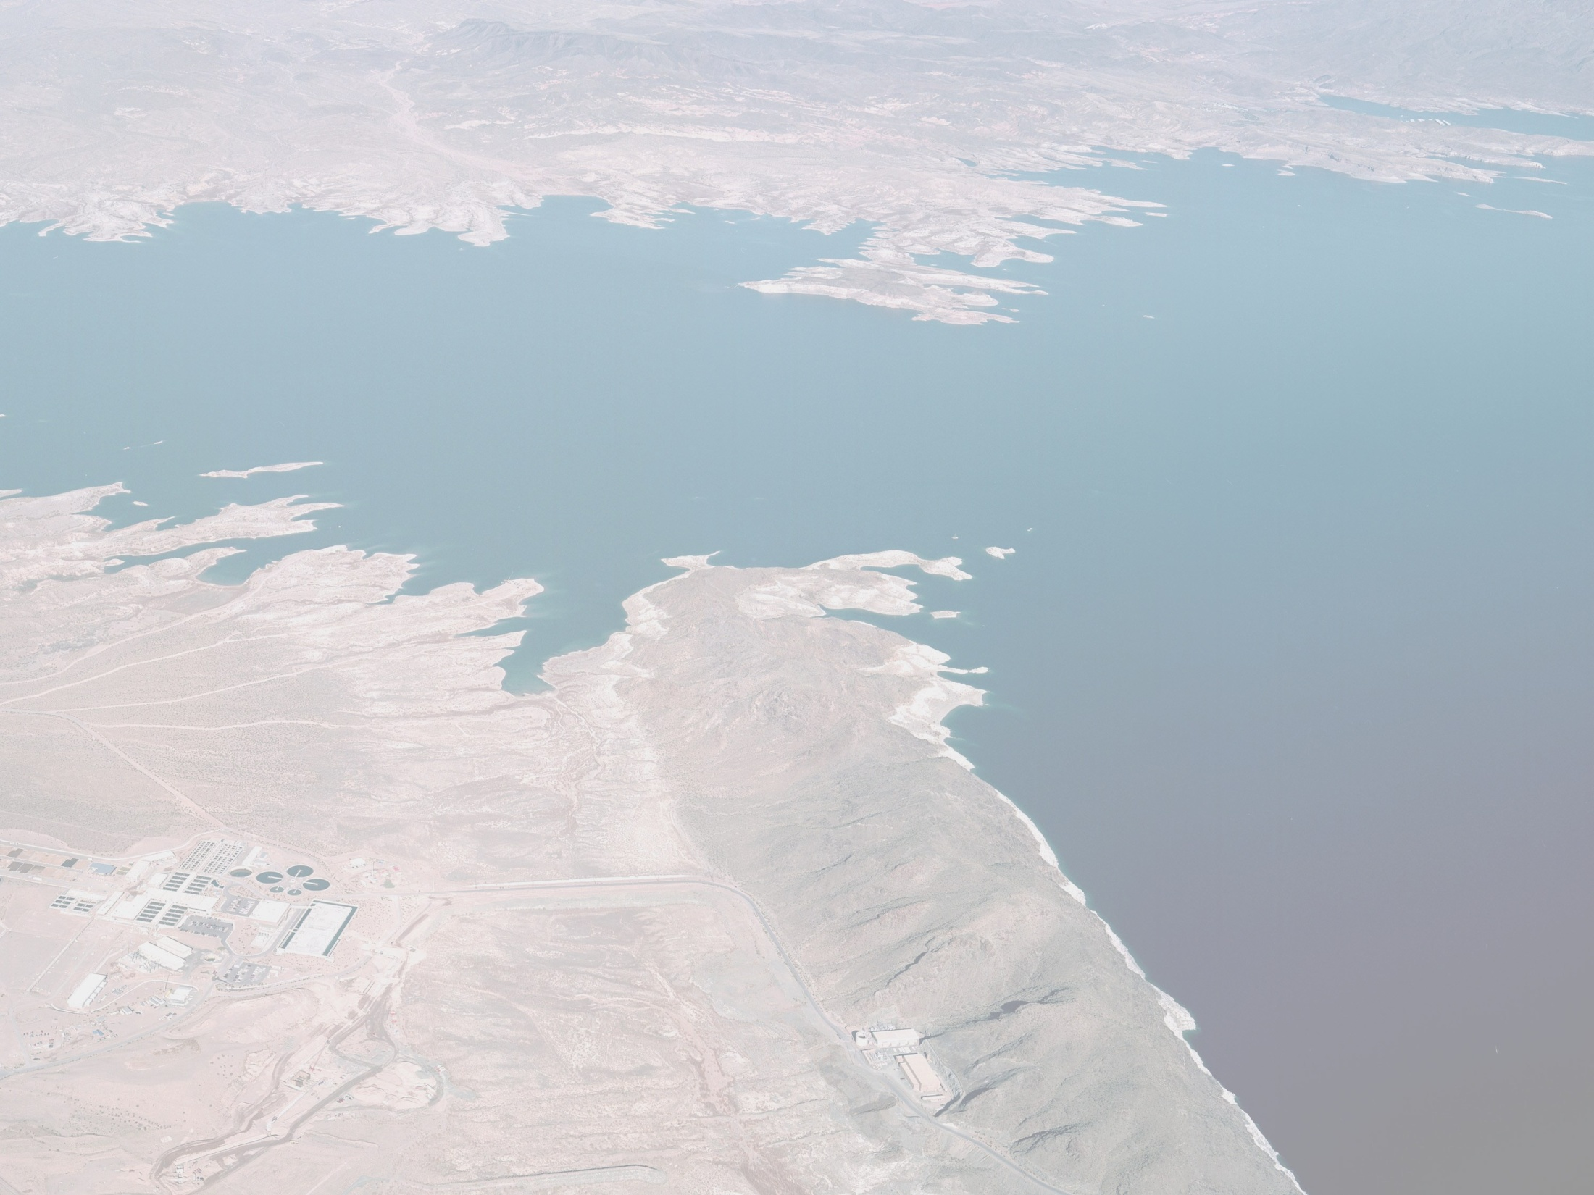
Lake Mead Intake No. 3 Total Project Scope
INTAKE SHAFT
Intake Tunnel
ACCESS SHAFT
Pumping Station
Intake No. 2 Connection
Discharge Pipeline
WATER TREATMENT FACILITY
(Existing)
Intake No. 1
Intake No. 2
Notes:
10
Narrative:
The largest portion of the construction work (yellow) is being accomplished as a design-build contract. It involves an access shaft on the shore of Lake Mead, a 3-mile long tunnel under the lake bottom, and an intake structure or riser deep on the bottom of the lake. The intake location was strategically chosen as a balance of good water quality, adequate depth, favorable geology, and reasonable cost.
Three contracts have been deferred (disappear with anamation: pumping station, discharge pipeline, and associated electrical) in response to declining revenue since 2006 (85% drop in new-connection fees and a 14% drop in sales tax revenues). Deferring these contracts reduces the overall project expense by approximately $200 million while still maintaining operational objectives (discussed in the next slide). This allows SNWA to prevent drawing down reserves to levels that may have negatively affected bond ratings and future borrowing costs.
Extra information about this slide:
Curved alignment -> better geologic conditions (still only ~50’ cover at OLD LV wash)
Other alignment such as straight line considered, although shortest distance btwn two points due to geography can be more expensive & longer duration

Slide 10
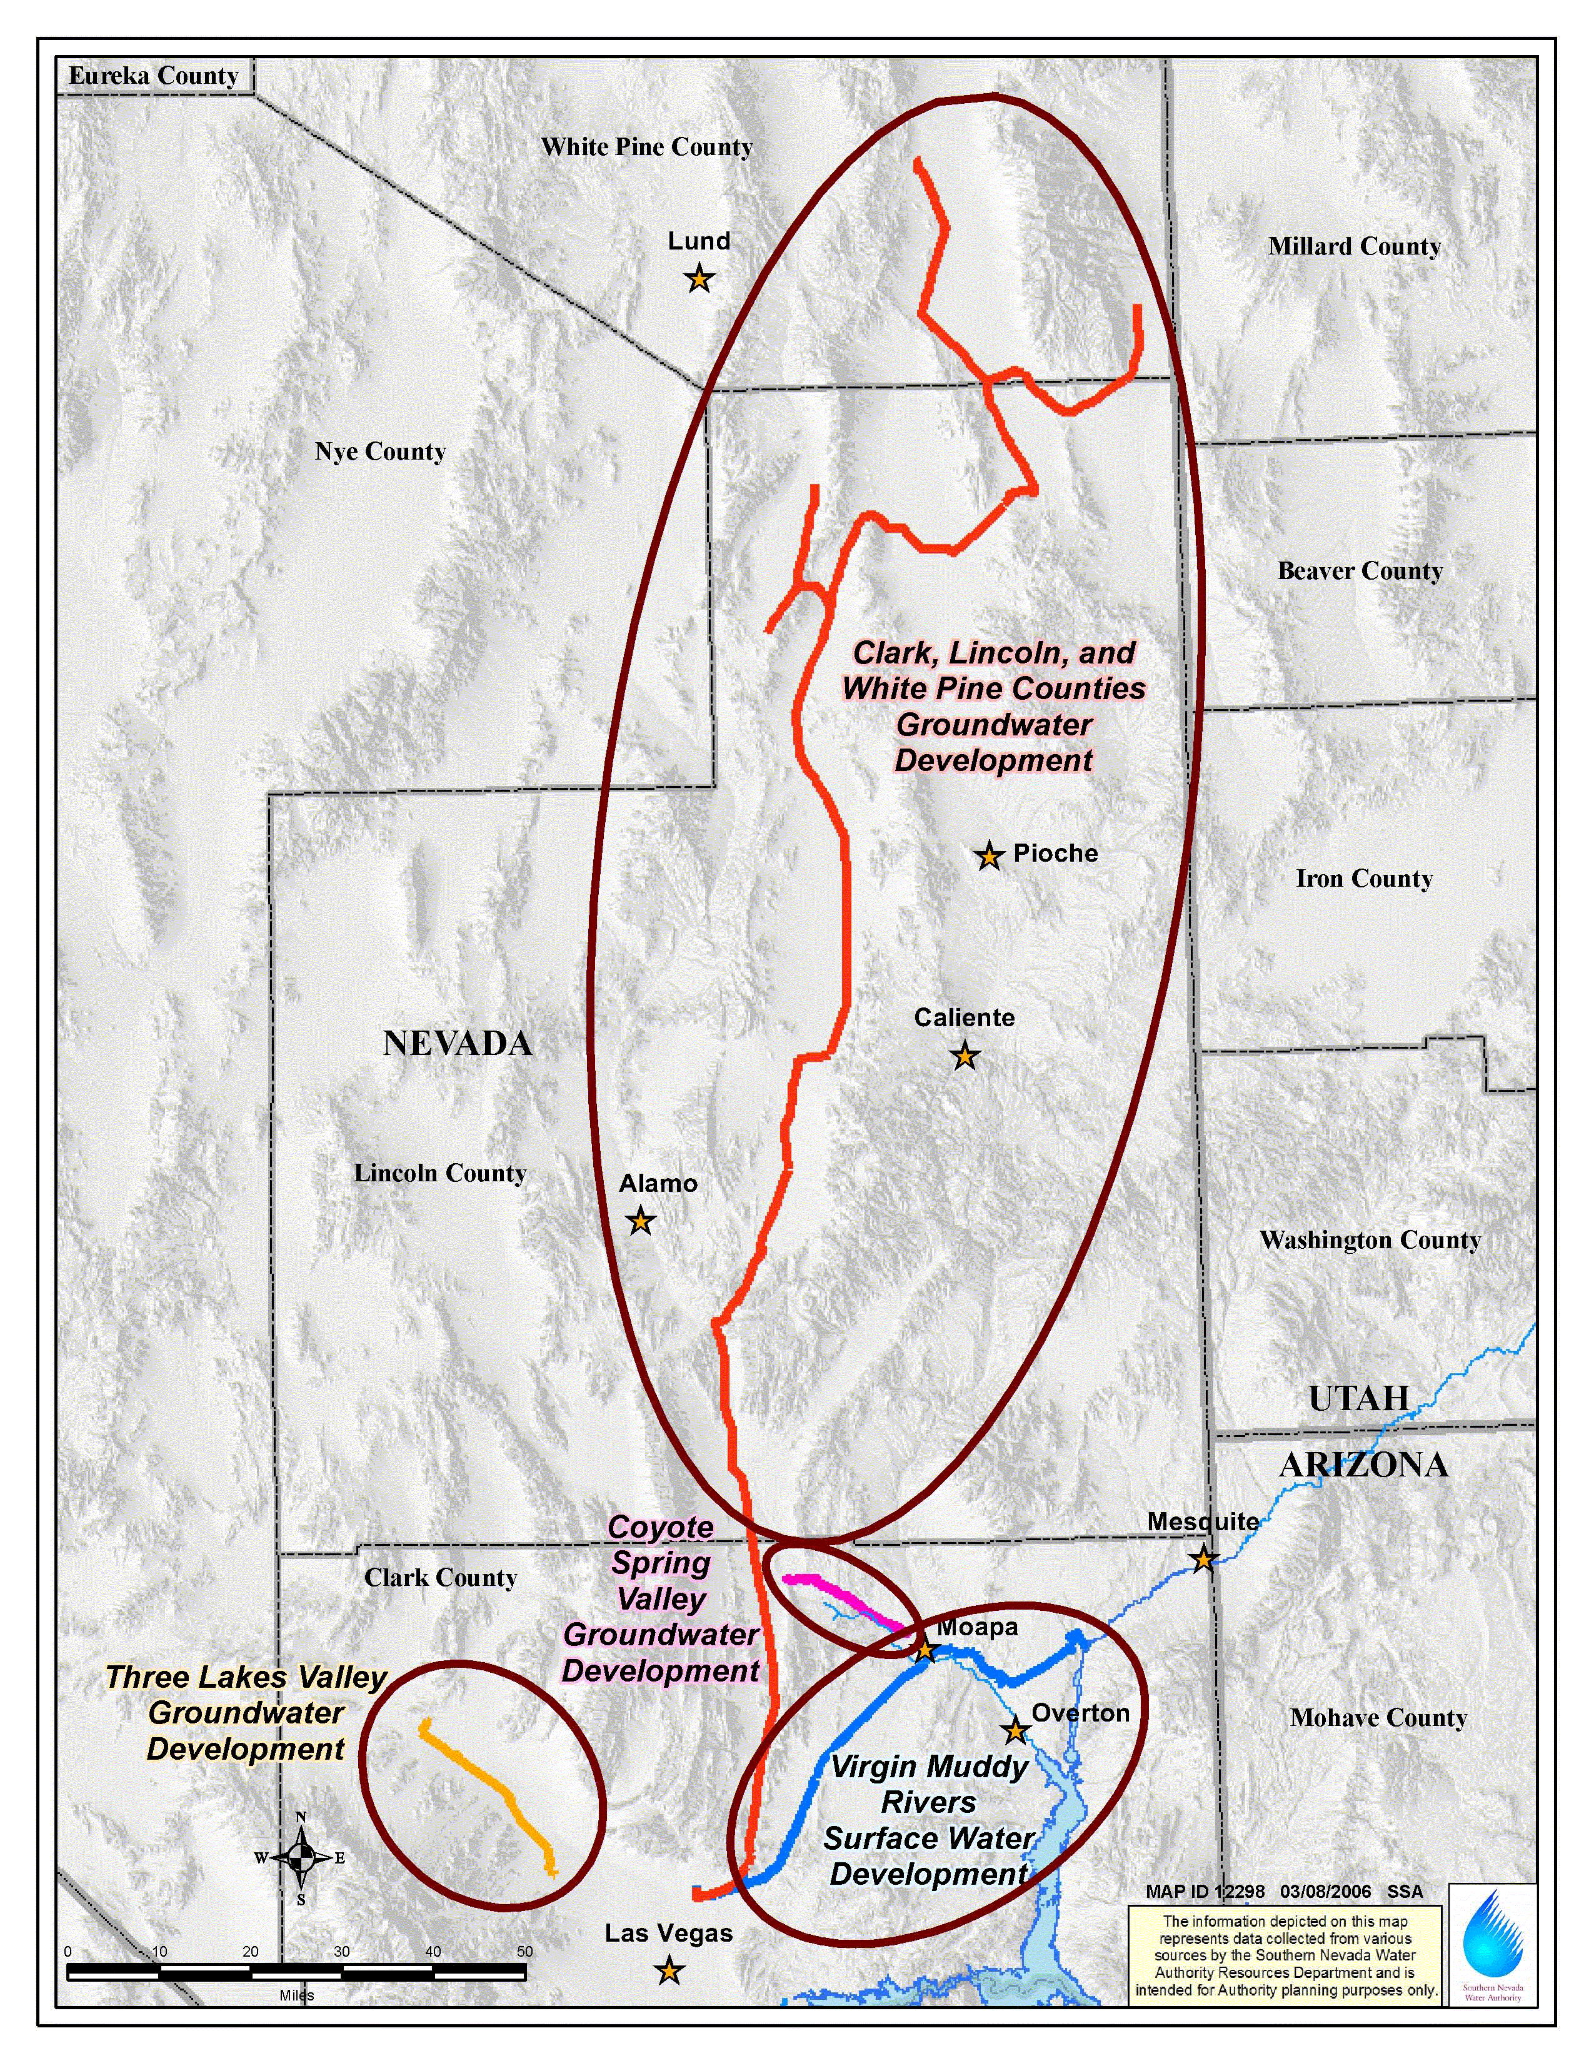

Slide 11
Desalination
Seven Basin States Agreement
Firm Water Supply
Bi-national Process
Partnership

