Slide 1
2014 California Water Bond
Southern California Water Dialogue
Sept. 24, 2014 • Timothy Quinn, ACWA Executive Director

Slide 2
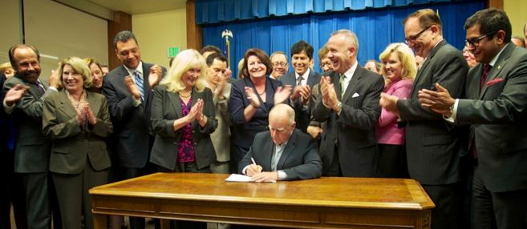
It Has Been a Big Year for California Water
California Water Action Plan
Water Bond “Jump Starts” the Comprehensive Plan
Why are these people so happy?

Slide 3
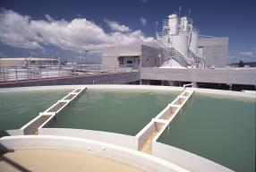
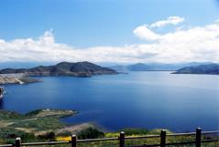
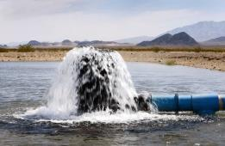
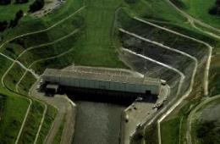
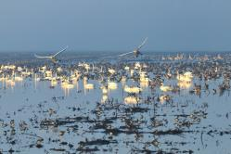
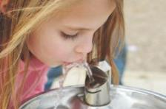
The Comprehensive Water Strategy
“In a Nutshell”
Use less
Store more
Fix the Delta
Manage groundwater
Provide safe drinking water
Invest in habitat and watersheds

Slide 4
2014 Water Bond
Total Expenditures = $7.545 billion
(Replaces $11.14 billion bond)

Slide 5
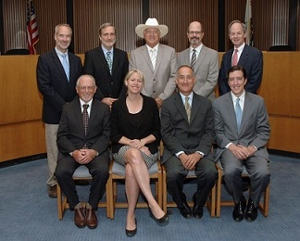
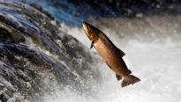
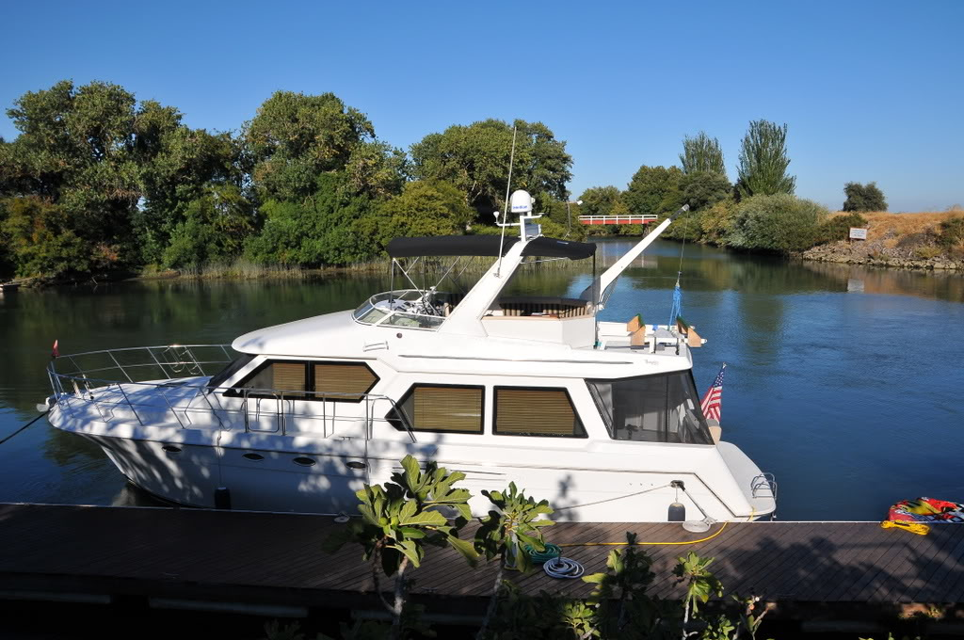
Prop 1 Funding for Water Storage
$2.7 billion continuously appropriated to California Water Commission
Competitive process to maximize public benefits
  Flows & temps for fish (>50%)
  Water quality
  Flood control
  Emergency Response
  Recreation
Funds for wider range of projects
  CALFED surface storage
  Other local/regional surface storage
  Groundwater storage
  Reoperation of existing storage
No funds for water supply benefits – must be paid by users

Slide 6
Proposition 1: The 2014 Water Bond
Resources
Official Voter Information Guide – Supplemental Ballot: http://www.voterguide.sos.ca.gov/en/pdf/
Yes on Proposition 1 and Proposition 2 campaign website: http://www.yesonprops1and2.com/prop-1
No on Proposition 1 campaign website: http://www.noonprop1.org/

Slide 7
Broad Support for 2014 Water Bond
Business
Bay Area Business Council
Bay Planning Coalition
California Building Industry Association
California Chamber of Commerce
Coachella Valley Economic Partnership
Silicon Valley Leadership Group
Agriculture
Agricultural Council of California
California Farm Bureau Federation
Fresno County Farm Bureau
Western Growers
Labor
California Alliance for Jobs
California Conference of Carpenters
California Labor Federation
California-Nevada Conference of Operating Engineers
California State Pipe Trades
California Coalition of Utility Workers
State Association of Electrical Workers
State Council of Laborers
Environmental Interests
American Rivers
Audubon Society
California League of Conservation Voters
California Trout
California Waterfowl Association
Clean Water Action
Community Water Center
Defenders of Wildlife
Ducks Unlimited
Natural Resources Defense Council
The Nature Conservancy
Trout Unlimited
Water Agencies
Assoc. of Cal. Water Agencies
Calaveras County Water District
Calleguas Municipal Water District
Castaic Lake Water Agency
Coachella Valley Water District
Contra Costa Water District
East Bay Municipal Utility District
Eastern Municipal Water District
Friant Water Authority
Water Agencies Cont’d
Helix Water District
Indian Wells Valley WD
Irvine Ranch Water District
La Puente Valley County WD
Las Virgenes Municipal Water District
Metropolitan Water District of Southern California
Monte Vista Water District
Regional Water Authority
Rincon del Diablo MWD
San Diego County Water Authority
Santa Clara Valley Water District
Santa Margarita Water District
Solano County Water Agency
Sonoma County Water Agency
Three Valleys MWD
Upper San Gabriel Valley MWD
Valley Center Municipal Water District
WateReuse California
Westlands Water District
West Basin MWD
Yuba County Water Agency
*As of Sept. 22, 2014. Includes supporters of legislation putting bond on the ballot.

Slide 8
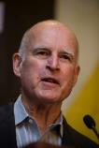

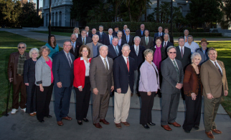
Underlying Themes of the
2014 Water Bond
Governor Brown’s leadership
Comprehensive vision & plan for all Californians
Fiscal responsibility
Economy & jobs
Unprecedented, diverse support base

Slide 9
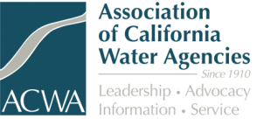
Contact & More Information
Timothy Quinn
ACWA Executive Director
timq@acwa.com
916.441.4545 • www.acwa.com

