Slide 1
Overview of the Integrated Water Resources Plan Update
Southern California Water Dialogue
September 23, 2015

Slide 2
IRP Background

Slide 3
IRP Background
What is the Integrated Water Resources Plan?
A comprehensive long-term strategy to identify potential resource development needs, adaptation measures, and implementation pathways
IRP Objectives
Ensure reliability
Ensure affordability
Ensure water quality
Maintain diversity and flexibility
Acknowledge constraints

Slide 4
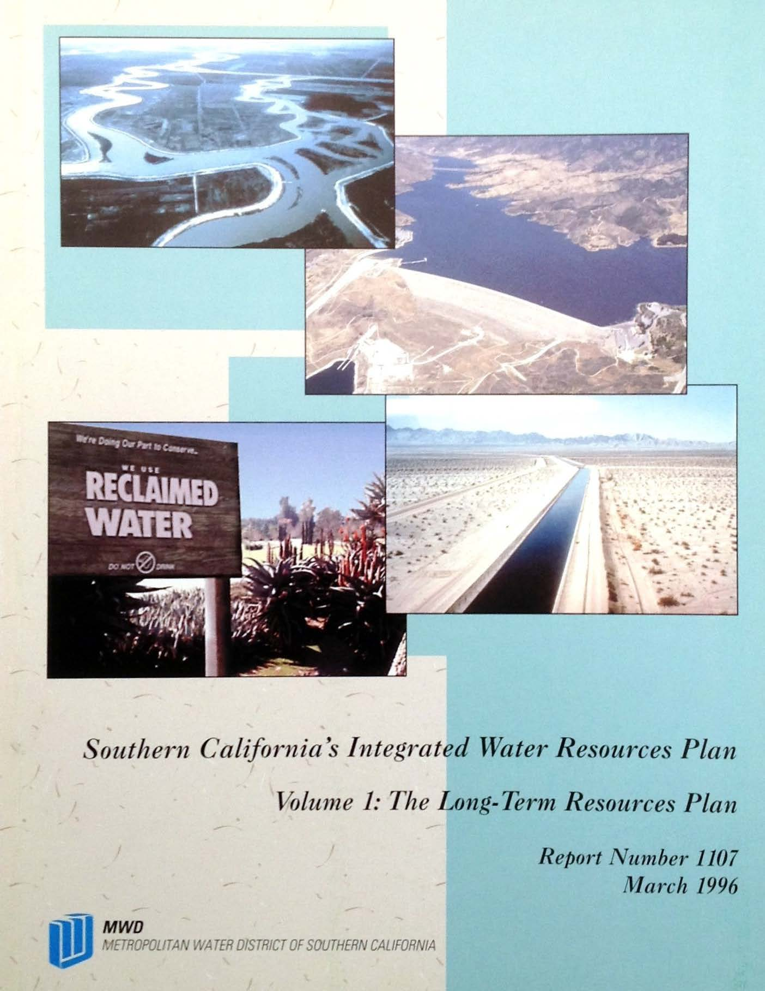
IRP History: 1996
Established MWD’s role as a regional water planner
Introduced a diversified portfolio approach
Established targets for major resource categories
Established regional reliability goal:
“Full-service demands at the retail level would be satisfied under all foreseeable hydrologic conditions”

Slide 5
IRP History: 2004 Update
Placed further emphasis on conservation and local resources development
Introduced the concept of a “planning buffer”

Slide 6
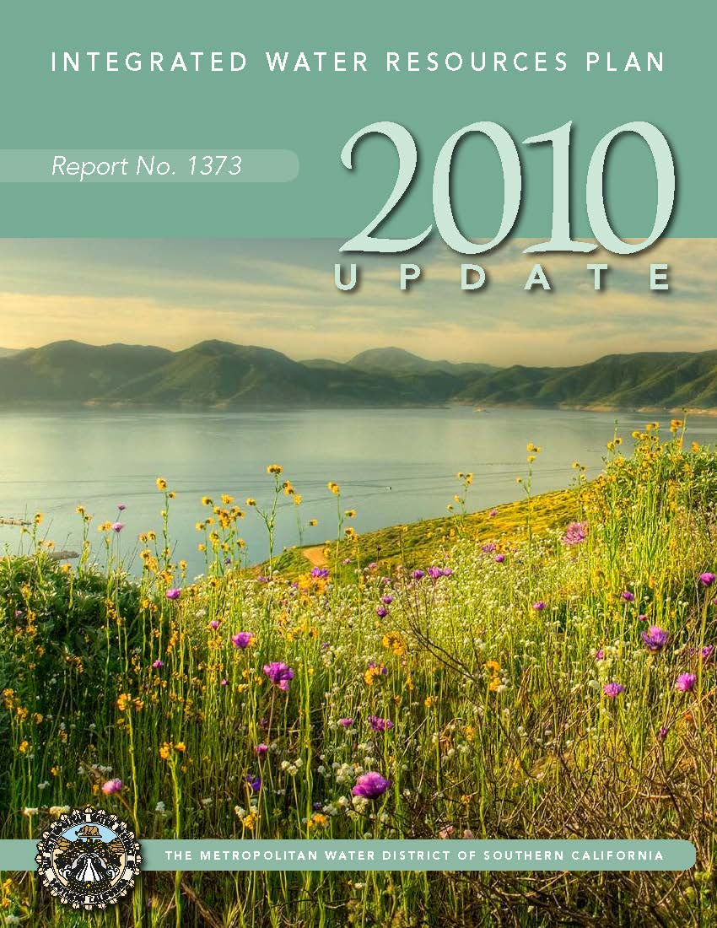
IRP History: 2010 Update
Introduced an adaptive management approach
Sought to stabilize imported supplies and meet growth through water use efficiency and local resources

Slide 7
The Adaptive Management Approach
Core Resource Strategy
Reliability Under Planned Conditions (e.g. Historical weather)
Supply Buffer
Adapt to Shorter-Term Uncertainty (Outside of planned conditions)
Foundational Actions
Preparation for Long-Term Change
(Climate Change, Supply Loss, Demands)

Slide 8
Key Drivers for the 2015 Update
Incorporate changed conditions impacting supplies and demands
Respond to new challenges
Refine long-term storage management strategy
Overcome barriers to implementation
Come to agreement on consistent/standard terms and definitions

Slide 9
Update Process
Technical update (2015)
People, economy, water demands
Climate change, hydrologic scenarios
Water supplies from existing and new projects
Reliability analysis
Setting resource and conservation targets
Implementation policy issues (2016)
How might we reach the resource targets?

Slide 10
2015 IRP Technical Update Goals
Review and update IRP resource targets
Assess strategy for managing short and long term uncertainty
Core Resources Strategy
Supply Buffer
Foundational Actions
Review IRP resource issue papers
Communicate technical findings and identify policy needs for Board policy discussions

Slide 11
Summary
The IRP represents Metropolitan’s long-term plan to assure adequate water supplies for Southern California
The IRP sets water resource targets to help meet the region’s needs over the next several decades
These targets will help guide policy discussion and investment decisions for imported and local water supplies as well as demand management through conservation

