Slide 1
A Clear Blue Future
How Greening our Cities can Address
Water Pollution, Water Supply, and
Climate Change in the 21st Century
June 13, 2010

Slide 2
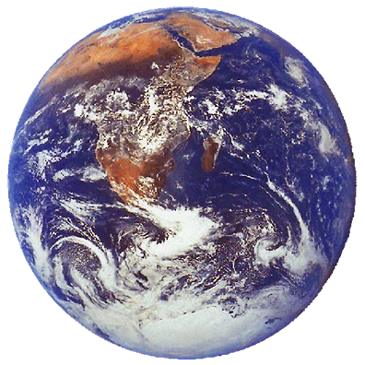
Water Supply, Energy and GHG Emissions

Slide 3

Water Supply
Major water supply systems in California are all over-allocated.

Slide 4
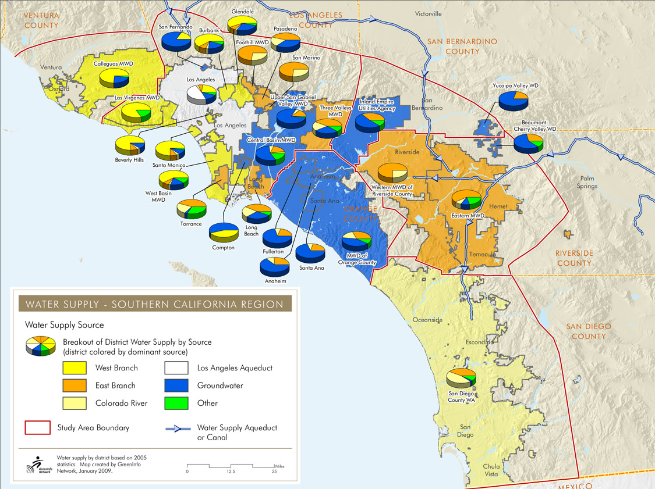

Sources of Water Supply

Slide 5
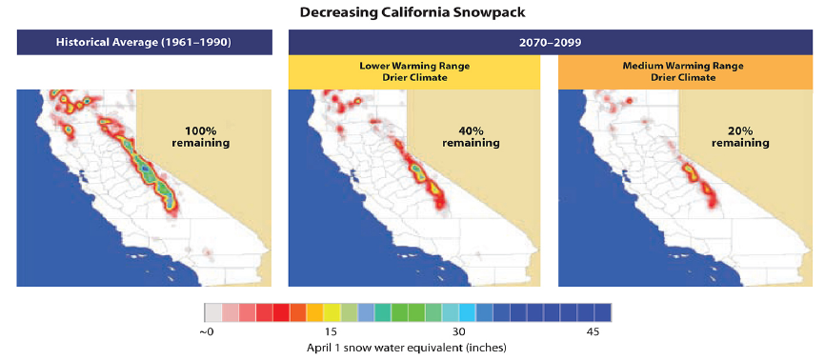
Water Supply Concerns
Courtesy California Climate Change Center

Slide 7
LID

Slide 8
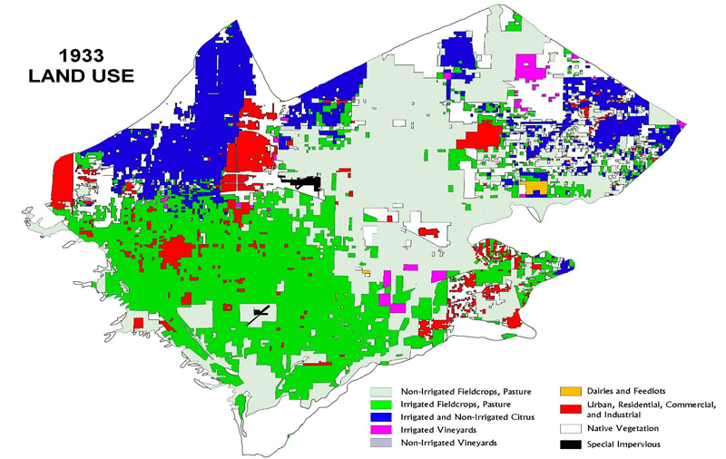
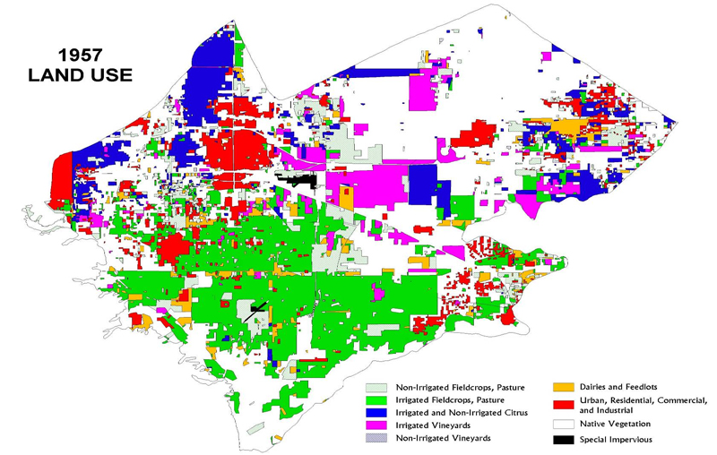
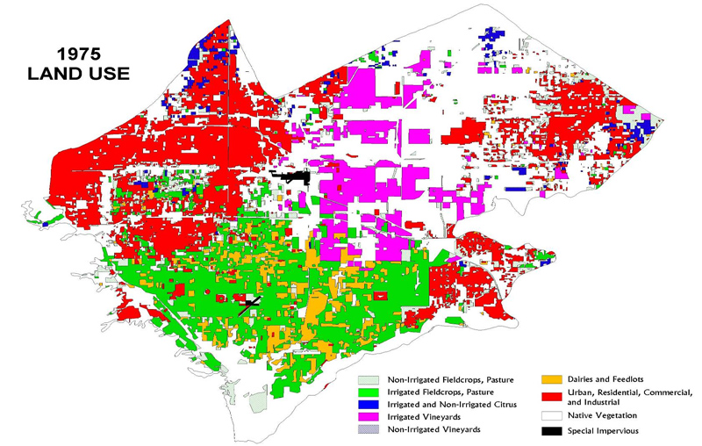
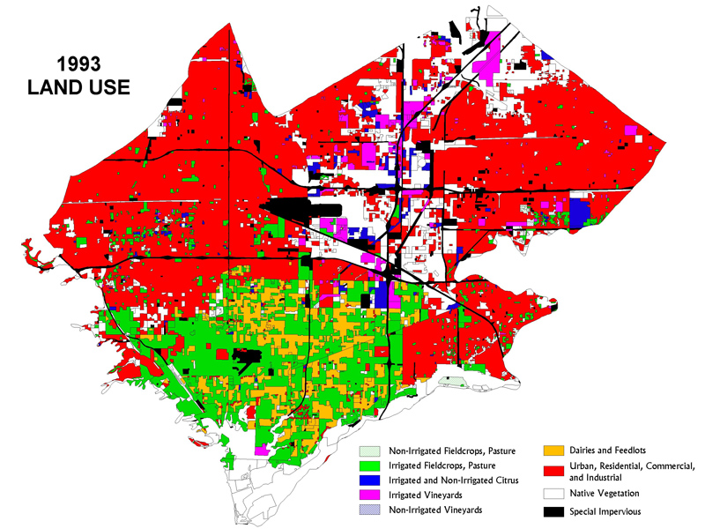
Land-Use in the Chino Basin
Wildermuth Environmental

Slide 9
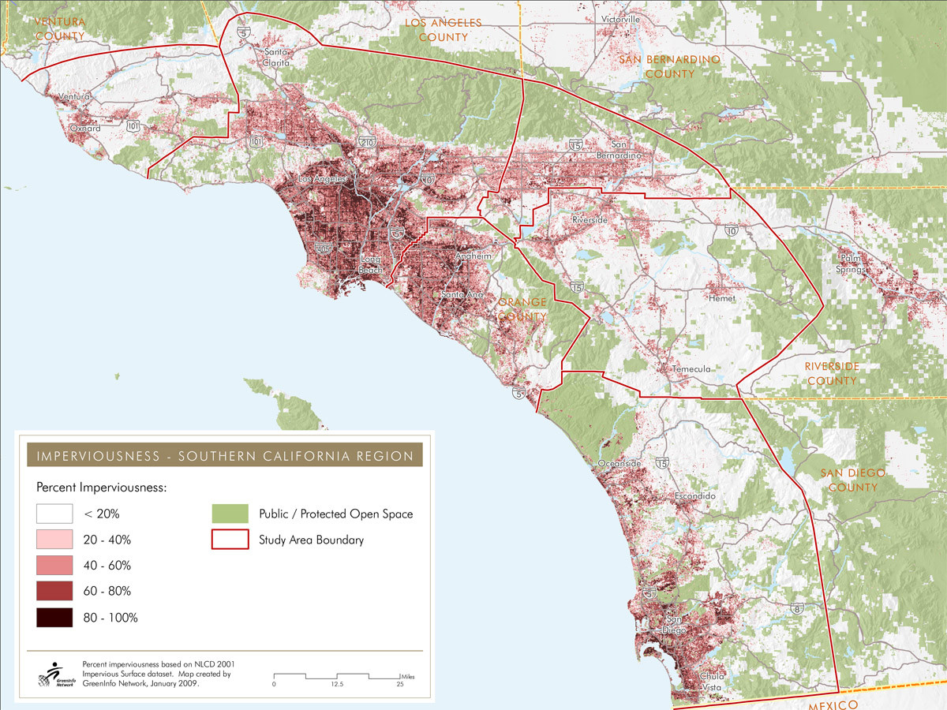
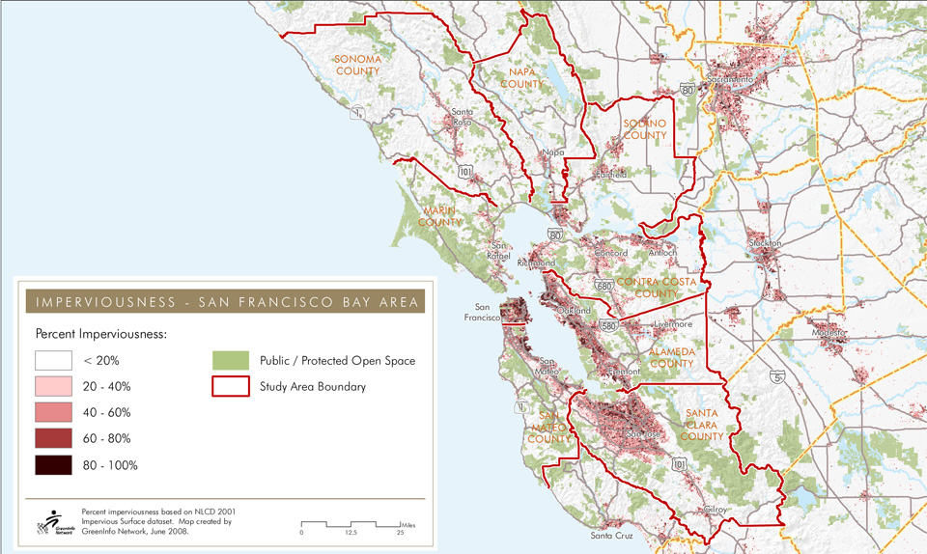

Impervious Surface in Coastal CA

Slide 10
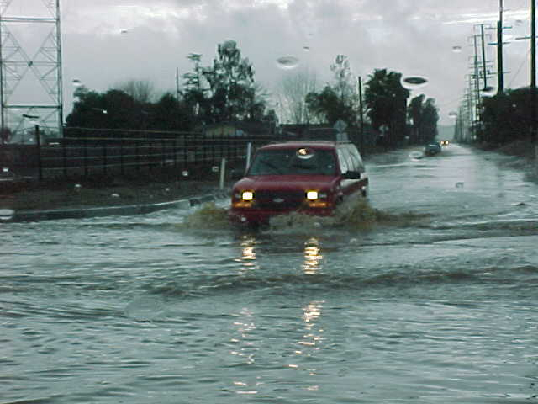
Stormwater Flows

Slide 11
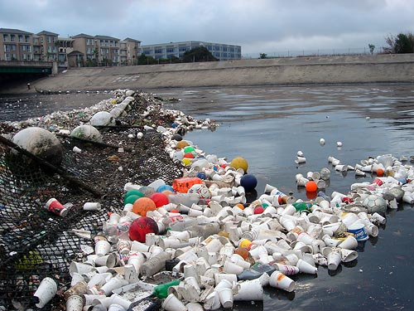

Stormwater Runoff: Impairment
Ballona Creek, Los Angeles (California Coastal Commission)
Los Angeles River (City of Los Angeles)

Slide 12
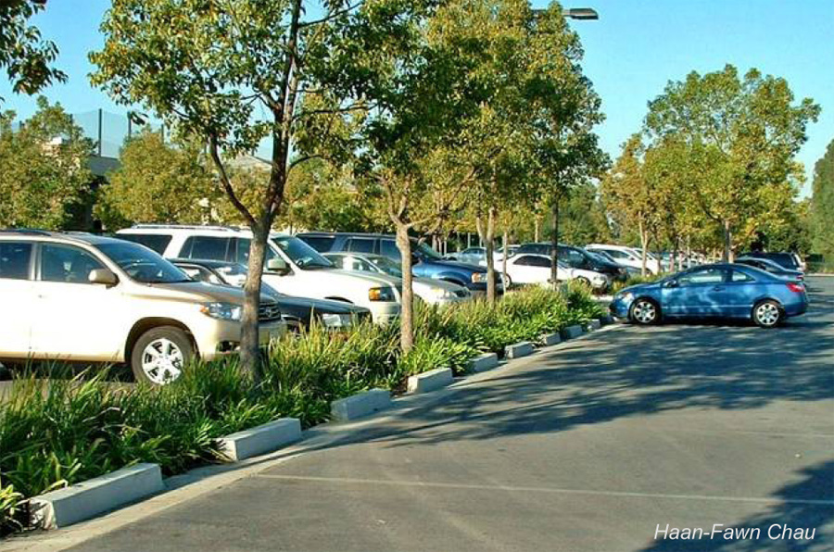
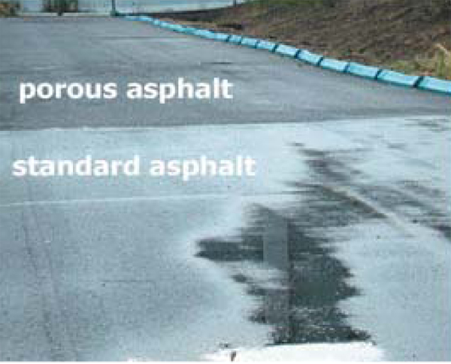
Infiltration
City of Los Angeles/Haan-Fawn Chau
City of Los Angeles

Slide 13
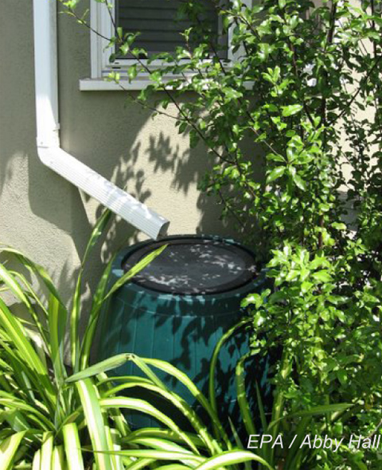
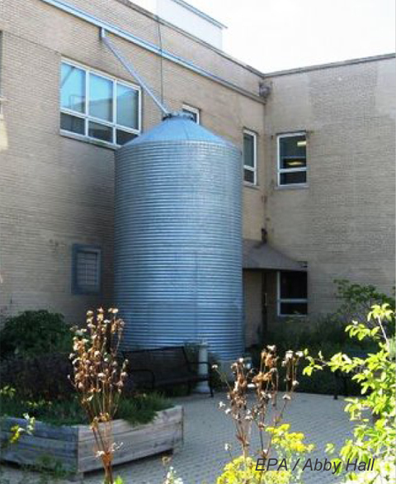
Rain Barrels / Cisterns
EPA / Abby Hall

Slide 14
Potential Benefits of LID

Slide 15
Steps in the Analysis
Land Use: Existing percentage of impervious surface and projected development rate for commercial and residential land use.
Infiltration potential based on soil permeability and availability of site open space.
Annual precipitation.
Current groundwater use and potential for aquifer recharge or capture and reuse.
Notes:
15

Slide 16
Constraints and Conservative Assumptions
Includes only urbanized southern California and the San Francisco Bay Area; does not account for the rest of the state.
Land Use: incorporates only commercial and residential development, and not industrial, government, public use, or transportation.
Only new and redevelopment, with limited application to retrofitting. Does not include the existing built environment.

Slide 17
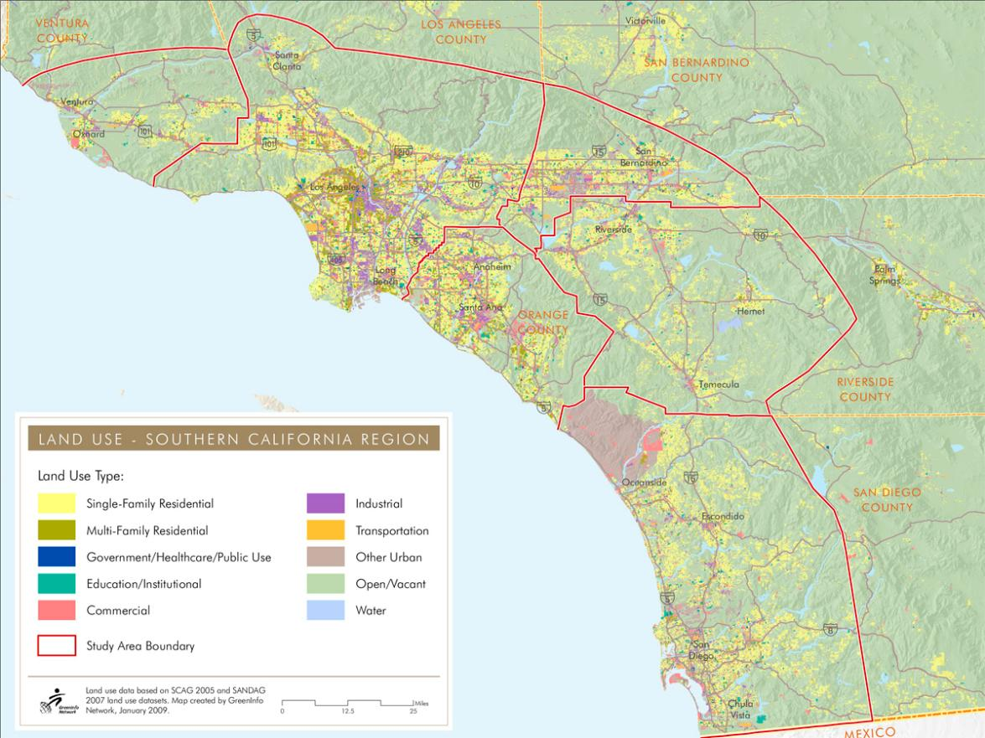
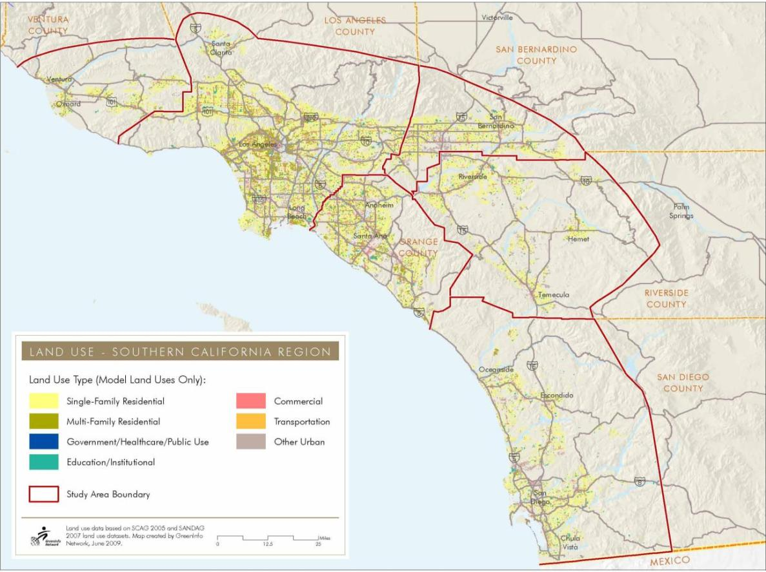
Land Use - Southern California

Slide 18
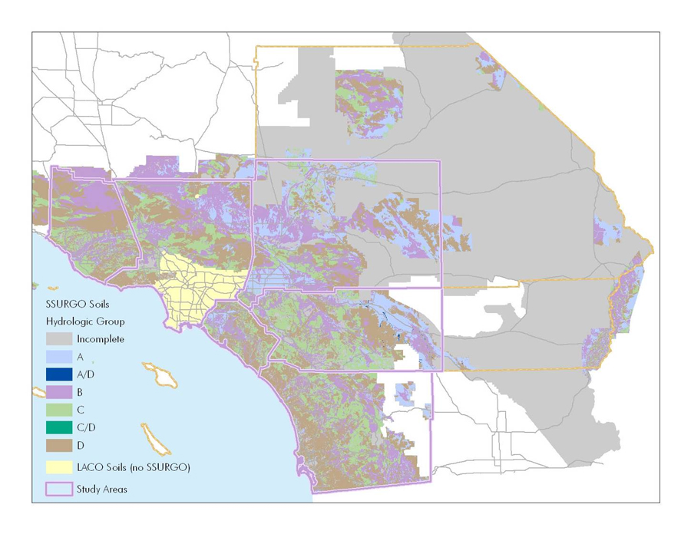
USDA Soil Classifications
A, B, and (with amendments) C Soils are suitable for infiltration

Slide 19
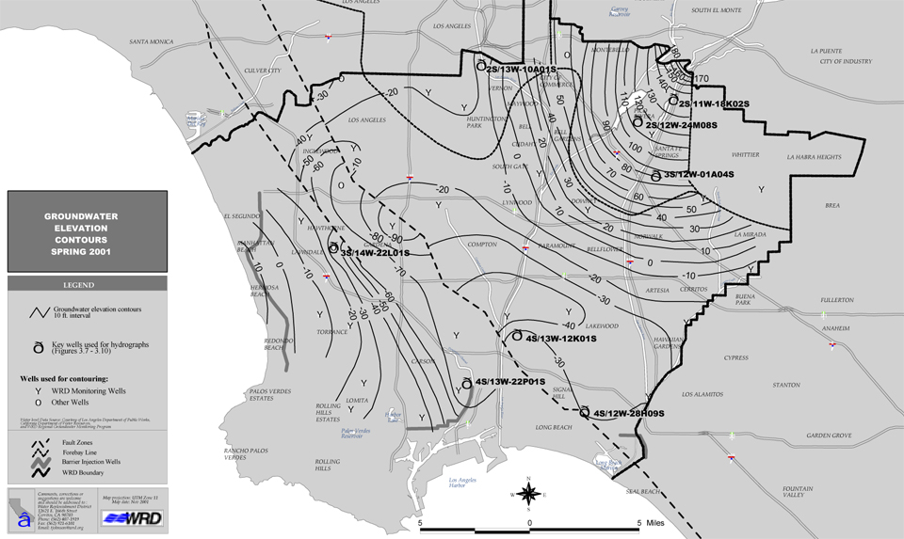
Shallow Groundwater/Contamination
Analysis assumes that 50% of Los Angeles County will augment water supplies through capture.
Water Reclamation District of Southern California

Slide 20
Low Impact Development
Potential Savings in Urbanized Southern California and SF Bay Area by 2020 (increasing each year thereafter):
109,000 to 191,000+ acre-feet/year
273,000 to 583,000 megawatt-hours/year
119,000 to 255,000 metric tons of CO2 equivalent/year

Slide 21
Low Impact Development
Equivalent to:
Water for more than 1,000,000 people
Electricity for more than 48,000 single family homes per year
More than 46,000 cars off the road annually
Does not take into account opportunity for use statewide or from industrial, government, public use, and transportation development.

Slide 22
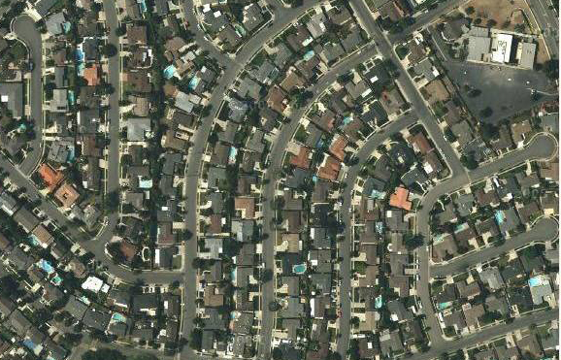
Rooftop Capture
Rooftop surface area averages 40-60% of an individual development site.

Slide 23
Rooftop Capture Potential
Study contemplated ~55,000 acre-feet/year attributed to rooftop capture (remainder to infiltration and recharge)
Potential for approximately 80,000-85,000 acre-feet/year rooftop capture by 2020 within the study area.
Enough water for more than 500,000 people per year

Slide 24

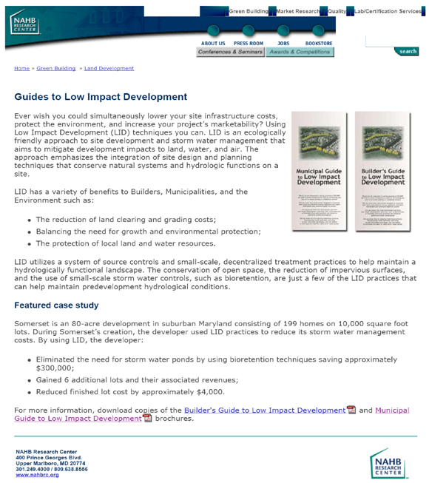


LID is Cost Effective
National Association of Home Builders:
…

