Slide 1
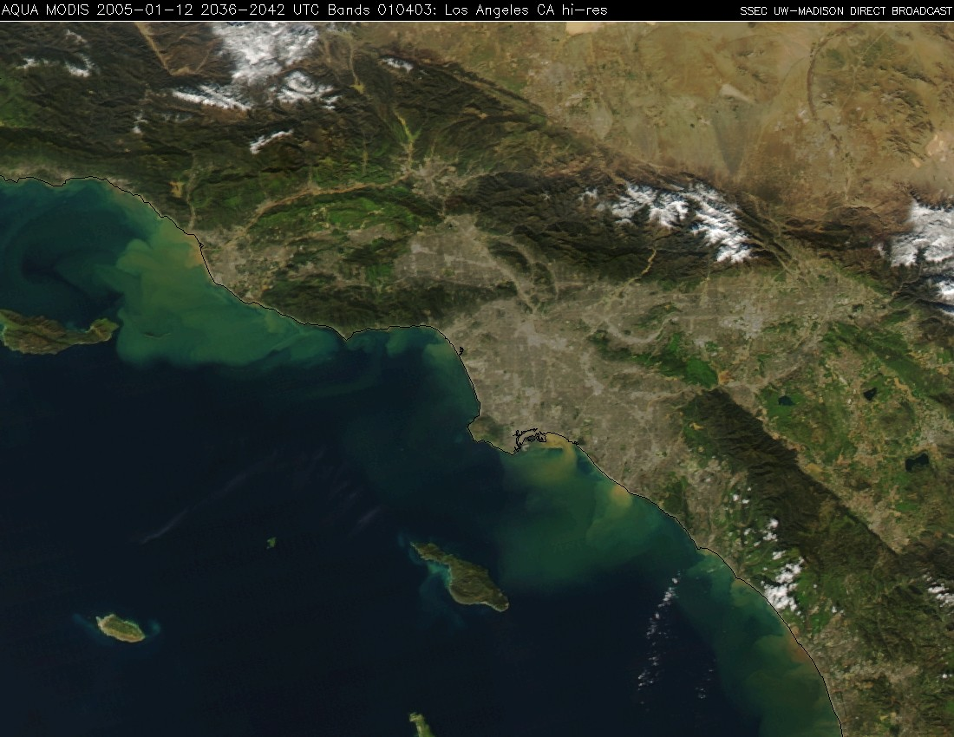

Water Quality Associated with Urban Runoff: Sources, Emerging Issues and Management Approaches
Martha Sutula and Eric Stein
Biogeochemistry and Biology Departments
Southern California Coastal Water Research Project

Slide 2
Increased Focus on Stormwater, As Point Sources Are Reduced
Annual Load Total Combined Metals to the SCB
Notes:
POTW contribution 90% → 40%
Stormwater 6% → 38%

Slide 3
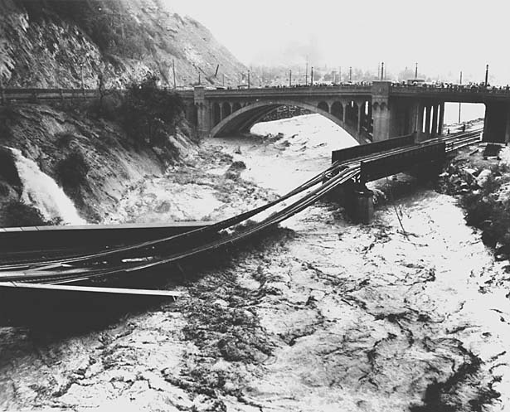
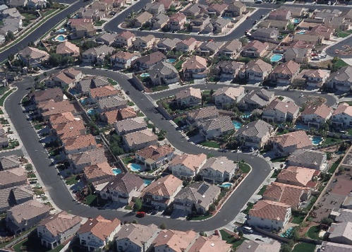
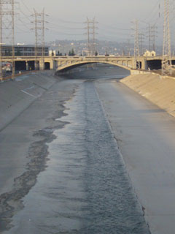
Origins of Storm Water Pollution- Urbanization
LA River - 1938 Flood

Slide 4
Challenges of Managing Storm Water
Difficult to understand and predict all the factors that influence storm water
  Highly variable
  Many sources and influencing factors
Effective management requires tools to increase our understanding
  Monitoring
  Source characterization and identification
  Model development
  BMP siting and design

Slide 5
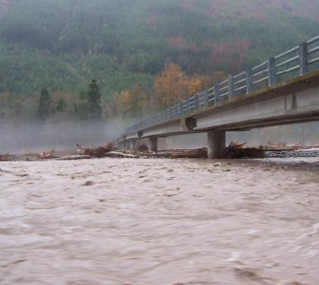
Today’s Talk
Take home messages from 20 yrs of SCCWRP stormwater research
Emerging issues
Thoughts on management approaches

Slide 6
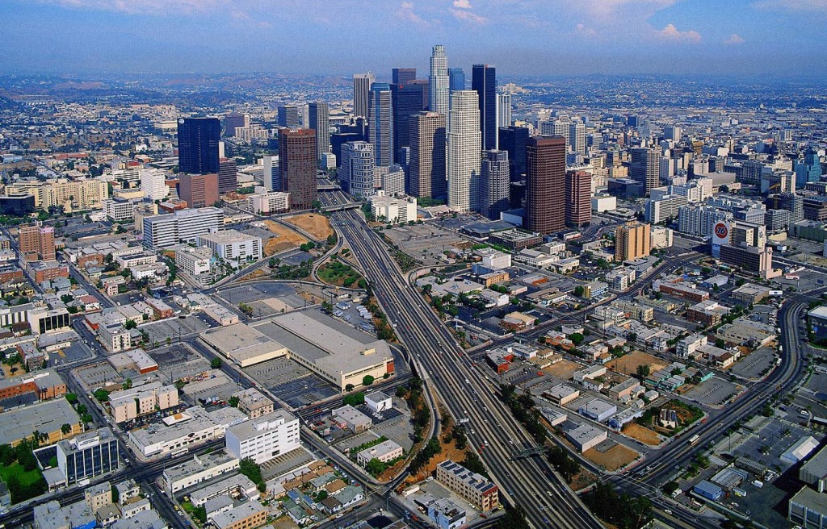
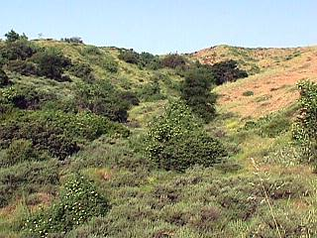
Potential Sources
Anthropogenic
  Land uses
  Mobile sources
  Aerial deposition
Natural
  Background

Slide 7
SCCWRP Studies Contributing to Understanding of Stormwater Sources
Wet weather sampling of land use sites
Monitoring and modeling of dry weather runoff in LA Region
Sources associated with natural landscapes
  Wet and dry weather concentrations and loads- bacteria, metals and nutrients
Atmospheric deposition of metals and organics
Studies of fire-related effects on stormwater

Slide 8
Main Messages on Wet Weather Runoff
Main sources vary by constituent
  Metals → industrial
  PAHs → aerial deposition
  Bacteria → recreation and agriculture
  Nutrients → agriculture and residential

Slide 9
Main Messages on Wet Weather Runoff
Main sources vary by constituent
Natural areas contribute low background levels, may be substantial for some constituents
  Atmospheric sources may play role
Wet weather metal concentrations
– natural versus developed

Slide 10
Main Messages on Wet Weather Runoff
Main sources vary by constituent
Natural areas contribute low background levels, but may be substantial for some constituents
Important to understand factors driving variability
  Affects strategy for managing stormwater as a resource

Slide 11
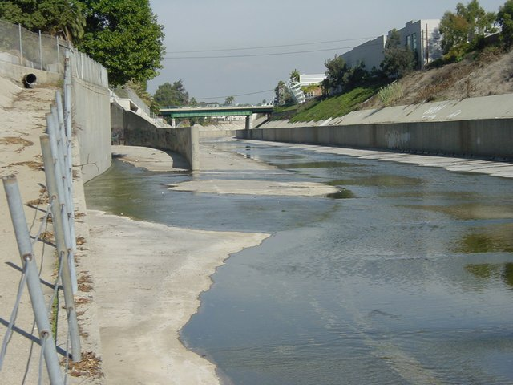
What About Dry Weather Runoff?
Region has on average 345 dry days per year
Source: USGS

Slide 12
Main Messages on Dry Weather Runoff
Can be as major load, particularly during dry years
Contribution of Dry Weather Load (30-year simulation – Ballona Creek)

Slide 13
Main Messages on Dry Weather Runoff
Can be as major load, particularly during dry years
Again, natural loadings can be substantial for some constituents
Dry Weather Concentrations of Nutrients– Natural Versus Developed

Slide 14
Emerging Management Issues
Biological quality of streams
Hydromodification
Contaminants of emerging concern
Recycled water

Slide 15
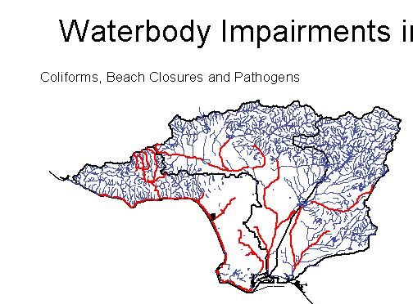
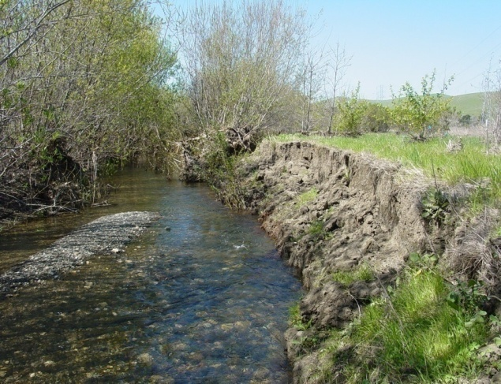
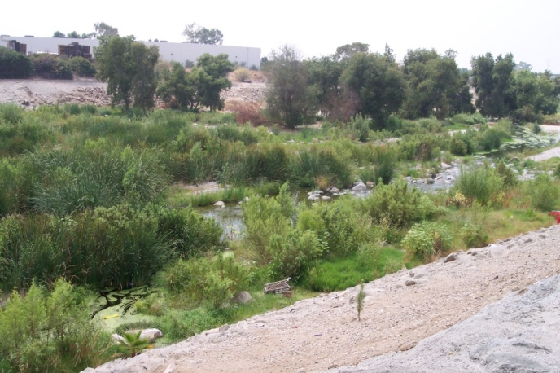
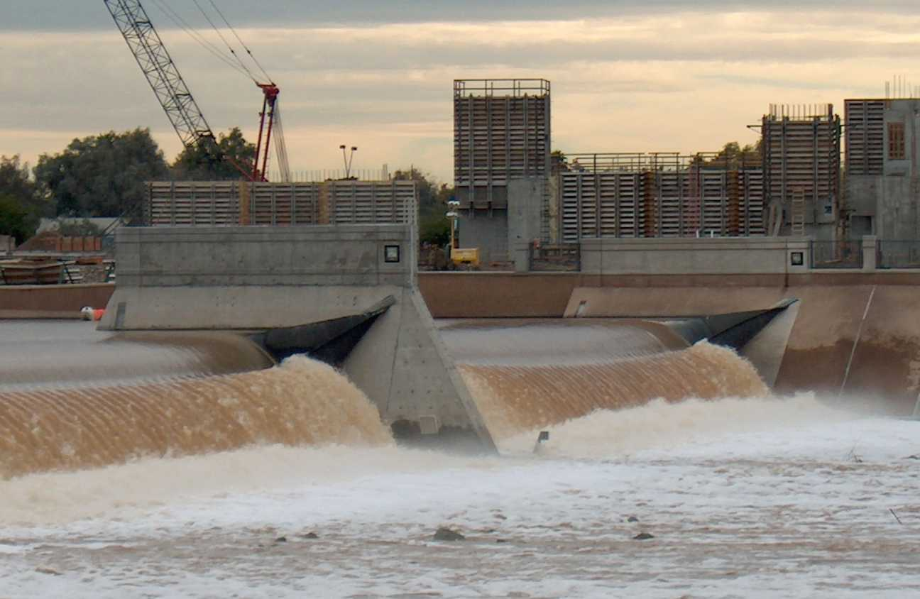
Effects of Watershed Urbanization Go Beyond Water Quality
Water quality/toxicity
Physical structure
Habitat condition
Water quantity/
hydrodynamics

Slide 16
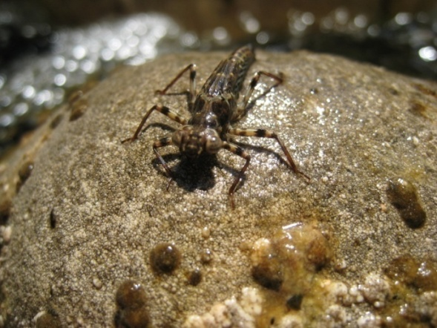
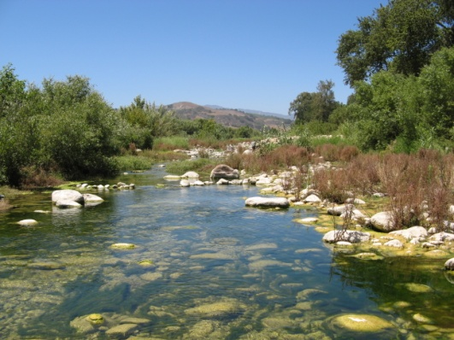
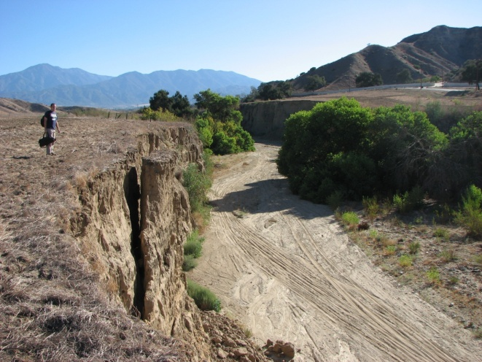
Increased Focus on Biological Endpoints in Assessing Effects of Urban Runoff
Benthic Invertebrates
SWRCB working on development of biocriteria for streams, eventually estuaries
Benthic invertebrates first, but over time, other lines of evidence may be included
  Stream algae
  Overall habitat condition
Stream Algae
In-stream and Riparian Habitat

Slide 17
Early Messages From Stream Bioassessment
Large percentage of stream miles with measureable effects in region

Slide 18
Early Messages From Stream Bioassessment
Large percentage of stream miles impacted in region
Lowest invertebrate IBI scores near urban and ag lands

Slide 19
Early Messages From Stream Bioassessment
Large percentage of stream miles impacted in region
Lowest invertebrate IBI scores near urban and ag lands
Nutrients, physical habitat disturbance are top stressors
Risk of Low Invertebrate IBI score associated with stressors

Slide 20
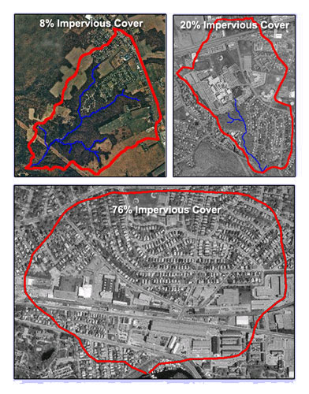
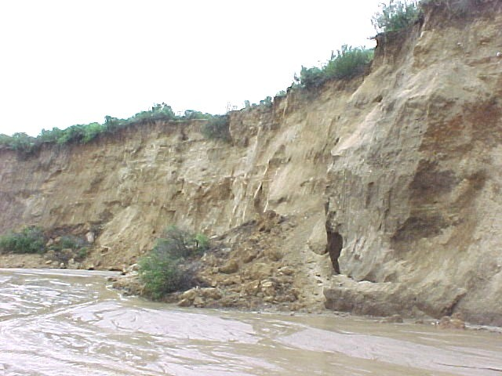
Effect of Increased Impervious Cover- Hydromodification
Hydromodification
Infrastructure damage
Instream habitat loss
Coastal erosion

Slide 21
SCCWRP is Developing Modeling Tools To Support Management of Hydromodification
Which streams are at the greatest risk of effects of hydromodification? Screening Tool
What are the anticipated effects in terms of increased erosion, sedimentation, or habitat loss, associated with increases in impervious cover? Modeling Tools
What are some potential management measures that could be implemented to offset hydromodification effects? Management Tools

Slide 22
What Can We Do?
Adverse effects of hydromodification and urban runoff must be addressed at watershed scale
General Concepts
Minimize runoff
Maximize infiltration
Avoid building in floodplains
Education
Approaches
Better Site Planning
On-site control of runoff
Biotechnical stream stabilization
Stream restoration
These General Principles Will Improve Physical and Biological Condition, and Ameliorate Water Quality

Slide 23
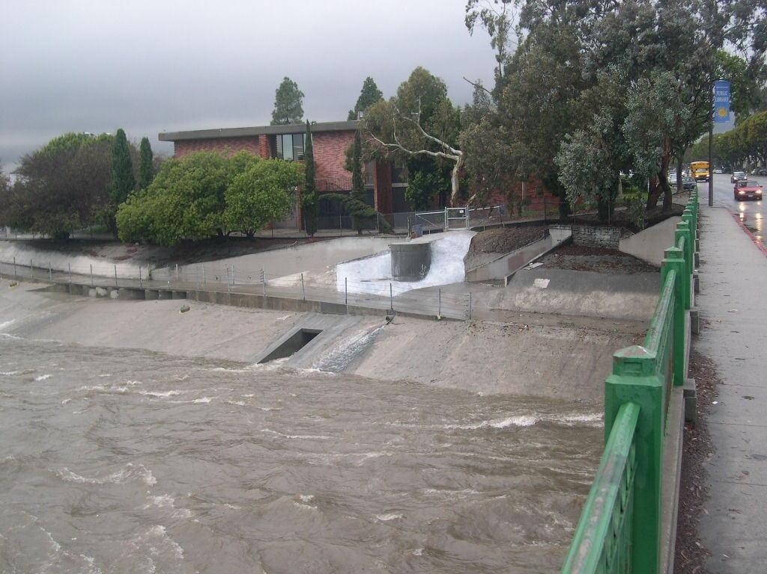
THANK YOU
For more information contact:
Eric Stein: erics@sccwrp.org
Martha Sutula: marthas@sccwrp.org

