Slide 1
Stormwater management……
…..not just a water quality issue
Deb Smith, CA RWQCB, LA Region
Notes:
Good afternoon, my name is Deb Smith and I am the Chief Deputy Executive Officer at the LA Regional Water Quality Control Board
I am here with Renee Purdy today
We will be talking about the regiona; importance of our stormwater program and our plans for updating the LA County MS4 permit over the next 10 months

Slide 2
Stormwater Program
Amendments to the Clean Water Act in 1987
US EPA required to issue regulations regarding stormwater under the NPDES Program
November 16, 1990 – NPDES regulations established permit application requirements for certain MS4s and certain industrial activities
Notes:
February 4, 1987 Congress required that the U.S. Environmental Protection Agency (EPA) issue regulations addressing storm water discharges under the National Pollutant Discharge Elimination System (NPDES) program.
November 16, 1990, NPDES regulations established permit application requirements for operators of certain municipal separate storm sewer systems (MS4), as well as of storm water discharges “associated with certain industrial activity.”
Regulated municipalities include those cities and counties operating medium and large MS4s (serving a population of 100,000 or greater) and other MS4s specifically designated by the permitting authority.

Slide 3
Permit History in LA County
June 1990 (Order 90-079) – required characterization of stormwater discharges and early action BMPs
July 1996 (Order 96-054) – new program requirements and land use and mass emission station monitoring
December 2001 (Order 01-182) – continued core elements as well as shoreline monitoring, inspections, receiving water limitations, new and re-development
Notes:
June 18, 1990 , Order 90-079 issued by the Los Angeles Regional Water Board requiring monitoring to characterize storm water discharges, the implementation of early action BMPs, defined as an existing stormwater/urban runoff quality management practice that is optimized to the MEP, and a workplan for the development of a stormwater/urban runoff monitoring approval subject to EO approval.
July 15, 1996, Order 96-054 issued by the Los Angeles Regional Water Board, required the development and implementation of an Illicit Connections/Illicit Discharges elimination Program, Development Planning and Construction Program, Public Agencies Activities Program, Public Information and Participation Program, and Industrial/Commercial Education Program consisting of educational site visits. A Monitoring Program was also required that mandated storm event sampling of Land Use stations and Mass Emission stations. Program reporting and evaluations were also established under this Order.
December 13, 2001, Order 01-182 issued by the Los Angeles Regional Water Board, continued to require the implementation of the core programs (Illicit Connections/Illicit Discharges elimination Program, Development Planning and Construction Program, Public Agencies Activities Program, Public Information and Participation Program, and Industrial/Commercial Education Program) but included several revisions;
In response to a City of Los Angeles request, shoreline monitoring was included in the monitoring program,
An inspection program of industrial and priority commercial facilities was established to control pollutants in storm water,
The Regional Board incorporated requirements for new development and significant redevelopment to control the discharge of pollutants in post-construction storm water,
The County of Los Angeles was divided into 6 Watershed Management Areas
Receiving Water Limitation language was incorporated in the Order, and
BMP substitution language was included in the Order.
For the first time a municipality within Los Angeles County was not covered under the Order (City of Long Beach).
Order 01-183 was amended on September 14, 2006, August 9, 2007, and December 10, 2009 to incorporate the Santa Monica Bay Beaches Dry Weather Bacteria TMDL and the Los Angeles River Watershed trash TMDL. On April 7, 2011, as a result of a legal challenge by the County of los Angeles the provisions of the provisions of the Santa Monica Bay Beaches Dry Weather Bacteria TMDL were removed from Order 01-182.

Slide 4

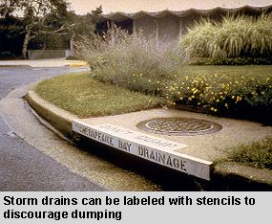
Early Efforts

Slide 5
Evolution of the Program
Initial efforts focused on public education and Best Management Practices
Evolved to look at land uses, mass emissions, and evolved best practices
The current model (adopted for Ventura County in 2010) brought in LID, more hydromodification controls, TMDLs, and refocused monitoring.
The LA County Permit is one of our top priorities for the next 10 months.

Slide 6
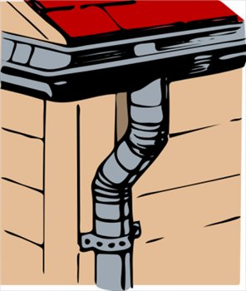
Disconnecting flows from hard surfaces
Notes:
You have heard from others last month and will hear more today about Low Impact Development that has been implemented around the region and will be required in the new stormwater permit.

Slide 7
Benefits of Improved Stormwater Management
Improved Water Quality is the key element
Other benefits include:
  conservation of scarce water resources
  augmentation of water supplies
  reductions in hydrologic impacts to stream channels and habitat
  increased habitat where water is reused
  greener neighborhoods, more ownership of neighborhoods and communities
  better quality of life.

Slide 8
Opportunities rather than burden
Opportunities to coordinate water quality, water supply, and habitat improvement benefits
Offsetting future costs (water supply, health, crime, better communities)
New permit structure can provide for new ways of managing stormwater, working together, and fostering integrated approaches.
Notes:
Lower LA/San Gabriel Rivers and Mountains Conservancy efforts – integrating multiple benefits
We are anticipating a time when the region may need to be self-reliant on local water supplies. It is imperative that we both enhance supplies and ensure that existing good quality waters are protected and that impaired waters are cleaned up
IRWMP opportunities

Slide 9
The NPDES Permit Renewal for Los County Watersheds is underway!
Notes:
On May 25th, we held a stakeholder kick-off meeting that laid out our strategy for renwing the MS4 for Los Angeles County.
Renee is going to take it from here and will discuss our path for coming 10 months or so to bringing the new permit to our Board for consideration.
Municipal Separate Storm System (MS4) Permits

