Slide 1
Southern California Water Dialogue
April 27, 2011
The Colorado River: Partnering for success
Bill Hasencamp
Manager, Colorado River Resources
Metropolitan Water District of
Southern California

Slide 2
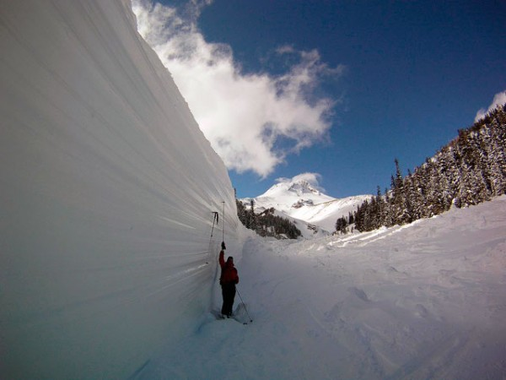
Biggest Colorado Snowpack on Record

Slide 3
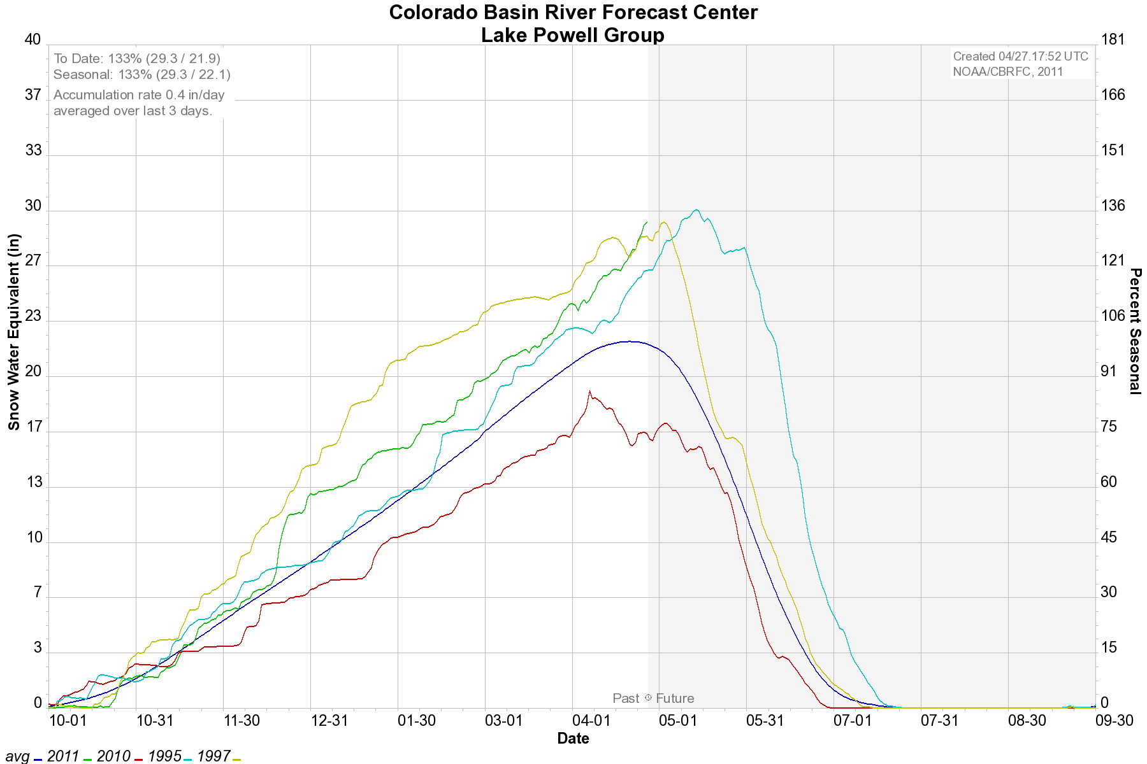
Colorado Basin Snowpack above Lake Powell

Slide 4
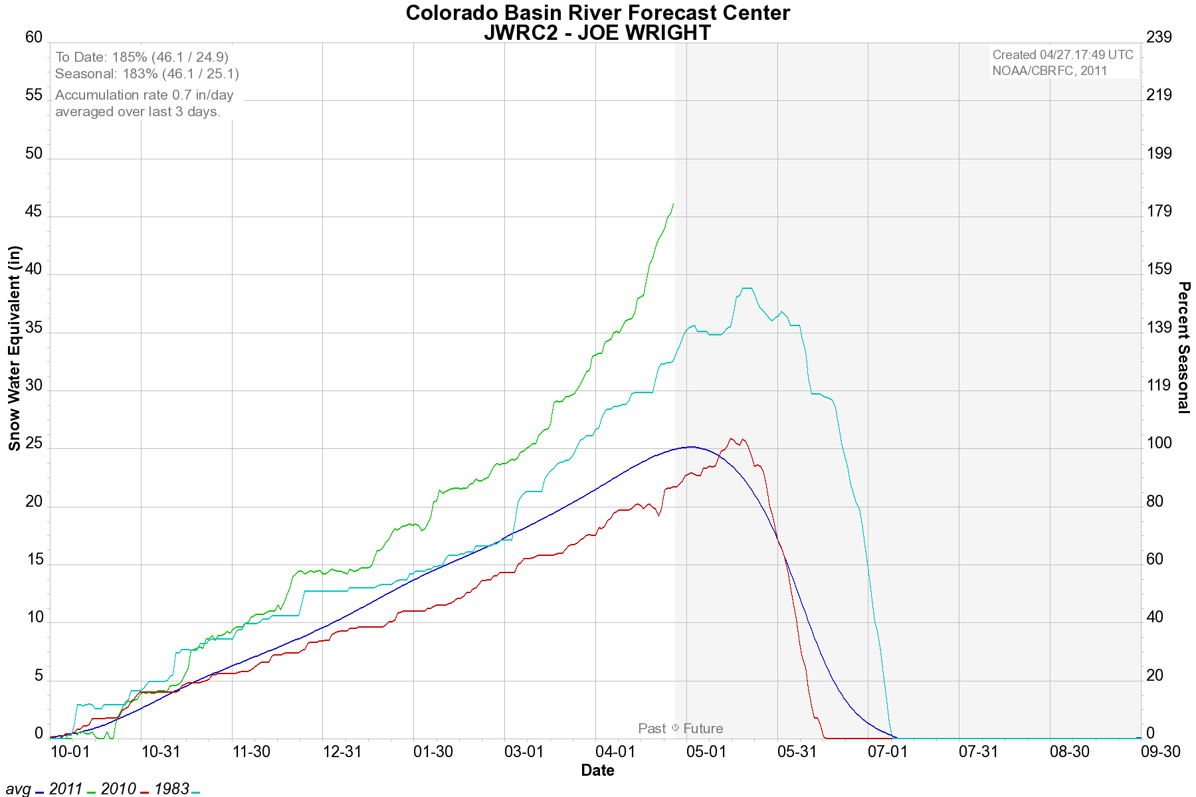
Current Snowpack in Rocky Mountain Natl. Park

Slide 7
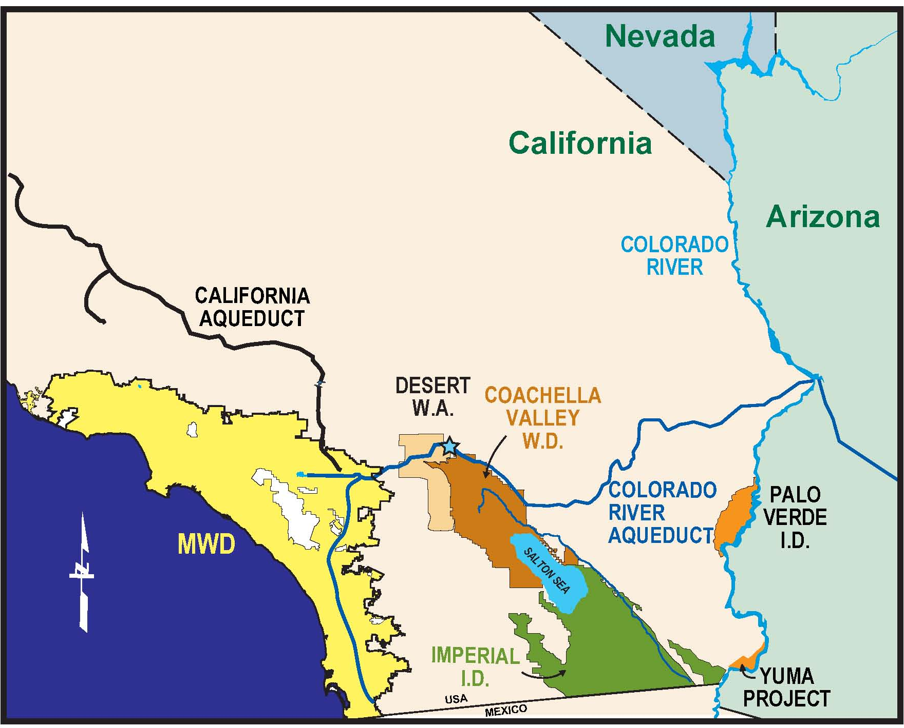
Colorado River Partnerships
Southern Nevada Water Agency
Arizona Groundwater Storage Program
Desert Water Agency
Coachella Valley Water District
Palo Verde I.D.
IID Conservation
Yuma Desalting Plant
AAC Lining

Slide 8
Colorado River Aqueduct 2010 Supply
Basic Apportionment 550 taf
PVID Land Fallowing 157 taf
Funding IID Conservation 105 taf
All-American/Coachella Canal Lining 98 taf
IID/SDCWA Transfer/Exchange 70 taf
Recovery of Arizona Groundwater 8 taf
Purchase water from LCWSP 4 taf
Fund Yuma Desalter 17 taf
Agricultural Adjustment 195 taf
ICS Stored in Lake Mead (105 taf)
Total CRA Diversions in 2010 1,099 taf

Slide 9
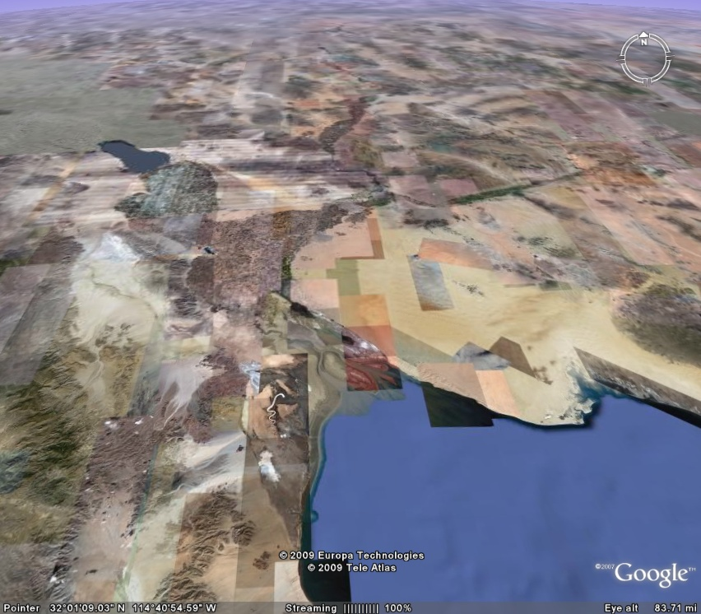
Color
California
a
do
Ri
ver
Arizona
Morelos Dam
YUMA
DESALTING
PLANT
Wellton-Mohawk IDD
C
ol
or
ad
o
Mexico
Ri
v
er
Ciénega de
Santa Clara
Gulf of California
Notes:
9

Slide 10
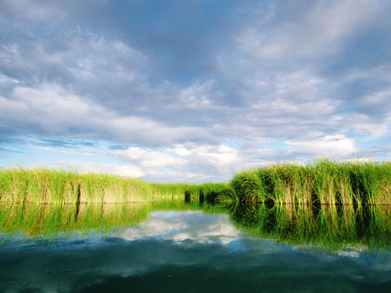
Cienega de Santa Clara

Slide 11
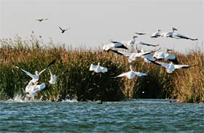
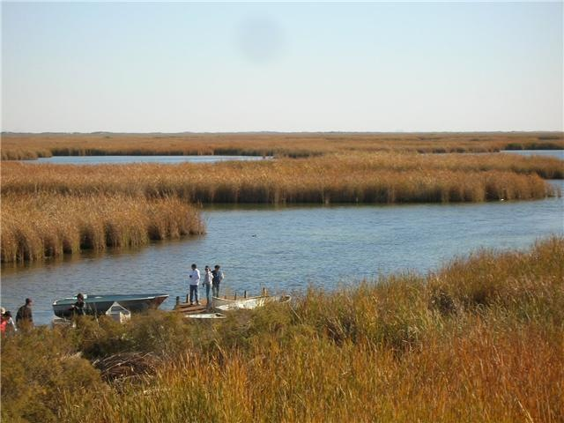
Cienega de Santa Clara

Slide 12
Pilot Operation Agreements
Agreements | MWD | SNWA | CAWCD
Pilot Funding | 80% | 10% | 10%
CRADA | 33% | 33% | 33%
Monitoring | 33% | 33% | 33%

Slide 13
Funding Agreement Obj: Conserve Colorado River Water
FUNDING
AGREEMENT
$8.2M - $11.0M
Partner with Reclamation, Arizona and Nevada
Contribute a portion of the operating costs
System Efficiency Project
Intentionally Created Surplus
FORBEARANCE
AGREEMENT
DELIVERY
AGREEMENT

Slide 14
Monitoring Agreement Obj: Identify Environmental Impacts
Partner with Arizona and Nevada
Identify changes in the Ciénega de Santa Clara
Contribute equal funding
MONITORING
AGREEMENT
$250,000

Slide 15
Cooperative Research and Development Agreement Obj: Long-term supply capabilities
Partner with Reclamation, Arizona and Nevada
Test effectiveness of existing and different treatment methods and processes
Contribute equal funding
CRADA
$315,000

Slide 16
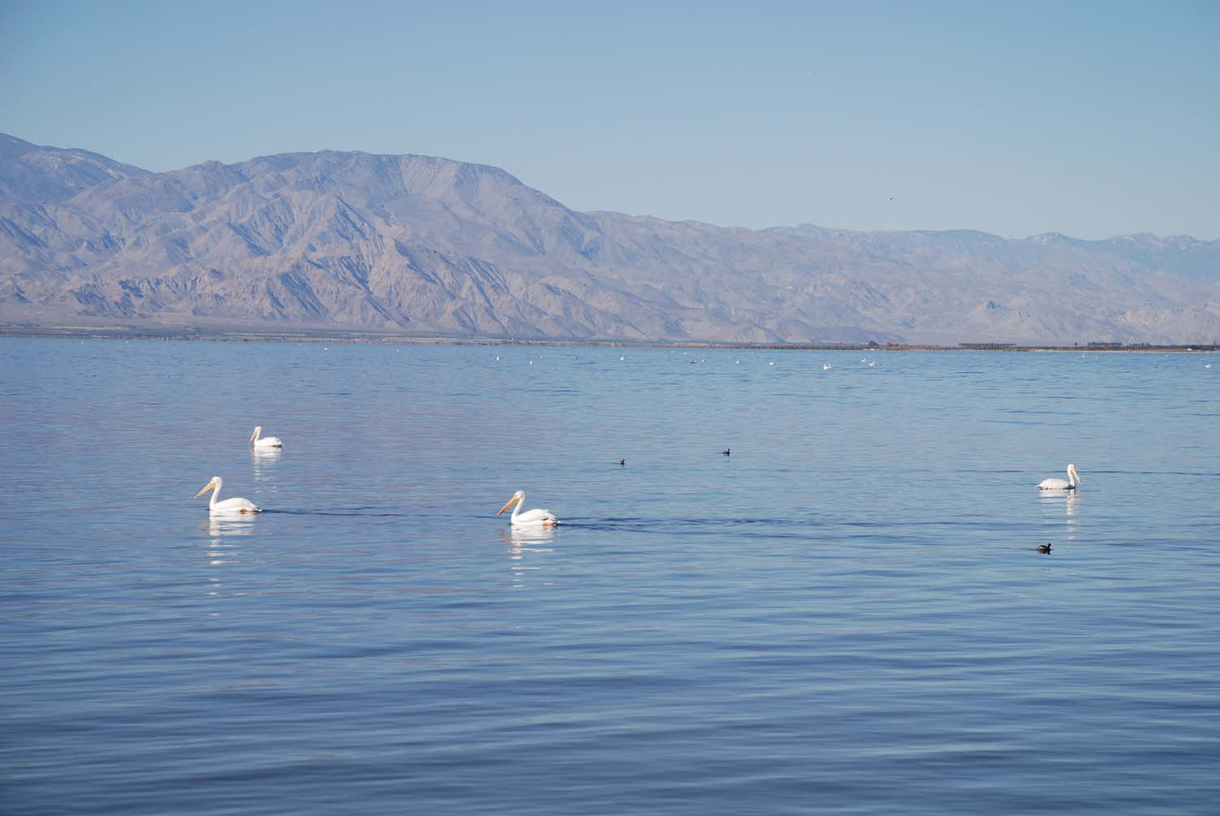
California’s Unresolved Dilemma: The Salton Sea

Slide 17
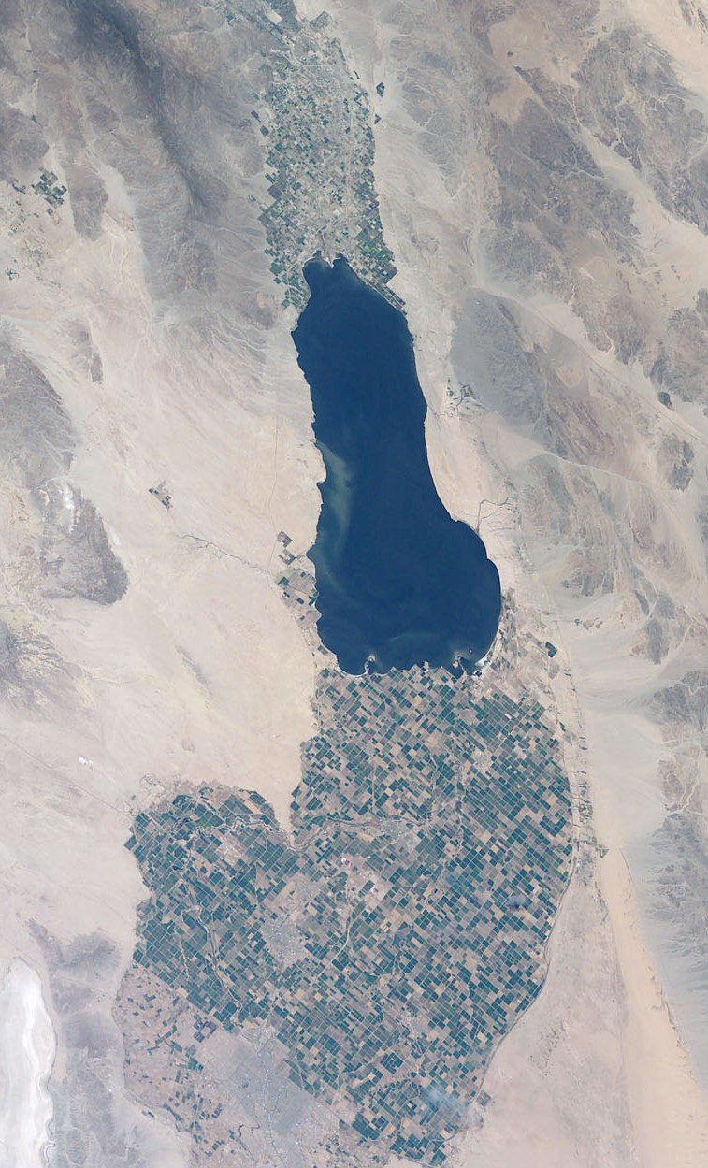
The Undetermined Future of the Salton Sea…
Formed in 1905
Sustained by Ag drainage
25% Saltier than Ocean
Salinity increase 1%/yr
Soon too Salty for Fish
State to Develop Restoration Plan
After EIR, no action or major funding from State
State agreed to pay QSA mitigation costs in excess of $133 million

Slide 18
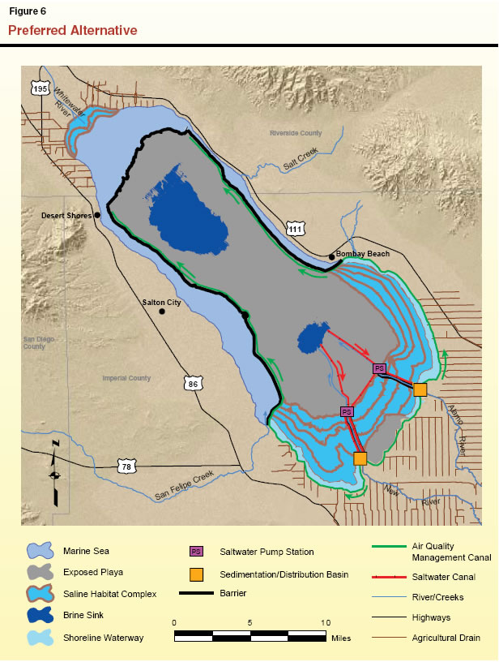
State of CA Preferred Alternative for Salton Sea
$9 Billion
$100 Million annual O&M

Slide 19
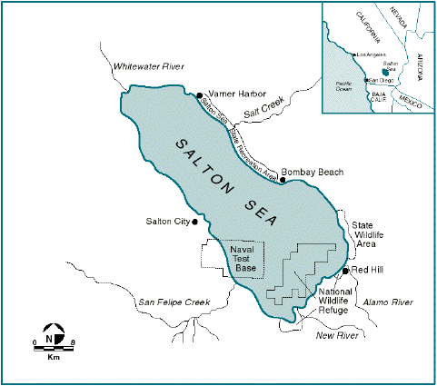
Salton Sea at Center of QSA Lawsuit

Slide 20
January 2010: Court Invalidates QSA
Superior Court rules QSA invalid
State agreement to pay mitigation costs violation of Constitution’s financing limits
Judgment on appeal
Ruling expected later this year
Subject to possible appeal to State Supreme Court
Transfers continue through appeals process

Slide 21
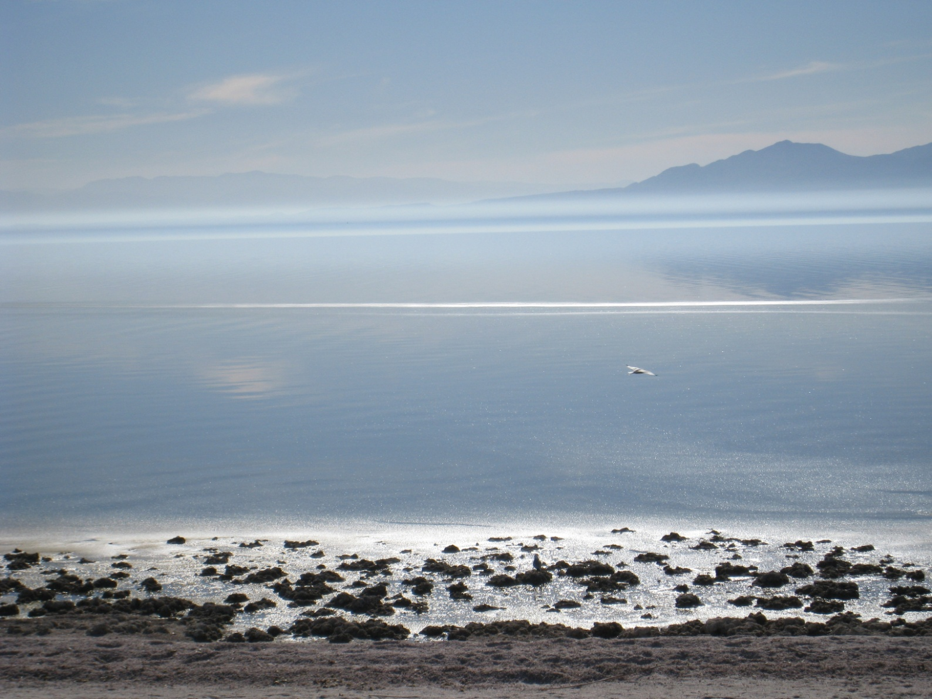
Acrimony in California Delivery of Non-Conserved Water to the Salton Sea

Slide 22
QSA Transfer Provisions
QSA included new transfers from IID to CVWD and SDCWA
Transfers included 2 principles:
No impact to Salton Sea for first 15 years
No impact to junior priority uses
Principles met with following provisions:
Mitigation water delivered to Sea to offset reduced drainage flow
Transfers and Salton Sea deliveries to be provided through water conservation programs

Slide 23
IID-MWD Dispute
IID delivered ~45,000 AF on non-conserved water to Salton Sea in 2010
Parties agreed to set aside legal positions until USBR accounting decision
USBR to make determination by July 1, 2011
USBR notified IID that it may be required to pay water back to system

Slide 24
Dispute Observations
Dispute has impacts throughout Colorado River Basin
Delivering non-conserved water to Sea reduces Lake Mead storage
Relates to amount of future conservation to be implemented
Whether conserved or non-conserved water delivered to Salton Sea
Solution requires agreement with State over future management of Salton Sea

Slide 25
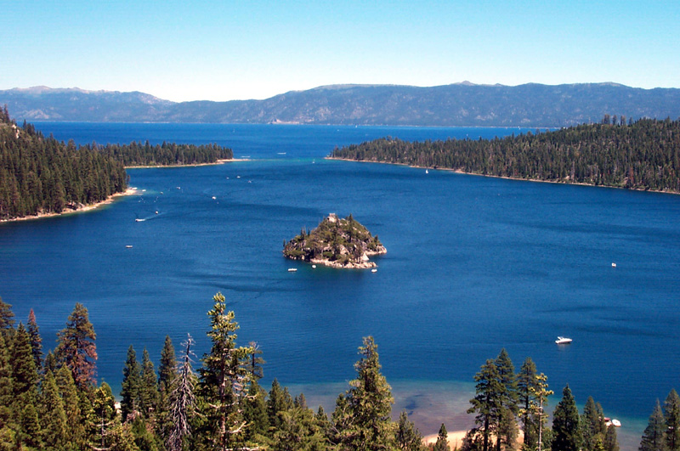
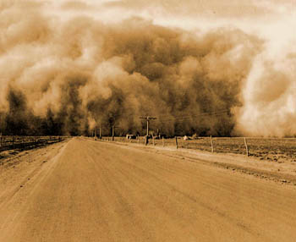
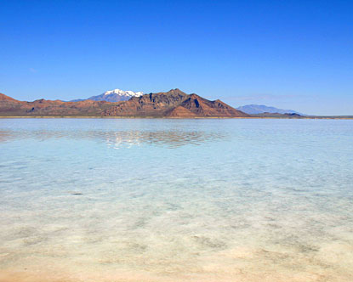
What will the Salton Sea be like in the future?

Slide 26
Bill Hasencamp 213-217- 6520 whasencamp@mwdh2o.com

