Slide 1
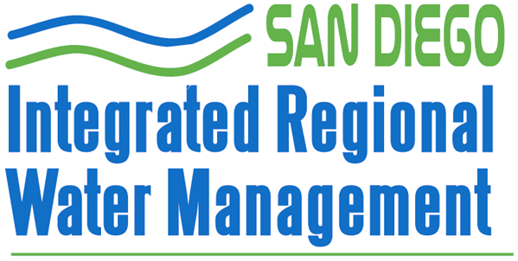
Southern California Water Dialogue
September 29, 2011
www.sdirwmp.org

Slide 2
San Diego’s IRWM Program Governance
*
* Tri-County Funding Area Coordination Committee

Slide 3
Is IRWM More Than Just a Grant Machine?
Not Yet

Slide 4
Benefits to IRWM Program
Local Control
Become (at least partial) stakeholders in one another’s success
Collaboration
Tri-County
Advisory Committee
Interagency/Intraagency
Building Trust

Slide 5
IRWMPs Build off Other Plans
Urban Water Management Plans
Watershed Urban Runoff Management Plans
Basin Plans
With Additional Discussions
Disadvantaged Communities
Climate Change

Slide 6
What IRWM Plans do NOT do
Have authority or priority over other Plans (UWMPs, WURMPs, etc.)
Require that agencies supporting the IRWM Plan and Projects selected for grant funding refrain from criticizing (or litigating) these projects (example – seawater desalination)
Dissolve political boundaries in favor of watershed boundaries

Slide 7
IRWM Plans Establish Funding Priorities
Objective A
Objective B
Objective C
$$$

Slide 8
Beyond the Grant Machine…
Umbrella Data Management
Financing Services (Revolving Loans)
Grant consolidation services (federal, state, local, other)
Basin Planning
IRWMs Issue Project RFPs
Research & Development

Slide 9
Questions?
www.sdirwmp.org
Notes:
This concludes our presentation today and we’d be happy to answer any questions you may have.

