Slide 1

The Colorado River:
Operation, Current and Projected Future Conditions
Southern California Water Dialogue
Los Angeles, CA
April 27, 2011

Slide 2
Overview
Basin Overview
Current System Conditions & Operations
Projected System Conditions

Slide 3
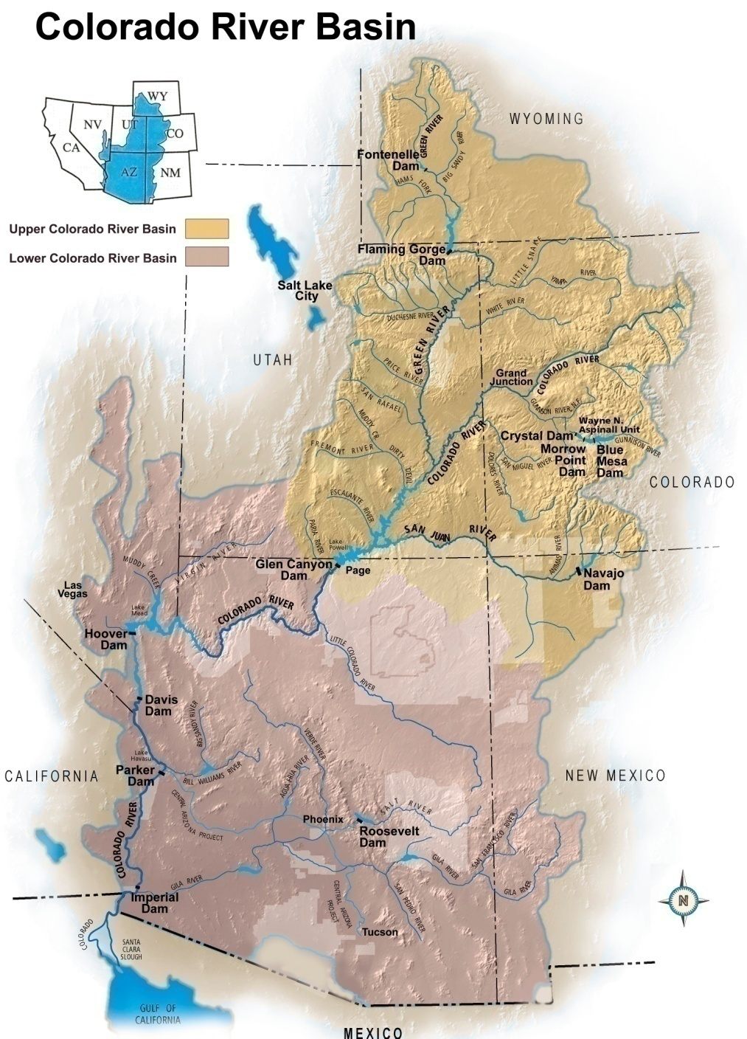
Colorado River Basin
16.5 million acre-feet (maf) allocated annually
13 to 14.5 maf of consumptive use annually
15.0 maf average annual “natural” inflow into Lake Powell over past 100 years
Inflows are highly variable year-to-year
60 maf of storage
Notes:
3

Slide 4
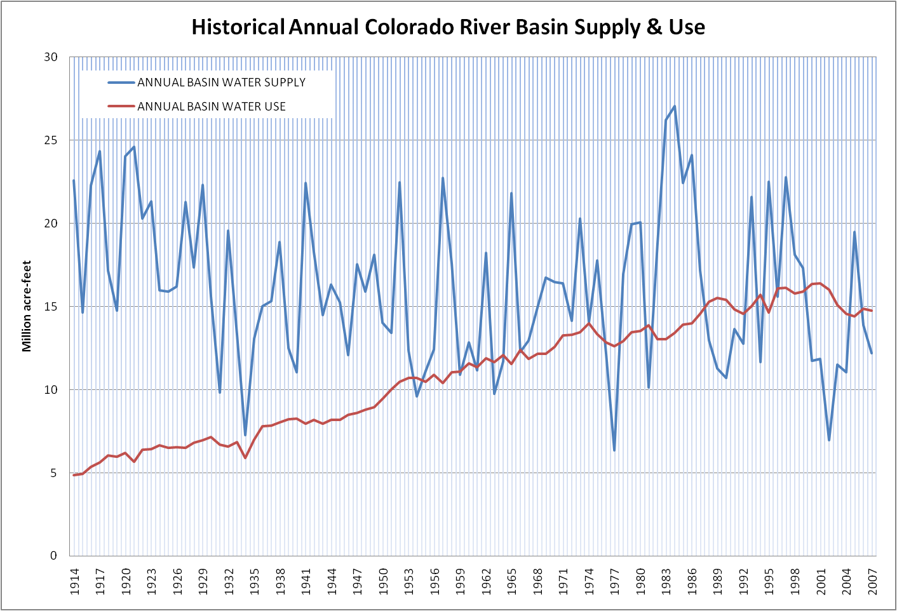
Historic Colorado River Water Supply & Use
(Annual)
Notes:
4

Slide 5
Notes:
5

Slide 6
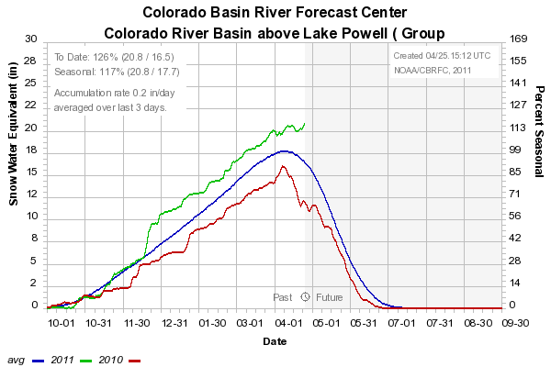
Water Year Snowpack and Precipitation as of April 25, 2011
Colorado River Basin above Lake Powell
Water Year Precipitation (year-to-date)
122%
Current Snowpack
130%
Chart developed with Snotel data as of 4/25/2011
Source: CBRFC

Slide 7
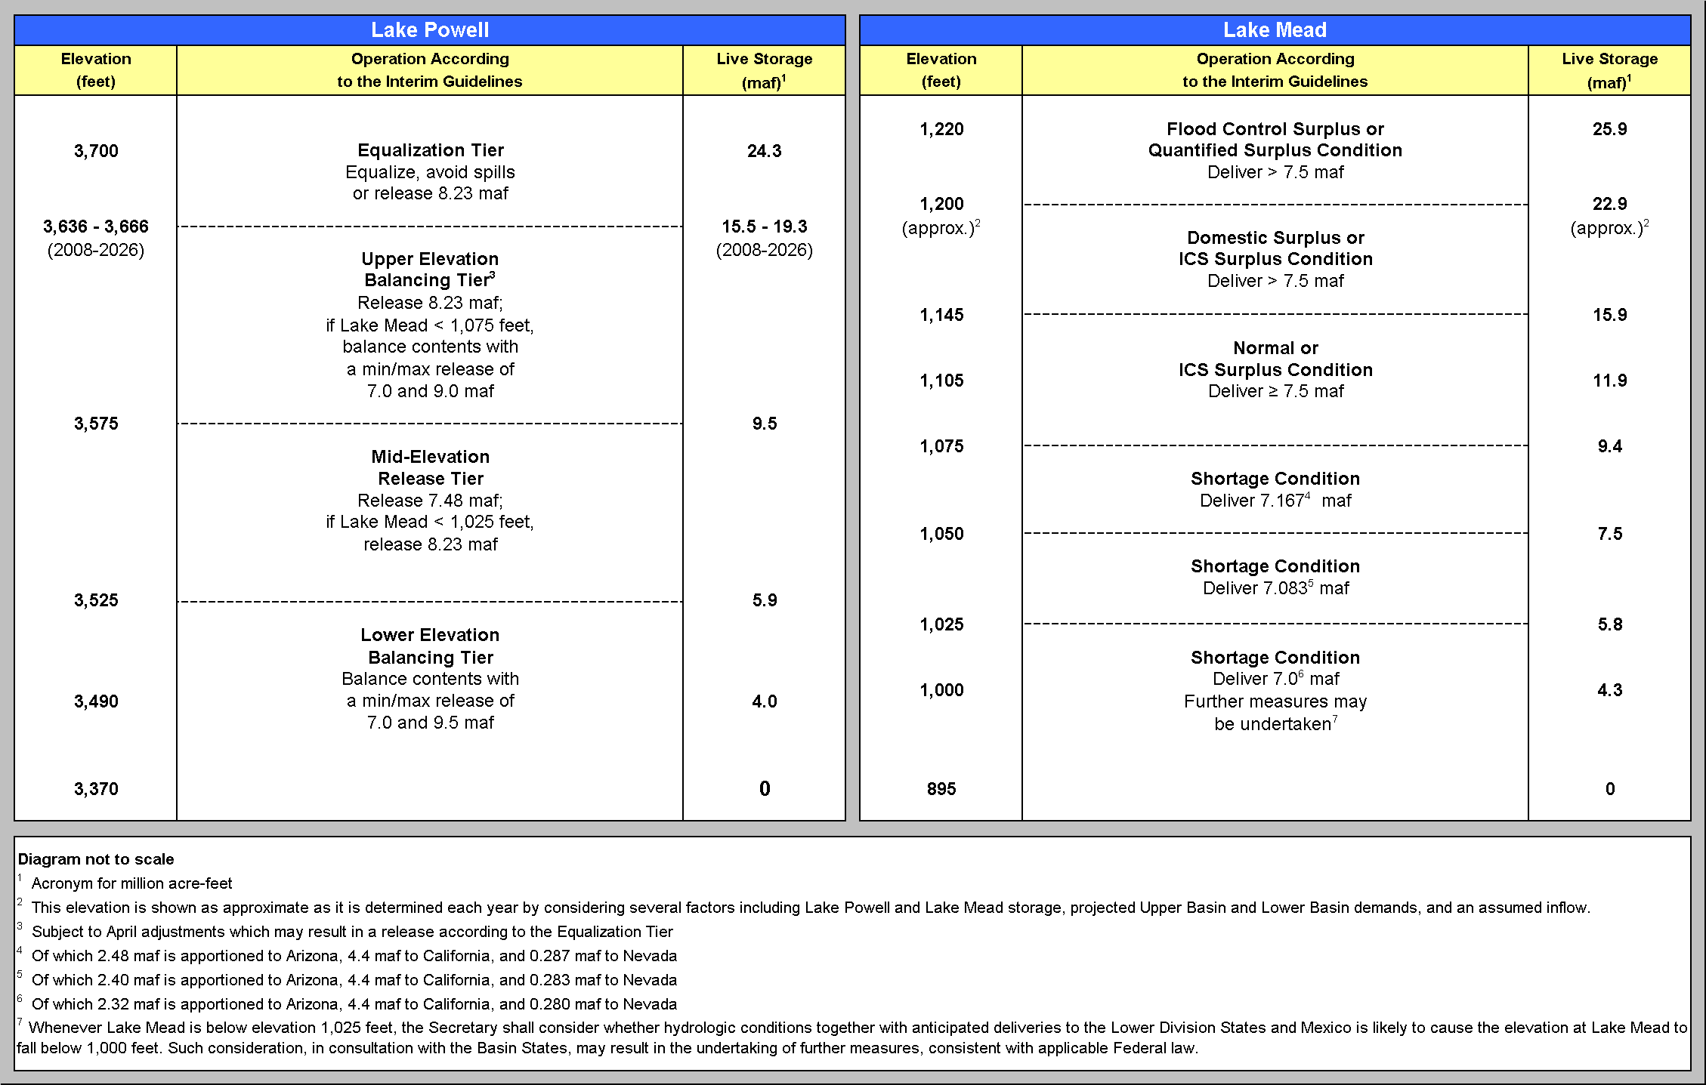
Lake Powell & Lake Mead
Operational Diagrams and Current Conditions
3,611
12.79
4/24/11
4/24/11
1,096
11.14
4/24/11
4/24/11

Slide 8
April 2011 Results from CRSS
Probabilities of occurrence, values in percent
 | Event or System Condition | 2012 | 2013 | 2014 | 2015 | 2016
Upper Basin | Equalization release from Powell | 48 | 46 | 50 | 40 | 41
 | Balancing release from Powell | 0 | 1 | 3 | 15 | 17
 | 8.23 maf release from Powell | 52 | 53 | 40 | 35 | 27
 | 7.48 maf release from Powell | 0 | 0 | 7 | 10 | 14
 | 7.00 maf release from Powell | 0 | 0 | 0 | 0 | 1
Lower Basin | Shortage – any amount (Mead ≤ 1,075) | 0 | 0 | 2 | 16 | 20
 | Shortage – 1st level (Mead ≤ 1,075 and ≥ 1,050) | 0 | 0 | 2 | 13 | 14
 | Shortage – 2nd level (Mead < 1,050 and ≥ 1,025) | 0 | 0 | 0 | 3 | 6
 | Shortage – 3rd level (Mead < 1,025 ) | 0 | 0 | 0 | 0 | 0
 | Surplus – any amount (Mead ≥ 1,145) | 0 | 9 | 21 | 28 | 32
 | Surplus – Flood Control | 0 | 0 | 3 | 4 | 7
 | Normal or ICS Surplus | 100 | 91 | 77 | 56 | 48

Slide 9
Colorado River Basin Water Supply and Demand Study
Two-year, $2 million study cost shared by Reclamation and the Basin States
  Assess future water supply and demand imbalance over the next 50 years
  Assess risks to all Basin resources
  Investigate options and strategies to mitigate impacts
Study will identify and evaluate options, not at feasibility level
A transparent, collaborative study with input from all stakeholders
Email: ColoradoRiverBasinStudy@usbr.gov
Website: http://www.usbr.gov/lc/region/programs/ crbstudy.html
Notes:
9

Slide 10
Addressing an Uncertain Future
The path of major influences on the Colorado River system is uncertain and can not be represented by a single view
An infinite number of plausible futures exist
A manageable and informative number of scenarios are being developed to explore the broad range of futures
Scenario Funnel

Slide 11
* Additional “branches” possible depending upon assumed trajectory of specific socio-economic factors.
Water Supply Scenarios *
Water Demand Scenarios *
Observed Resampled:
future hydrologic trends and variability will be similar to the past 100 years
Paleo Resampled:
future hydrologic trends and variability are represented by the distant past (approximately 1250 years)
Paleo Conditioned:
future hydrologic trends and variability are represented by a blend of the wet dry states of the paleo-climate record but magnitudes are more similar to the observed period
Downscaled GCM Projected:
future climate will continue to warm with regional precipitation trends represented through an ensemble of future GCM projections
Current Trends:
growth, development patterns, and institutions continue along recent trends
Economic Slowdown:
low growth with emphasis on economic efficiency
Expansive Growth:
economic resurgence (population and energy) and current preferences toward human and environmental values *
Enhanced Environment and Healthy Economy:
expanded environmental awareness and stewardship with growing economy*
* Preliminary – Subject to change

Slide 12
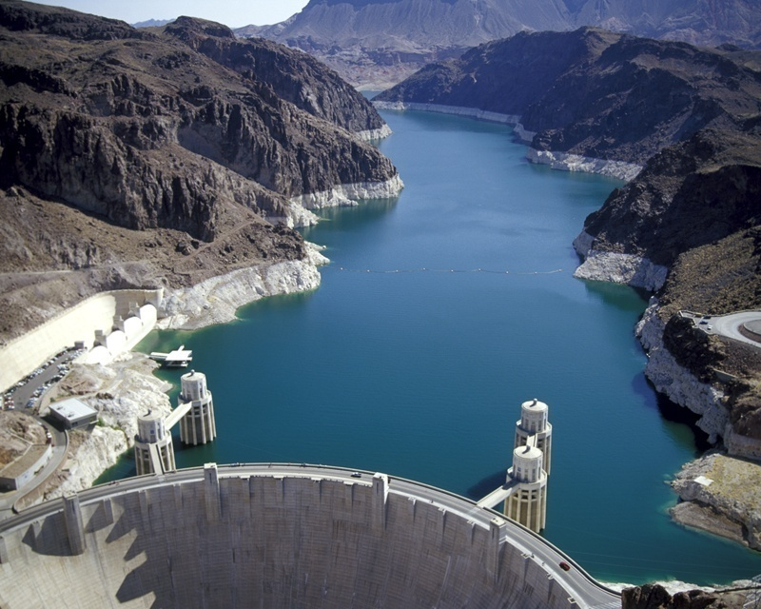
The Colorado River:
Operations and Current Conditions
For further information:
http://www.usbr.gov/lc/region
Notes:
12

Slide 13
Driving Forces of Uncertainty
No. | Driving Forces
1 | Changes in streamflow variability and trends
2 | Changes in climate variability and trends (e.g. temperature, precipitation, etc.)
3 | Changes in watershed conditions (e.g. diseases, species transitions, etc.)
4 | Changes in population and distribution
5 | Changes in agricultural land use (e.g. irrigated agricultural areas, crop mixes, etc.)
6 | Changes in urban land use (e.g. conversion, density, urbanization, etc.)
7 | Changes in public land use (e.g. forest practices, grazing, wilderness areas, etc.)
8 | Changes in agricultural water use efficiency
9 | Changes in municipal and industrial water use efficiency
10 | Changes in institutional and regulatory conditions (e.g. laws, regulations, etc.)
11 | Changes to organization or management structures (e.g. state, federal, bi-national institutions)
12 | Changes in water needs for energy generation (e.g. solar, oil shale, thermal, nuclear, etc.)
13 | Changes in flow-dependent ecosystem needs for ESA-listed species
14 | Changes in other flow-dependent ecosystem needs
15 | Changes in social values affecting water use
16 | Changes in cost of energy affecting water availability and use
17 | Changes in water availability due to tribal water use and settlement of tribal water rights claims
18 | Changes in water quality including physical, biological, and chemical processes

Slide 14
Driving Forces Groupings

Slide 15
Natural Flow
Colorado River at Lees Ferry Gaging Station, Arizona
Water Year 1906 to 2011
Notes:
15

Slide 16
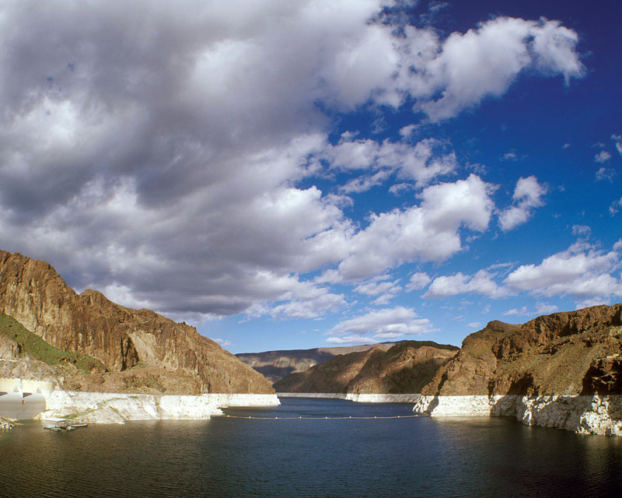
Impetus for the Interim Guidelines
Seven years of unprecedented drought
Increased water use
To date, there has never been a shortage in the Lower Basin and there were no shortage guidelines
Operations between Lake Powell and Lake Mead were coordinated only at the higher reservoir levels “equalization”
Notes:
16

Slide 17
Interim Guidelines¹ - A Robust Solution
Operations specified through the full range of operation for Lake Powell and Lake Mead
Encourage efficient and flexible use and management of Colorado River water through the ICS mechanism
Strategy for shortages in the Lower Basin, including a provision for additional shortages if warranted²
In place for an interim period (through 2026) to gain valuable operational experience
Basin States agree to consult before resorting to litigation
  Issued in Record of Decision, dated December 13, 2007; available at http://www.usbr.gov/lc/region/programs/strategies.html
  Mexico water deliveries are not directly affected by these guidelines
Notes:
17

Slide 18
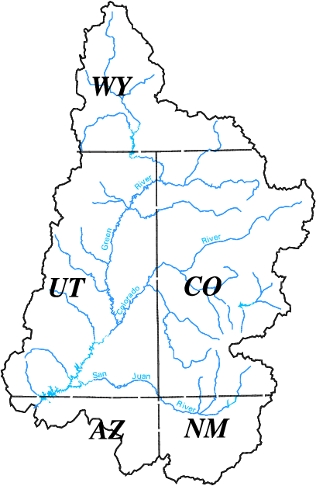
2011 Upper Colorado
Forecasted
Apr–Jul Inflow as of April 15
Flaming Gorge – 126%
Blue Mesa – 111%
Navajo – 70%
Lake Powell – 122%
Notes:
18

Slide 19
Lake Mead Capacity
1,219.6 ft
25.9 maf
Surplus Conditions
124 ft
1,145 ft
15.9 maf
Normal or ICS Surplus Conditions
1,096 ft
11.14 maf
(43% of Live Capacity)
46 ft
1,075 ft
Shortage Conditions
1,050 ft
Min Power
Pool
Inactive Pool (7.5 maf)
1,000 ft
Lower SNWA Intake
895 ft
Dead Pool Elevation
Dead Pool (2.0 maf)
Not to scale
As of Apr 24, 2011
Notes:
19

Slide 22
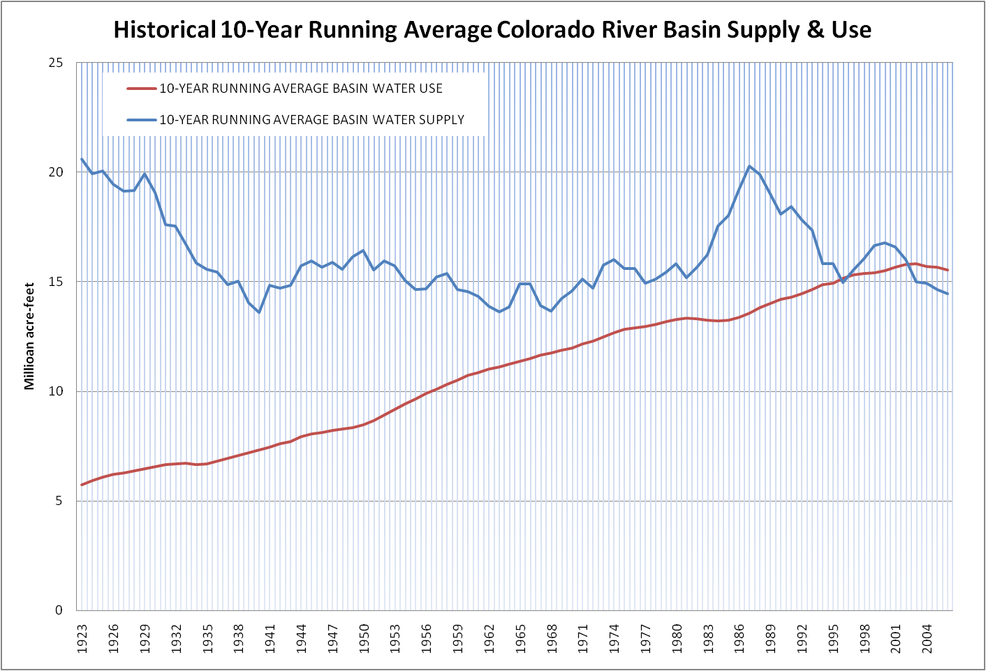
Historic Colorado River Water Supply & Use
(10-year Running Average)
Notes:
22

Slide 23
Colorado River Basin Storage
(as of April 24, 2011)
Current Storage | Percent Full | MAF | Elevation (Feet)
Lake Powell | 53% | 12.79 | 3,611
Lake Mead | 43% | 11.14 | 1,096
Total System Storage* | 53% | 31.46 | NA
*Total system storage was 32.75 maf or 55% this time last year
Notes:
23

Slide 24
Lower Basin Shortage through 2026
Notes:
24

