Slide 1
Is IRWM More Than a Grant Machine?
Sustaining and Enhancing Regional Collaboration
Lynn Rodriguez
Watersheds Coalition of Ventura County
Southern California Water Dialogue
September 28, 2011

Slide 2


Is it all about the money?

Slide 3
IRWM programs are about:
A new way of approaching water management
Interconnectedness and collaboration
Projects that are multi-disciplinary and multi-benefit
Building trust and relationships
Grant funding
New ways to resolve challenges and conflicts
Shared knowledge and resources

Slide 4
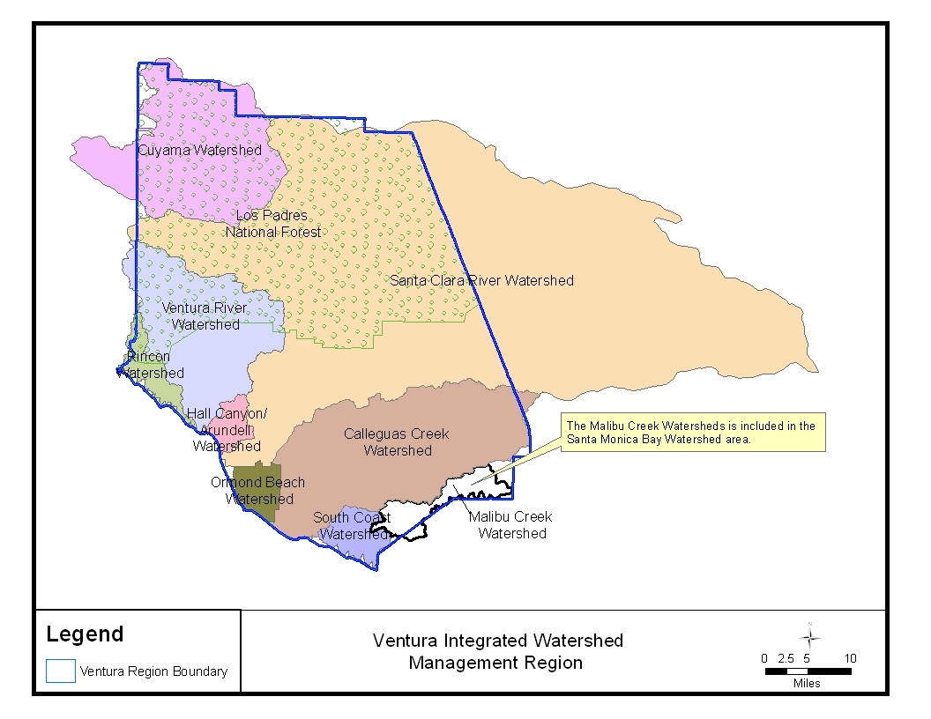
Watersheds Coalition of Ventura County – IRWM Region

Slide 5
Developing the Game Plan 2002
Pay to Play?
Project priorities?
What makes a region?
Schedule?
In-house? Whose house?
Coordination?
Hire a consultant?
$$$ for planning?
How can we meet the deadlines?
Everyone at the table?
Who takes the lead?
How do we slice the pie?
What’s your role? What’s my role?

Slide 6
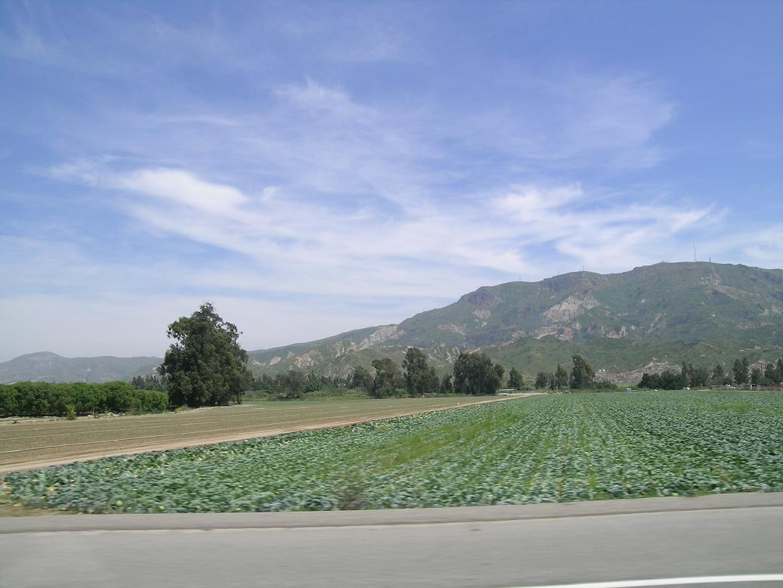
Ventura County Highlights
Microcosm of the water issues facing the state
Population 823,000
1,843 square miles
50% in National Forest
330,000 acres of Ag land (125,000 acres irrigated)
Ag products valued at $1.5 billion
3 major watersheds
10 cities
65% Groundwater - 25% Imported state water - 8% Surface water

Slide 7
More Than $43 Million
in Grant Funding Secured
2006 – Prop 50 Planning Grant $220,000
2007 – Prop 50 Implementation Grant $25 million
2011 – Prop 84 Planning Grant $485,684
2011 – Prop 84 Implementation Grant $17.5 million
Total Grant Funding Awarded $43,216,283
Local Funding and Match $60,666,823
TOTAL $103,883,106

Slide 8
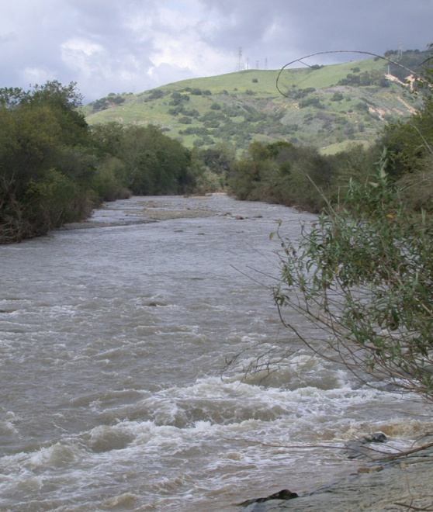
How we succeed
Unity, diversity, and leadership
Long history of collaboration
Projects and programs integrated within and across local watersheds
Collaboration throughout watersheds and across IRWM boundaries - in spite of political boundaries and political differences

Slide 9
Lessons learned
It’s not all about the money
It is all about relationships and trust
Balance perspectives of diverse stakeholder interests
There is no such thing as too much communication

Slide 10
What’s next for our region?
Update IRWM Plan
Improve data access – GIS and web-based
Implement projects in IRWM Plan
Enhance watershed-level planning efforts with all stakeholders
Increase collaboration with partners both in and adjacent to WCVC region
Seek diverse sources of funding

Slide 11
More……
Re-energize regional water management group(s) - keep them engaged in shared future vision
Take the message and information to other community groups – outreach to DACs, tribes, others

Slide 12
Integrated Regional Water Management
Habitat
IRWM Plan
Stakeholders
Recreation
Water Quality
Surface Water
Infrastructure
Water Supply
Stormwater
Regulations
Land Use Practices
Climate Change
Research
Land Acquisition
Groundwater

Slide 13

Questions?
Visit us on the web..
(www.watershedscoalition.org)

