Slide 1
Managing One Water
Mark Pestrella, P.E.
Assistant Director
LA County Public Works
Southern California Water Dialog Sept 27, 2011

Slide 2
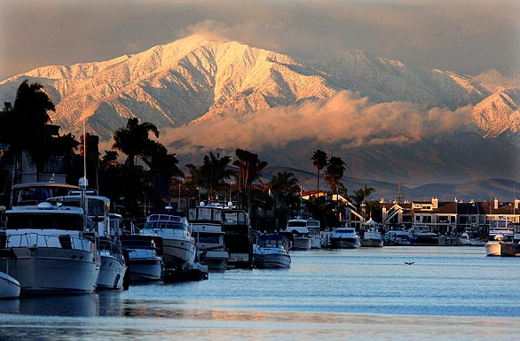
Notes:
In today’s environment, agencies must be looking for sustainable solutions ; that economically feasible, environmentally sound and socially acceptable.
Our Vision is to protecting and enriching lives and creating the ability for life to go on.
In the area of water resources management:
Today, local agencies, organizations, cities, and county government are working together to develop an IRWMP for the Region that is inclusive and provides opportunities for cost effective solutions to address the water resource needs of the Region.

Slide 3
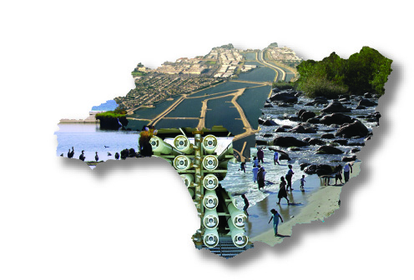
Diverse Water Resources…
Diverse Issues…Diverse Players
Metropolitan Water District
Main San Gabriel Watermaster
Water Replenishment District
Santa Monica Bay
Restoration Commission
Watershed Conservation Authority
San Gabriel Basin Water Quality Authority
Las Virgenes
Municipal Water District
Los Angeles County Flood Control District
Central Basin Municipal Water District
Raymond Basin Watermaster
West Basin Municipal Water District
County Sanitation Districts
Upper Los Angeles Area Waterrmaster (DWP)
City of Los Angeles
Most local agencies operate with single-purpose mission.
Notes:
Agencies responsible for water resource management traditionally operate in silos and have single-purpose missions: water supply, flood protection, wastewater, groundwater, stormwater management, open space, or recreation.
Example of water “leaders” in Greater LA:
Flood Control – LAFCD
Groundwater – Main San Gabriel Basin Watermaster and other watermasters
Water Supply – Metropolitan Water District and its member agencies such as West and Central Basin Municipal Water District.
Surface Water – Stormwater Agencies such as City of LA’s Watershed Protection Division
Wastewater – County Sanitation Districts of LA
Open Space – Santa Monica Bay Restoration Commission; LA Parks & Rec

Slide 4
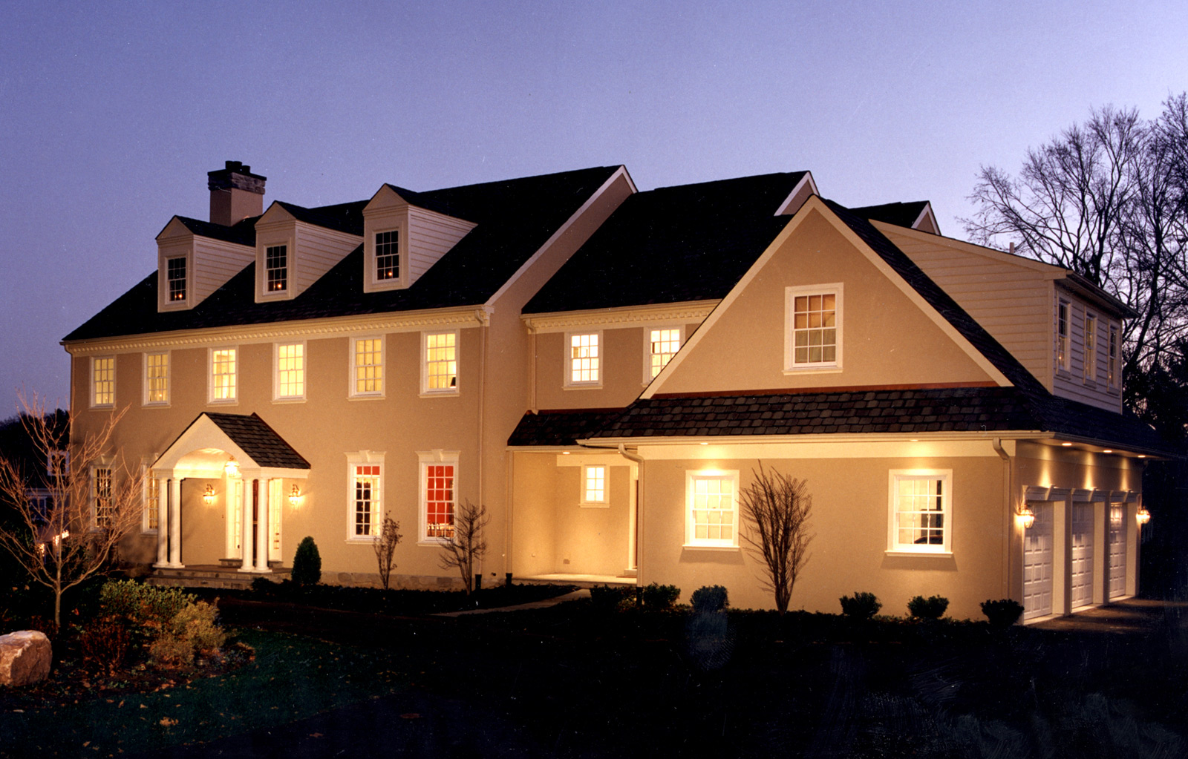
Partners Under One Roof
South Bay
DWR
Central Basin MWD
City of Beverly Hills
City of LA Bureau of Sanitation
City of LA DWP
City of Torrance
LA County Flood Control District
LA County Sanitation District
Mono Lake Committee
Santa Monica Bay RestComm
South Bay Cities COG
Water Replenishment District
West Basin MWD
Upper San Gabriel River
California Dept of Water Resources
City of La Verne
Council for Watershed Health
LA County Flood Control District
LA County Sanitation District
Main San Gabriel Basin Watermaster
Rivers and Mountains Conservancy
San Gabriel Basin WQA
San Gabriel Mountains Regional Con
San Gabriel Valley COG
San Gabriel Valley MWD
San Gabriel Valley Water Association
Three Valleys MWD
Upper San Gabriel Valley MWD
Lower LA & Lower San Gabriel Rivers
Central Basin MWD
Gateway Cities COG City of Downey
Gateway Cities COG City of Lakewood
Gateway Cities COG City of Paramount
City of Long Beach
Council for Watershed Health
LA County Dept of Public Works
Orange County Public Works
LA County Sanitation District
Water Replenishment District
Watershed Conservation Authority
North Santa Monica Bay
California Coastal Conservancy
California Dept of Parks and Recreation
City of Agoura
City of Calabasas
City of Malibu
City of Westlake Village
City of Westlake Village
Heal the Bay
Las Virgenes MWD
LA County Beaches & Harbors
LA County Dept of Public Works
LA County Flood Control District
LA County Waterworks Districts
Malibu Lake Mountain Club
Mountains Restoration Trust
National Park Services-Santa Monica Mts NRA
Santa Monica Baykeeper
Santa Monica Mountains Conservancy
Triunfo Sanitation District
Upper LA River
Arroyo Seco Foundation
Burbank Water and Power
City of Calabasas
City of LA Bureau of Sanitation
City of LA Dept of Recreation & Parks
City of LA Dept of Water and Power
City of Pasadena
City of South Pasadena
Coastal Conservancy
Glendale Water and Power
Council for Watershed Health
LA County Flood Control District
Mountains Restoration Trust
Upper LA River Area Watermaster

Slide 5
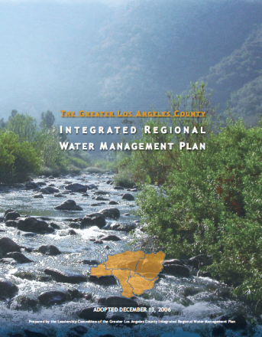
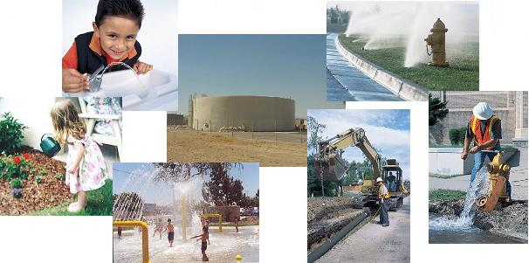
I N T E G R A T E D R E G I O N A L W A T E R M A N A G E M E N T P L A N
The mission of the Greater Los Angeles County Region Integrated Regional Water Management Plan is “to address the water resources needs of the Region in an integrated and collaborative manner.”

Slide 6
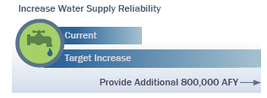
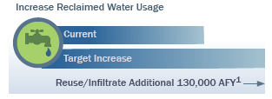
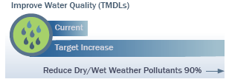
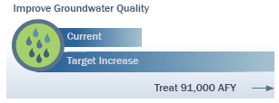
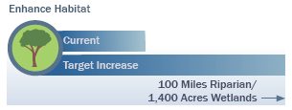
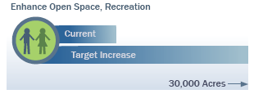
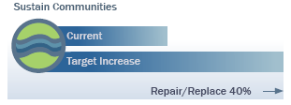
I N T E G R A T E D R E G I O N A L W A T E R M A N A G E M E N T P R O G R A M
Multi-Agency, Collaborative Targets
Repair/replace 40% of aging infrastructure

Slide 7
As State funding became more geared towards regional planning
Local agencies started collaborating
Water Supply &
Water Quality
Minimize
Flood Risk
Support Environmental
Stewardship
IRWMP
Notes:
Funding was also single purpose focused and very limited.
Most local agencies are aware that seeking outside funding is a highly competitive and expensive process.
When State funding started gearing towards integration – as evidenced by the passage of Prop 50 in 2002 – agencies started breaking down silos toward integrated multi-purpose projects.
Solutions can be integrated to address regional instead of single purpose objectives. Collaboration can result in multipurpose solutions and result in more effective use of available resources. This becomes a blueprint for integrated planning and proactive water resource management.

Slide 8

Not All About the Money $$$
Bringing together diverse agencies, large and small, single or multi-purpose, under one single roof
Promoting open and free dialogue by breaking down barriers
Developing common understanding of regional and subregional challenges

Slide 9

Not All About the Money $$$ (con’t)
Developing an understanding of how success by one means success for all
Building Relationships

Slide 10
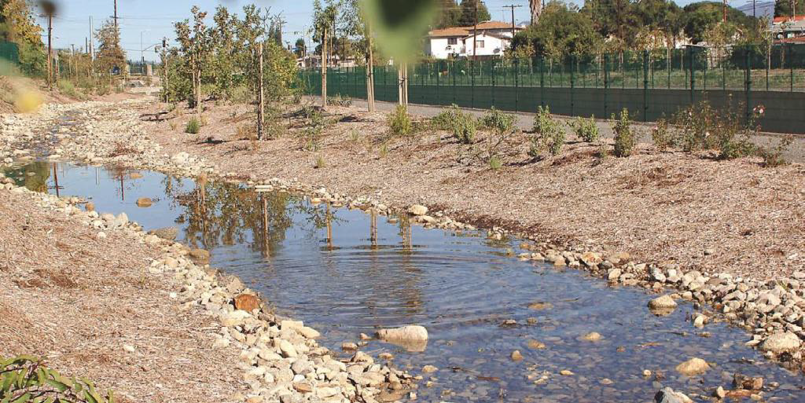
Promoting Collaboration
Many examples of groups of agencies collaborating on long-term projects with multiple benefits and stakeholders…
  Managing Sediment
  Water Quality Funding Initiative
  Prop 1E

Slide 11
Questions?

