Slide 1
The Southern California Water Dialogue
Bruce Moore, Division Manager
Southern Nevada Water Authority
April 27, 2011

Slide 2
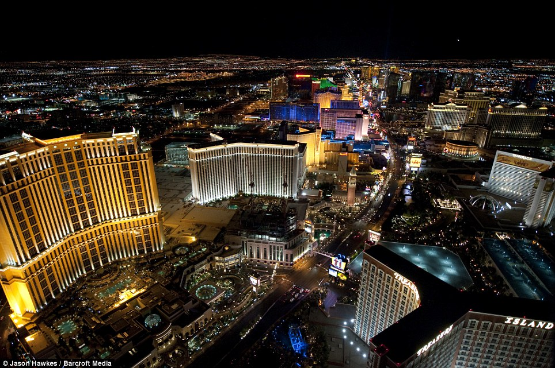
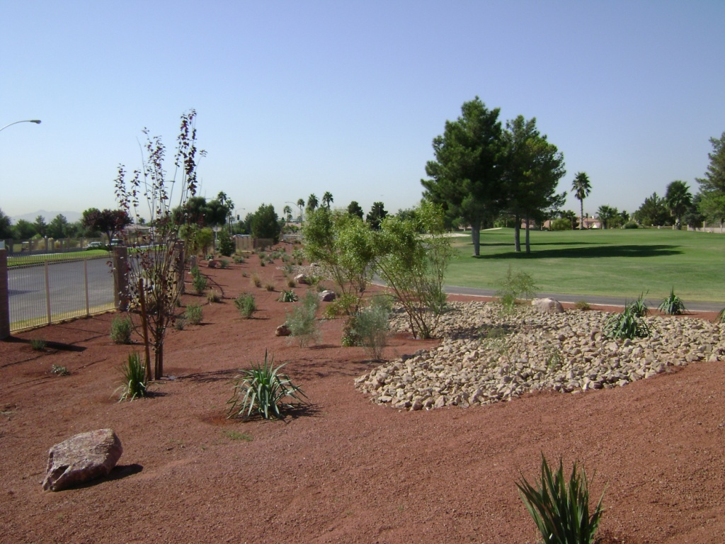
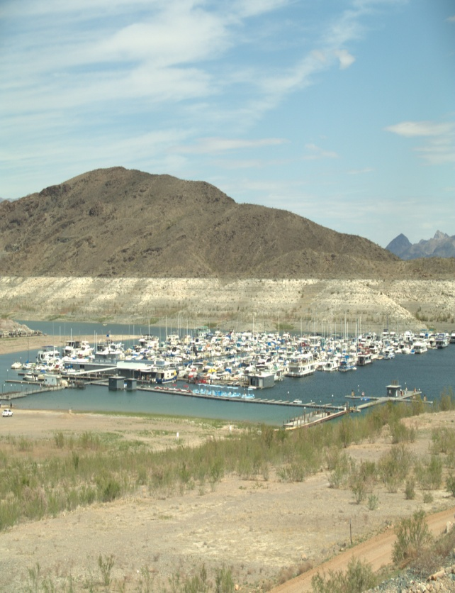
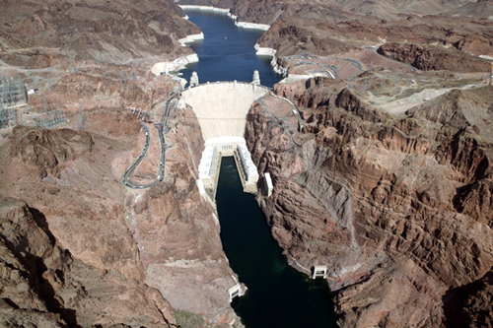
WELCOME TO LAS VEGAS

Slide 3
Sustainability
Recycle 100% of Non-Consumed Water Supply
Conservation ($150 mil, 130 + mil sqft turf, 7.5 bil gal, 400k people)
Ground Water Banking AZ, CA, NV
3rd Intake
Building Code Revisions
Intentionally Created Surplus
Brock Reservoir
Development of Nevada Surface & Ground Water Rights
Augmentation

Slide 4
Conservation
Because of return-flow credits, the total amount of water “consumed” is far less than the actual amount of water “used.”
250
240 GPCD
200
199 GPCD
150
Total System wide GPCD
100
“Consumption” GPCD
145 GPCD
119 GPCD
50
0
Current
Goal 2035

Slide 5

3rd Intake Profile
Pumping Station and Access Shafts
Saddle Island
1,111’ (Oct 2007)
Lake Mead
IPS 1 1,050’
Const 1971
Old Las Vegas
Wash Channel
Const 2003
Intake Shaft (860 feet)
IPS 2 1,000’
Operational pumping
Limit 1,000’
Tunnel (approx. 3-1/2 miles)
Pipeline (7,000 ft.)

Slide 6
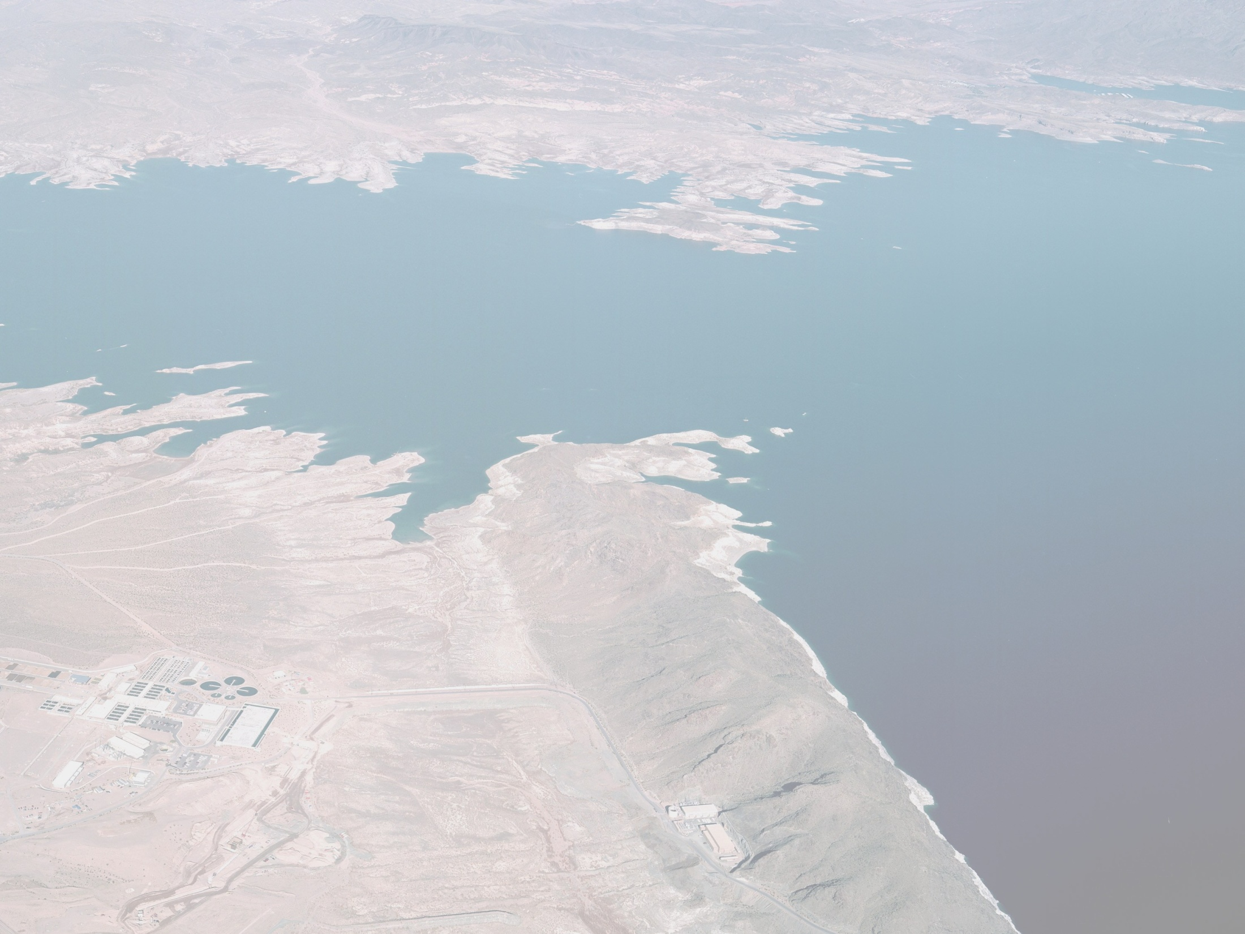
Lake Mead Intake No. 3
Total Project Scope
INTAKE STRUCTURE
INTAKE TUNNEL
ACCESS SHAFTS
PUMPING STATION
DISCHARGE PIPELINE
CONNECTOR TUNNEL
WATER TREATMENT FACILITY
INTAKE 1
INTAKE 2
Notes:
6

Slide 7
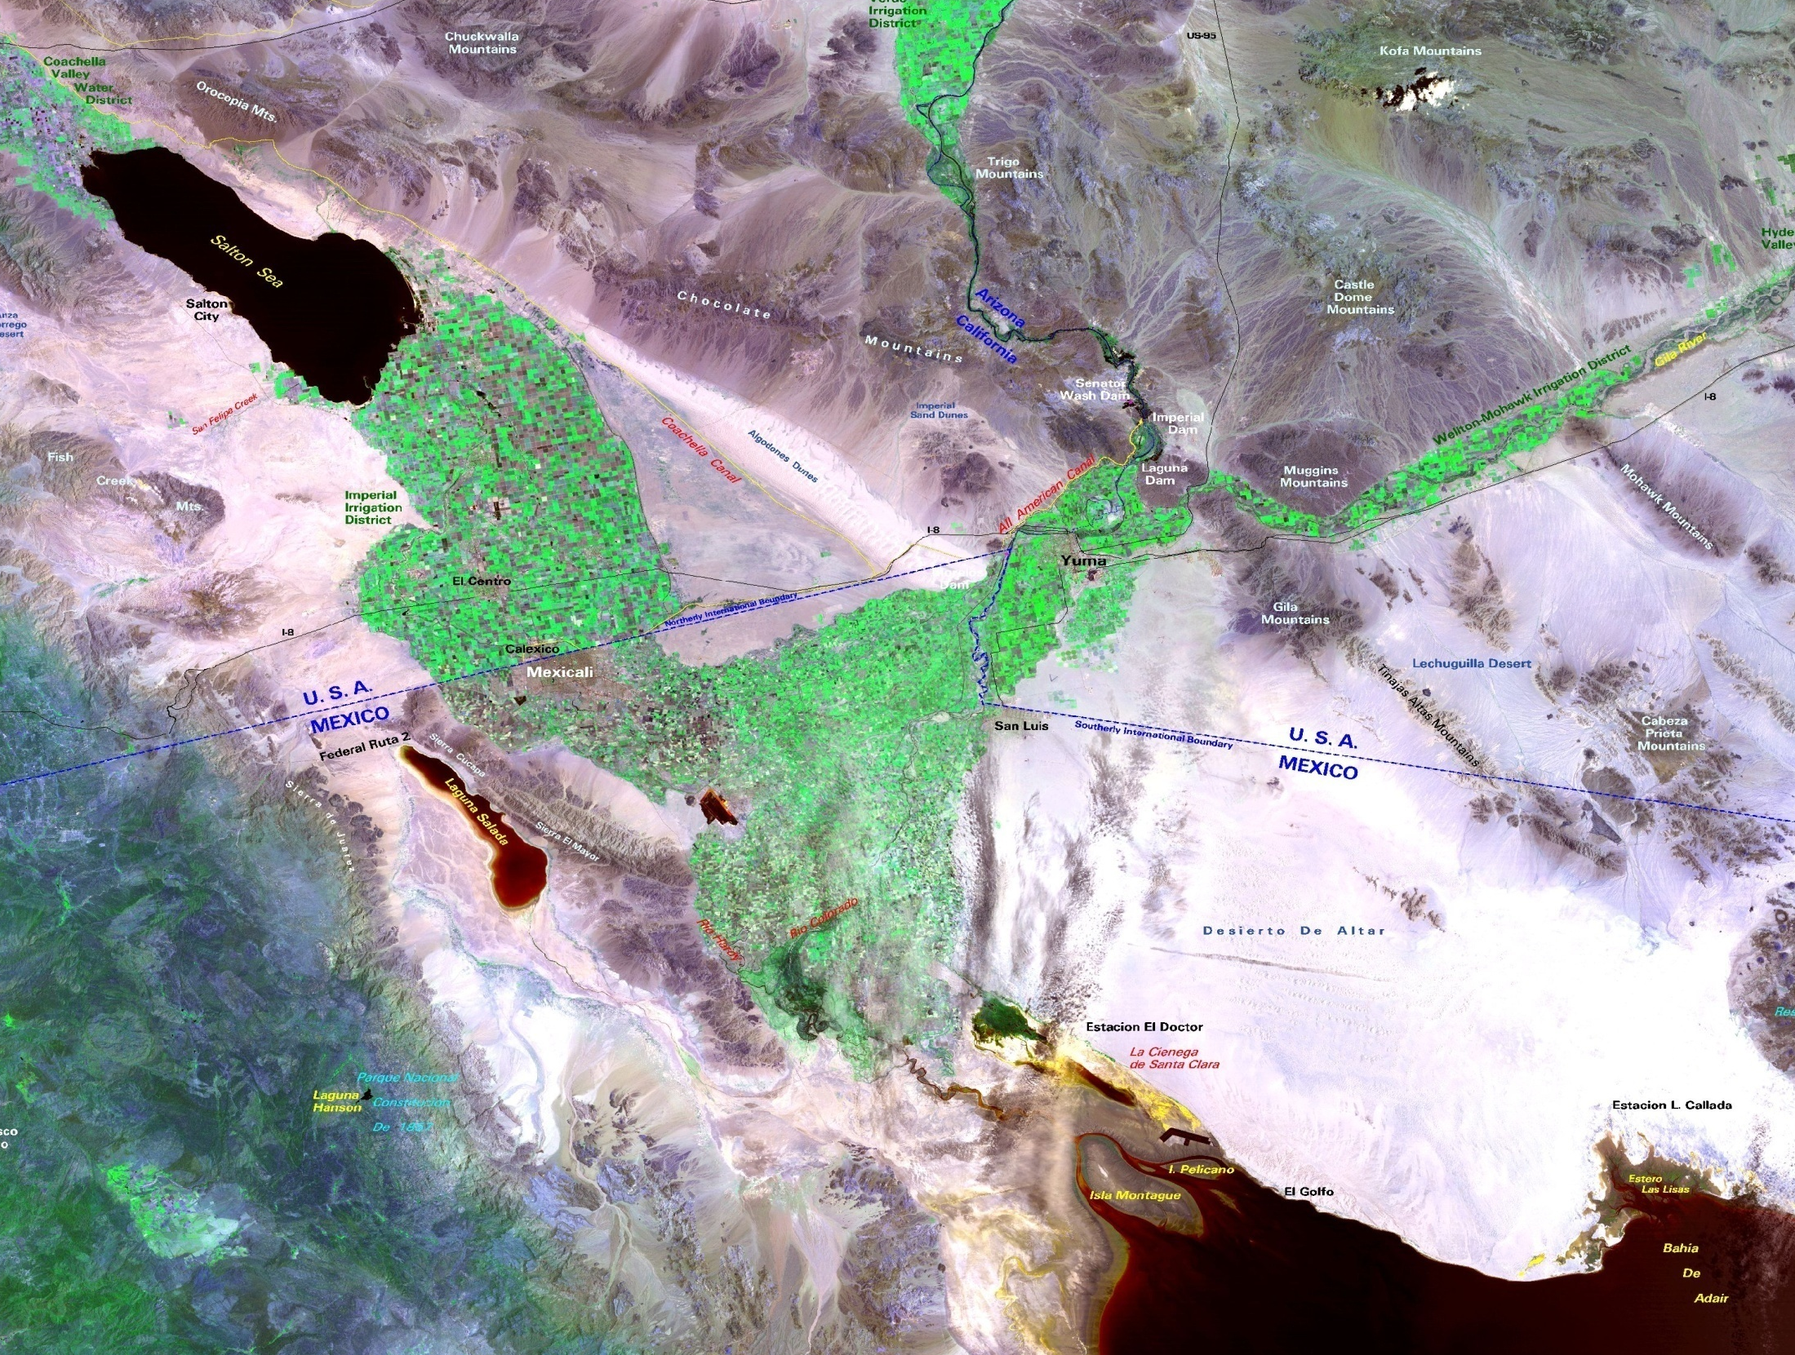
Geographic Overview
Colorado River
Coachella Canal
Gila River
All American Canal
Bypass flow
WMIDD
Yuma Desalting Plant
Rio Colorado
Santa Clara Wetland
(Cienega de Santa Clara)
Courtesy of the
Bureau of Reclamation
Sea of Cortez

Slide 8
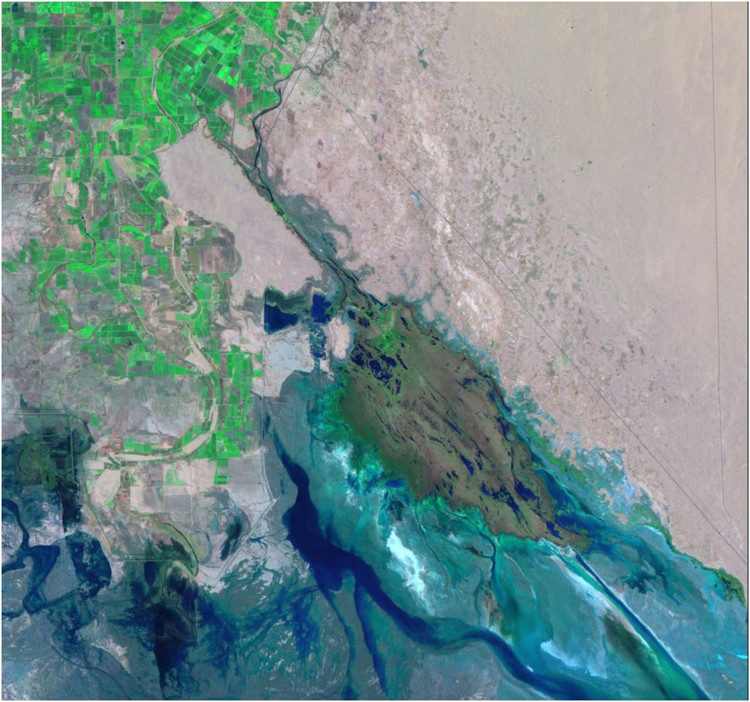
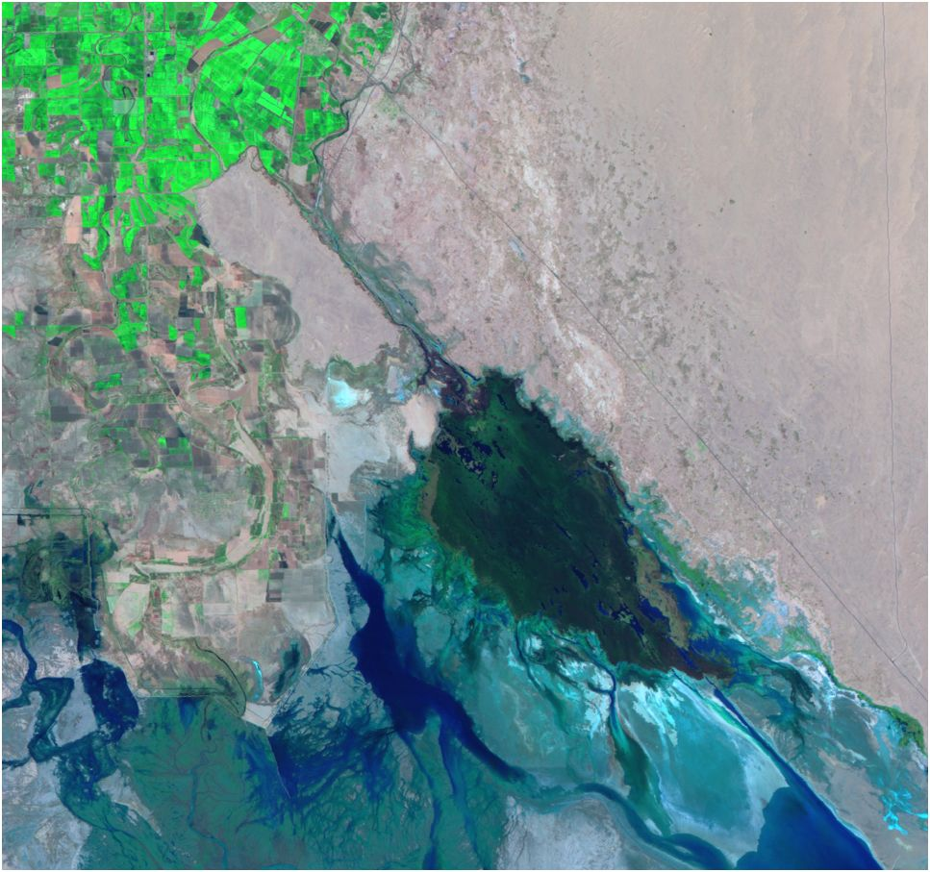
Natural Color 2010/2011 Landsat 5 Imagery of the Cienega de Santa Clara
April 30, 2010
April 17, 2011

