Slide 1


The Promise of IRWMP
Celeste Cantú
General Manager
Santa Ana Watershed Project Authority
Notes:
“One Water One Watershed” Plan – An Integrated Systems Approach

Slide 2
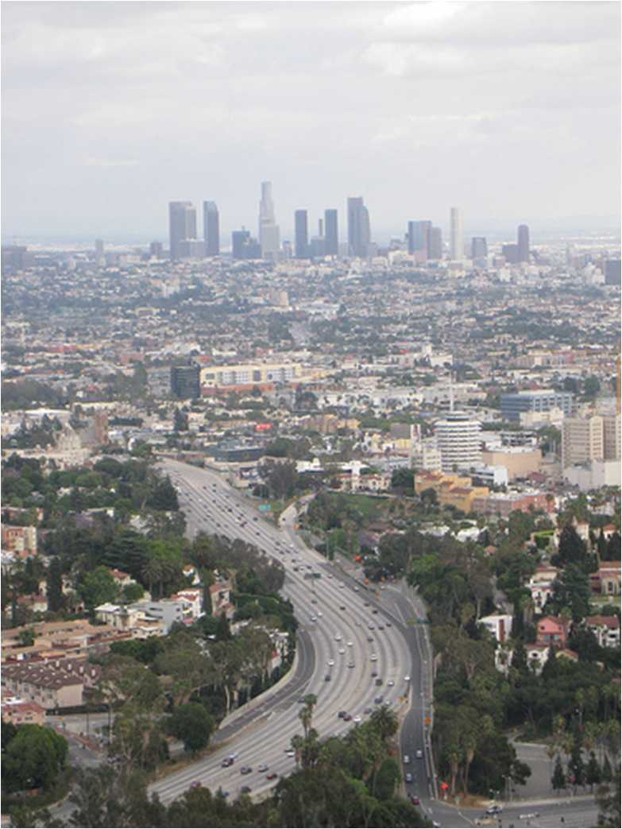
Water leaders drive the future
Notes:
Here we are, this is us this is where we live. This is what 20 C water policies built. Water drives the future. It is all about you, the water resources managers of So CA and those who care about or future. The policies we make and the decision we implement drive the economy, quality of life, social equity, and a sustainable ecology. It is up to us. You may not feel it but you are the most important people in any room. It is up to you.
I think it is because the skill set that got us here is not the one to lead us into the 21 Century. You know what IRWMP is but I have not seen any training on how to actually do it. I will explore that in the context of IRWMP specifically.
So we do we feel so helpless?
We have a long history of sectoral development based on a narrow understanding of water as an input into economic development.

Slide 3
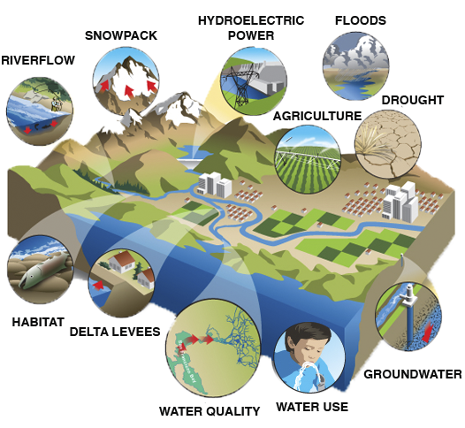
California’s Hydrology is stressed by competing demands.
Notes:
1. The seasonal timing of river flows has changed, with more flow in winter and less in the late spring and summer. CLICK
2. precipitation will come as rain rather than snow. CLICK
3. An earlier snow melt may overflow storage facilities resulting in a significant loss of usable water and reduced power generation CLICK
4. agricultural water demands will increase. CLICK
5. The earlier snow melt would lead to flooding. CLICK
6. Less precipitation and warmer temperatures will decrease in soil moisture, recharge and river flows. CLICK
7. increased salt concentrations in groundwater reservoirs due to sea level rise and over pumping CLICK
8. increase in urban water demand CLICK
9. sea level rise in the Delta increases salinity. CLICK
10. and poses a risk to levees, CLICK
11. less water for fish CLICK
Lawrence Livermore National Laboratory
CLICK

Slide 4
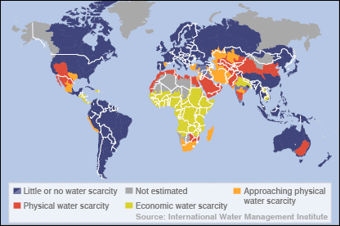
Global Water Stress & So CA
Notes:
It shows two key types of scarcity; water is said to be either physically scarce or economically scarce. And puts us in the global context, which is how I see our water world since my visit at world water Week.

Slide 5

Four Horsemen of the
Apocalypse..the herd is growing
Reduced Water from Delta
Climate Change
Colorado River Import Reductions
Reduced Groundwater Recharge
Notes:
You have seen this slide before and nothing has changed. Except the herd is growing.
The OWOW Plan pursues multiple objectives beyond the “traditional” objective of providing reliable water, and ensuring high quality water for all users, by preserving and enhancing the environment, promoting sustainable water solutions, managing rainfall as a resource, preserving open-space and recreational opportunities, maintaining quality of life (including addressing the needs of disadvantaged communities), providing economically effective solutions, and improving regional integration and coordination. Integrate multiple interests (e.g. economic growth vs. environmental protection), rather than focus on conflict and litigation; If we see each challenge, drought, climate change, water quality, as separate and approach each separately the solution we come up with will fall short or be opportunistic. Quick fixes do nothing to address deeper dysfunctions.
But water is not the only driver. Budget limitations are changing how we fulfill our goals. Because of our financial limits, we have increasingly called upon citizens and stakeholder to help craft responsible, sustainable solutions.
Many challenges facing the water community today cannot be solved by technology, infrastructure or engineering alone. Solutions popular in the 20th Century are today too expensive and have too great carbon footprint. We hope to solve our problems and meet our needs through collaboration and cooperative agreements in additional to engineering regional projects.

Slide 6

Energy Cost

Slide 7

Fiscal Crisis

Slide 8

Meet Conflict
Notes:
IRWMP is a challenge to conventional practices, attitudes and professional certainties. It confronts entrenched sectoral interest and require that the water recourse is manage holistically for the benefits al all. No one pretends that meeting the IRWMP challenge will be easy but it is vital that a start is made now to avert the burgeoning crisis. So the sill set we need to be talking about and developing is conflict management. We are not talking about conflict resolution but management. The conflict management process does not begin with the identification of a particular conflict. It fits in the planning stage of a project or program of water resource development anticipating possible conflict among stakeholders. There are tools and methods. This work is just as important of the skill sets that we have used for the past decades.

Slide 9
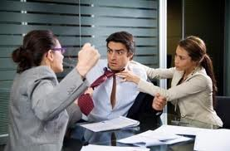
Conflict Management is key to IRWMP
Notes:
The case for IRWMP is strong many would say incontestable. The problem for most is the long history of sectoral development based on a narrow understand of water. We are now coming to grips with the enormity of the problems we have created for ourselves through the unselfconscious manipulation of nature for particular ends. The need for change is undeniable . With change comes challenge and with challenge come threats as well as opportunities. There are threats to people’s power and position and threats to their sense of themselves as professional. IRWMP requires that platform be developed to allow very different stakeholders, often with apparently irreconcilable difference to somehow work together.

Slide 10
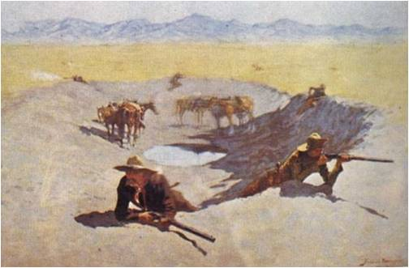
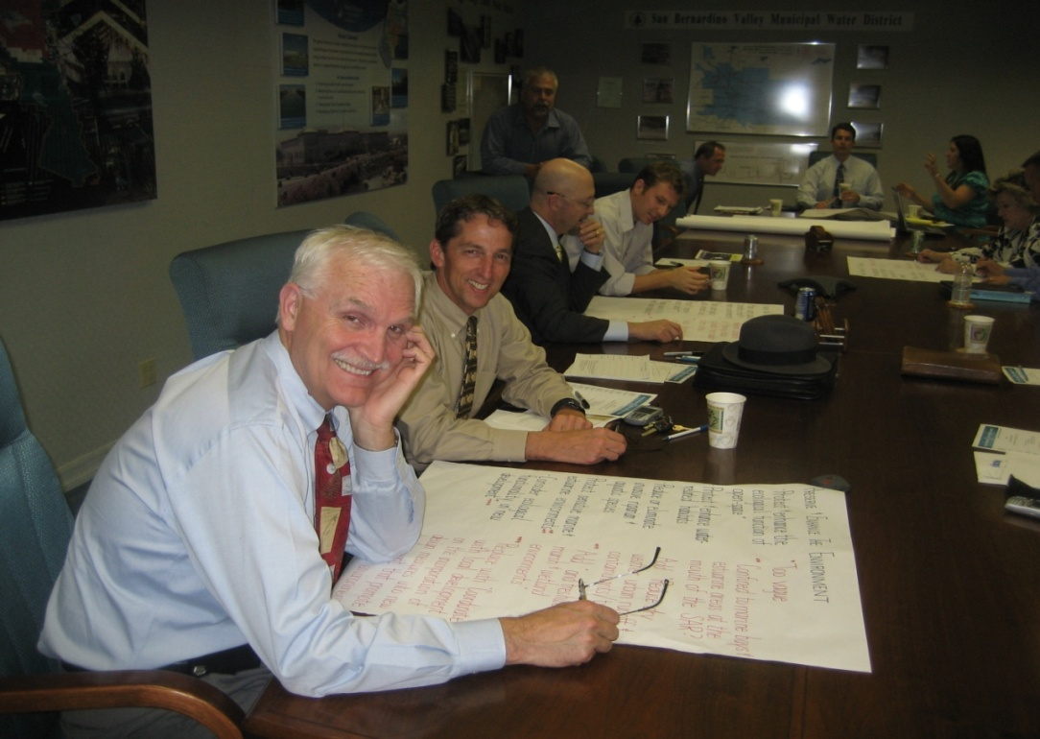
By partnering with others, water suppliers find win-win solutions.
Notes:
In California, our legacy is best summed up by Mark Twain’s saying “whiskey is for drinking; water is for fighting over.” CLICK
But there is another model for building unique alliances to develop and implement integrated solutions to our water challenges. Instead of fighting the other side, we have begun to embrace collective problem solving by unlikely partners.
It is generally recognized that the problems of today and tomorrow are as much a consequence of our past traditions of governance as they are of scarcity.
Governance is both outcome and process, involving a variety of legitimate and authoritative actors. The out come is widespread approval of its practices and an achievement of a sustainability. Good governance can never reach an end point, as a process it depends on the reiteration of activities that deepen trust.

Slide 11
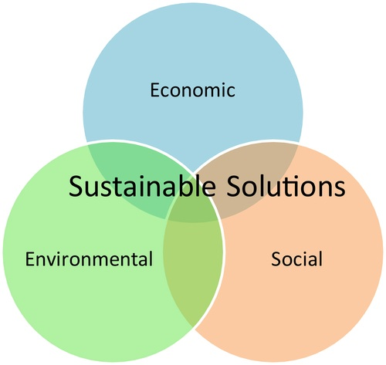
Plan for Sustainability – not the next grant
Notes:
“Humanity has embarked on a huge global ecological engineering project, with little or no preconception or indeed full present knowledge of the consequences. UN World Water Development Report 2. The IRWM Plan defines solutions to meet demands that address economics, the environment and our society. Sustainability must be the end goal.

Slide 12
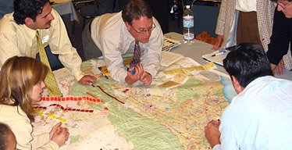
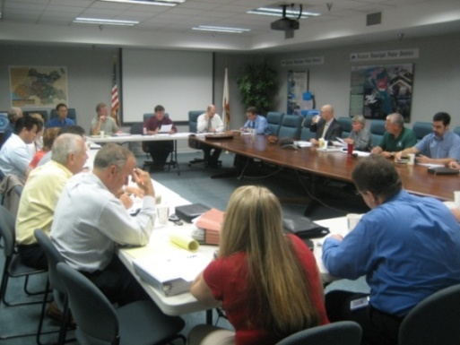
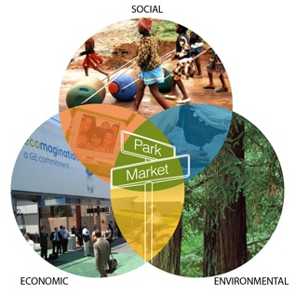
OWOW Guiding Principles
Create Anew – OWOW
2
Collaboration Across Boundaries Citizens of watershed,
3
Adopt Systems Approach –Problems are interrelated, seek synergies, create catalysts
1
shared vision and adopting a
new water ethic
multi-jurisdictional solutions
Notes:
A new shared vision for the Watershed
Breakthrough Innovations
Many Challenges are Institutional not Technical or Physical
Not only solving problems, but creating a new desirable future.
See each problem as interrelated, seek efficiencies and synergies
As Citizens of the Watershed, create solutions.
No ONE person has resources, authority, credibility or understanding enough to connect the larger network.
Collaborate across boundaries.
Plan describes the Santa Ana River Watershed as a hydrologic whole, detailing functional and dysfunctional dynamics.
Working in concert with Nature is cost effective.
We asked the stakeholders to create anew, to move easily from problem solving to creating, to create a new shared vision and to realize breakthrough innovations. Problem solving is about making what you don’t want go away. Creating a new involves bringing something you care about into reality. Shifting the conversation from problems to possibilities
Watershed as a whole system from the 30,000 foot level.

Slide 13
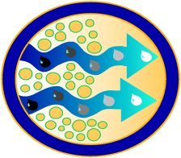


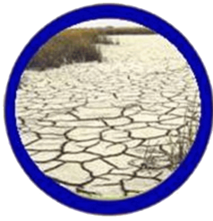



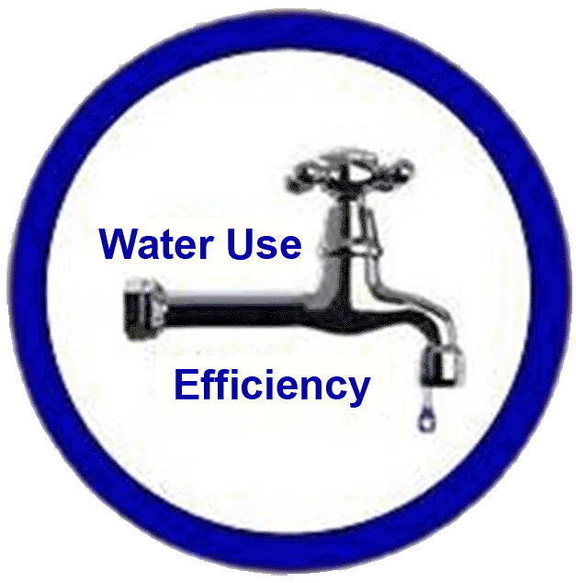


OWOW integrates all aspects of water and every stakeholder.
Flood Control and
Storm water Runoff
Water Quality
Improvement
Environment
& Habitat
Climate Change
Land Use
Water
Supply
Reliability
Water
Recycling
Water use efficiency
Environmental justice
Parks, Recreation & Open Space
Notes:
You know Managing the water resources at the watershed scale, while difficult, offers the potential of balancing the many competing demands we place on water resources. OWOW acknowledges linkages between uplands and downstream areas, and between surface and ground water and reduces the chances that attempts to solve problems in one realm will cause problems in others. Watershed management integrates all the various human activities that occur on a given area of land that have effects on or affected by water. We focus on all sources of pollution as a whole rather than on types of sources or on the arbitrary political boundaries. With this perspective we can plan long term sustainable solutions to many natural resources problems. We can find a better balance between meetings today’s needs and leaving a sound resource legacy for generations to come.
The active participation of this diverse group of stakeholders integrates the different interests in the Watershed beyond political boundaries. We asked everyone to check their identity, at the door. We asked them to think of themselves only citizens of the Santa Ana River Watershed, and to suspend assumptions and balance advocacy and inquiry to foster a collective intelligence. All other loyalties, agendas and priorities were to be secondary to those of the holistic view of the Santa Ana River watershed. Individually no one has sufficient resources to address the sustainability issue we face. No one person has enough understanding, credibility or authority to connect the larger networks of people and organizations to do this work. We have to do it together.
OWOW reflects the watershed moving from a water supplier to a water resource manager mentality. We are moving from a mission of providing abundant high-quality water at the lowest cost possible, to one in which water resources are managed in a sustainable manner and with regard for the needs of the environment and those downstream. Rather than investing more or working harder on the ways of the 20th century, OWOW seeks a new approach that is lighter on the land, protects habitat and a sustainable future for a robust economy and healthy environment.
It is hard to ask people to change. And I will suggest that none of us have the skill of managing the conflict that will arise if you implement IRWMP correctly.

Slide 14
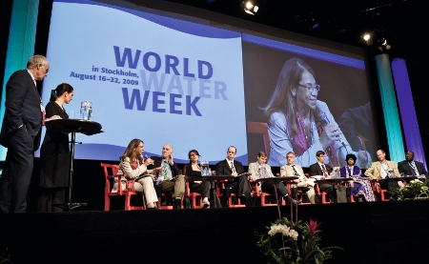
Stockholm World Water Week

Slide 15

We have choices to make: It’s time to catch up with the rest of the world
Notes:
We can continue business as usual and believe that nothing has or ever will change. Or we can notice that in fact there have been clear indications that we can not continue as we have been and adopt IRWMP as the basis for water governance. The next 100 years will not be like the last.

Slide 16
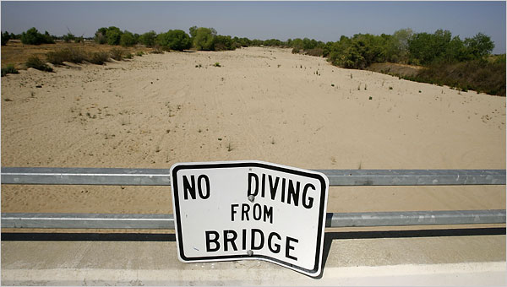
www.SAWPA.org
Notes:
We must resist a desire to jump to a solution, and invest time and energy to understand the whole watershed system. How the issues fit together, how there could be unintended consequences. Groups with diverse missions can work together to find a solution that benefits all stakeholders. In the midst of the controversy, it is difficult to believe that a consensus solution is possible. But interest based negotiation is an effective problem solving tool. This is the model that can resolve California’s water challenges. Thank you.

