Slide 1
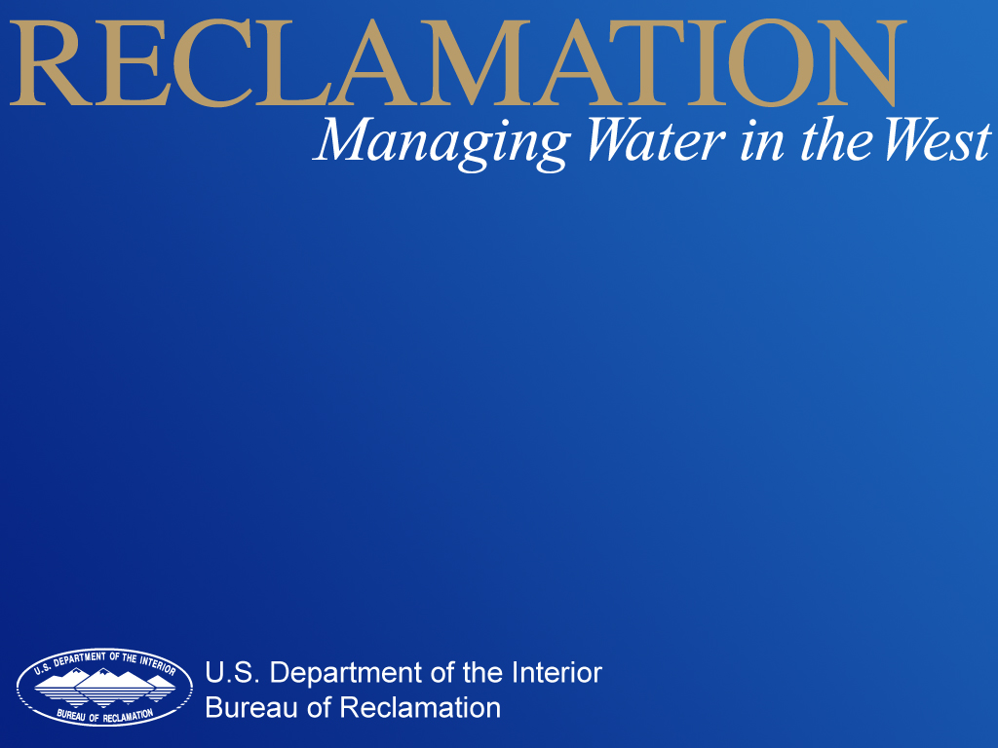
Hydrology of Climate Change: Telling the LOCAL Story Using Global Climate Models
May 23, 2012, Los Angeles, CA
Subhrendu Gangopadhyay, Ian Ferguson, Tom Pruitt
Water Resources Planning and Operations Support Group
Technical Service Center, Denver, Colorado

Slide 2
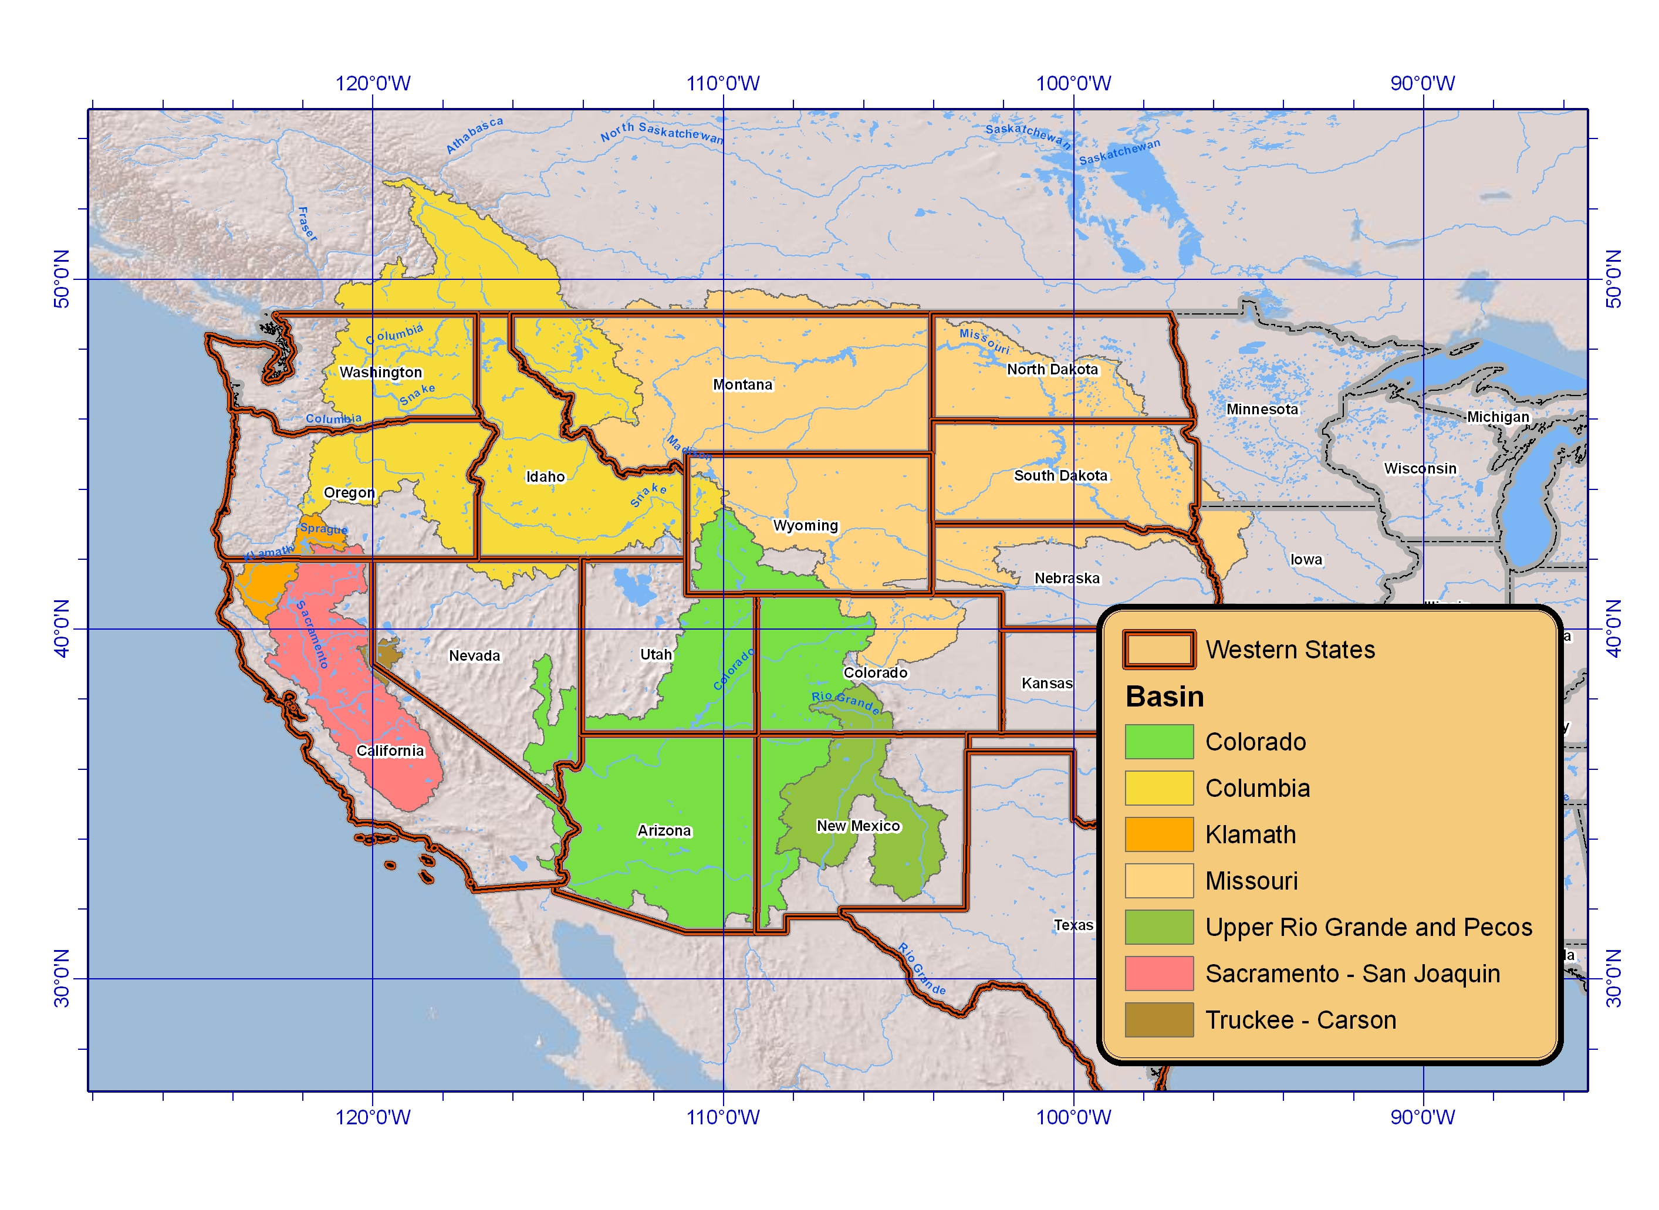
Background
Public Law 111-11, Subtitle F (SECURE Water Act, SWA, 2009) § 9503.
Climate change risks for water and environmental resources in “major Reclamation river basins.”
Reclamation’s WaterSMART (Sustain and Manage America’s Resources for Tomorrow) Basin Study Program
  Basin Studies
  West-Wide Climate Risk Assessments (WWCRAs)
  Landscape Conservation Cooperatives (LCCs)
8 major Reclamation River Basin
SECURE – Science and Engineering to Comprehensively Understand and Responsibly Enhance

Slide 3
Reclamation WaterSMART Program
      Comprehensive approach to incorporate the best available science into planning activities for climate change adaptation planning
LCCs
Science / Coordination / Communication
Risks
Impacts
Adaptation / Mitigation
Feasibility
WWCRA
Basin Studies
Notes:
Reclamation Climate Change and Water Program has four main components:
Coordinating Federal agencies, tribes, states, NGO and other stakeholders
Enhancing climate science
Assessing the risks and impacts of climate change to water resources
Implementing mitigation and adaptation strategies
WWCRA – associated with global climate change
Quantity of water
Impact on operations
Basin Studies evaluating
Present and futures water needs
Incorporating potential impacts to operations
LCCs is about developing and sharing science so that resource managers may address the impacts

Slide 4
Outline
West-Wide Climate Risk Assessments (WWCRAs) - foundation for Basin Studies
Santa Ana Watershed Basin Study – surface water and groundwater hydrologic projections
Reclamation Hydroclimate Datasets and Tools – Program Management Office (PMO), and the Science and Technology (S&T) Program

Slide 5
West-wide Climate Risk Assessments
West-Wide Climate Risk Assessments (WWCRAs) - foundation for Basin Studies
Santa Ana Watershed Basin Study – surface water and groundwater hydrologic projections
Reclamation Hydroclimate Datasets and Tools - PMO and S&T

Slide 6
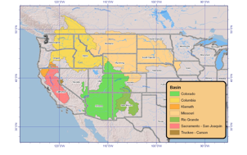
SECURE Water Act, 2009
Risks
  Change in snowpack
  Groundwater recharge and discharge
  Increases in water demand or reservoir evaporation as result of increasing temperature
Impacts
  Ability to deliver water
  Hydroelectric power generation
  Recreation at Reclamation facilities
  Fish and wildlife habitat
  Endangered, threatened, candidate species
  Water quality issues
  Flow dependent ecological resiliency
  Flood control management

Slide 7
West Wide Climate Risk Assessments
Baseline Assessments of Risks and Impacts
  Transforming General Circulation Model information into a spatial and temporal scale relevant to a planning context
  Projections of Future Water Supply
  Projections of Future Water Demand
  Simulating future operations of Reclamation facilities
    Hydropower, flood control, … etc.
  Determining Ecosystem Responses and Resiliency
* Consistent approach across 8 major Reclamation River Basins

Slide 8
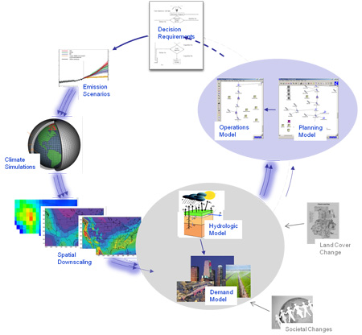
WWCRA Activities
With Stakeholders
e.g. CO Basin Study
CMIP3 &
Updates
FY 2011 Rio Grande
FY 2010 - 2011
BCSD 2008 &
Updates
FY 2011 - 2012

Slide 9
Downscaled GCM Output

Slide 10
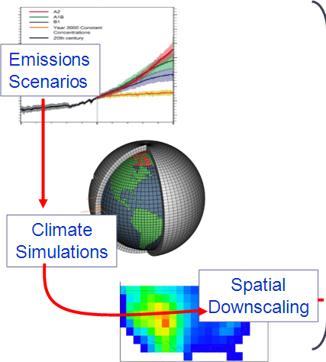
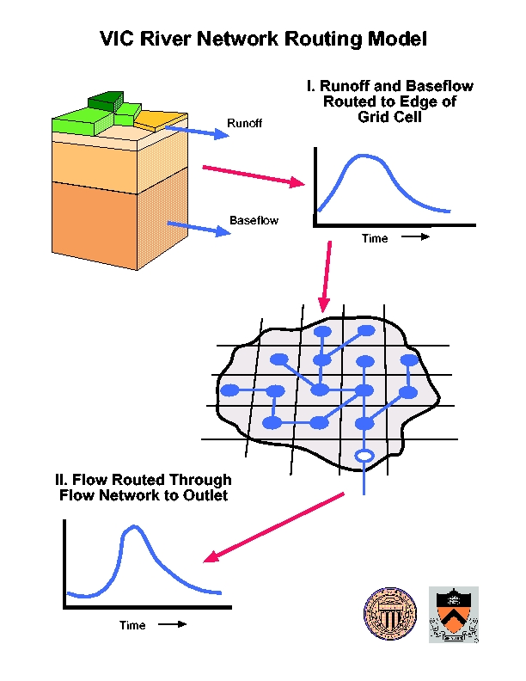
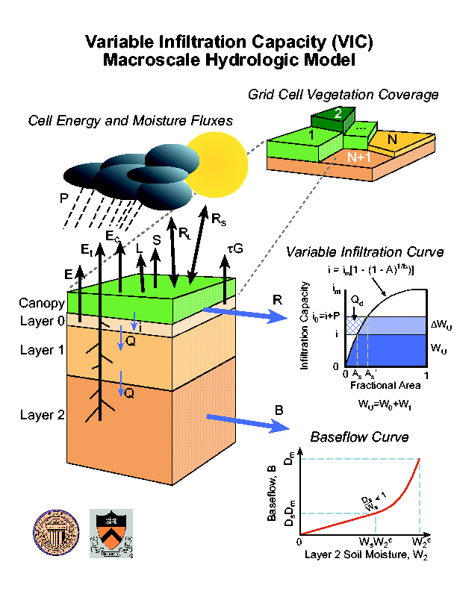
Downscaled GCM Output and Hydrologic Modeling
Streamflow Routing
Land Surface Simulation

Slide 11
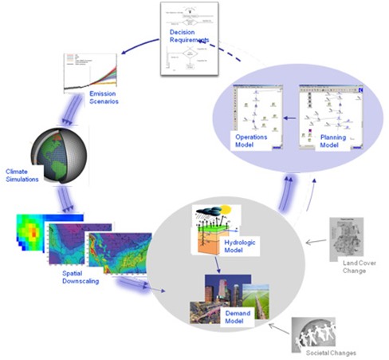
Hydrologic Modeling – VIC Setup, 2 Steps
1.Land Surface Simulation
simulate runoff (and other fluxes) at each grid cell
2. Streamflow Routing
transport runoff from grid cell to outlet

Slide 12
What’s being simulated
112 gridded climate projections → 112 gridded hydrology projections (runoff, swe, et, pet)
Time Period: daily 1950-2099
~36,000 grid cells at 1/8th degree (~12 km) spatial resolution

Slide 13
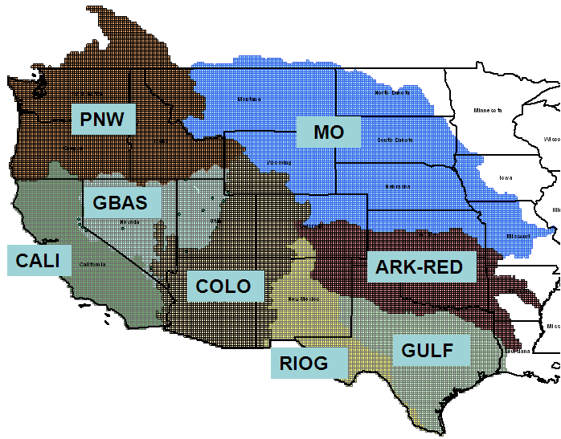
Hydrologic Modeling - VIC Applications

Slide 14
Results - WWCRA
Precipitation and temperature trends
Change in snowpack – SWE
Timing of runoff
For reporting
  43 WWCRA locations spanning the major Reclamation basins
  152 HCDN (Hydroclimate Data Network) sites spanning the western US

Slide 15
Results – West-Wide Summary
Precipitation is expected to increase from the 1990s level during the 2020s and 2050s, but declines nominally during the 2070s.(though the early to middle 21st century increases could be artifacts of the BCSD climate projections development leading to slightly wetter projections).
Temperature shows a persistent increasing trend from the 1990s level.
April 1st SWE shows a persistent decreasing trend from the 1990s level.
Annual runoff shows some increase for the 2020s decade from the 1990s level, but shows decline moving forward to the 2050s and 2070s decade from the 1990s reference, suggesting that although precipitation changes are projected to remain positive through the 2050s, temperature changes begin to offset these precipitation increases leading to net loss in the water balance through increased evapotranspiration losses.
Winter season (December-March) runoff shows an increasing trend.
Spring-summer season (April-July) runoff shows a decreasing trend.
Notes:
Precipitation is expected to increase from the 1990s level during the 2020s and 2050s, but declines nominally during the 2070s.(though the early to middle 21st century increases could be artifacts of the BCSD climate projections development leading to slightly wetter projections).
Temperature shows a persistent increasing trend from the 1990s level.
April 1st SWE shows a persistent decreasing trend from the 1990s level.
Annual runoff shows some increase for the 2020s decade from the 1990s level, but shows decline moving forward to the 2050s and 2070s decade from the 1990s reference, suggesting that although precipitation changes are projected to remain positive through the 2050s, temperature changes begin to offset these precipitation increases leading to net loss in the water balance through increased evapotranspiration losses.
Winter season (December-March) runoff shows an increasing trend.
Spring-summer season (April-July) runoff shows a decreasing trend.

Slide 16
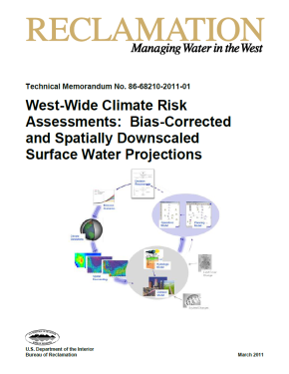
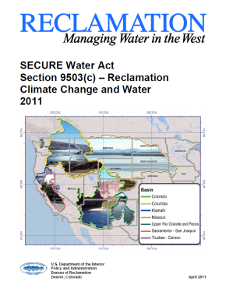
Reporting
http://www.usbr.gov/climate
Report to Congress
Technical Report

Slide 17
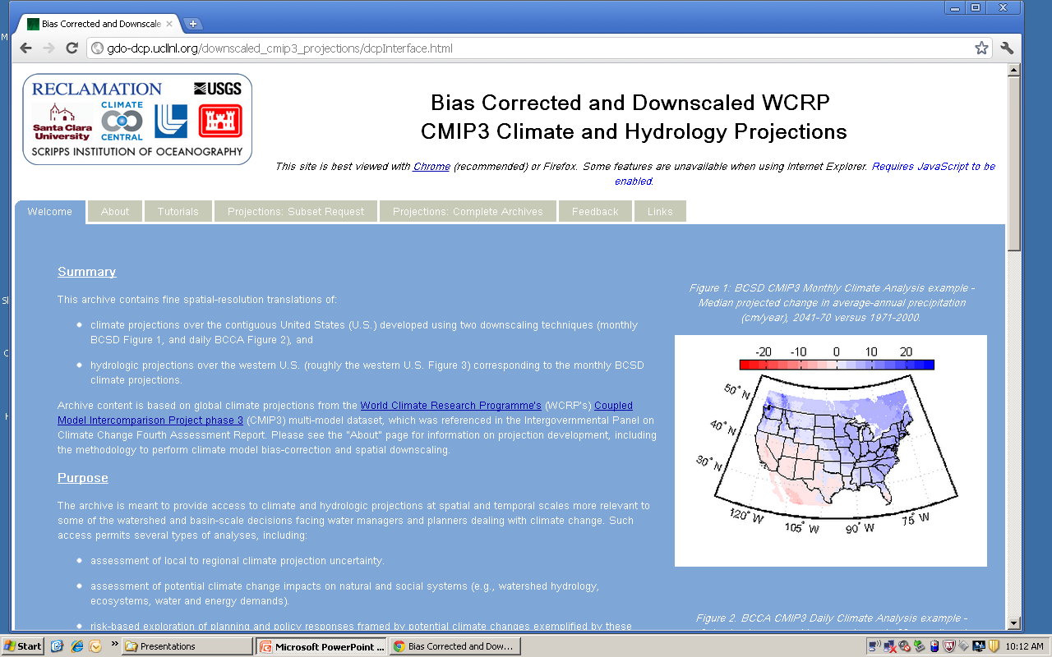
Online Data Access

Slide 18
Data Dissemination
Gridded hydroclimate co-hosted with the current CMIP-3 archive at LLNL
  http://gdo-dcp.ucllnl.org/downscaled_cmip3_projections
Time-series of streamflow projections, Reclamation GIS/WaterSMART website
    http://gis.usbr.gov/streamflow_projections/
American Geophysical Union (AGU) Eos Article describing the online gridded hydroclimate archive (… more than 61,000 Earth and space scientists worldwide …)
Gangopadhyay, S., T. Pruitt, L. Brekke, and D. Raff (2011), Hydrologic projections for the western United States, Eos Trans. AGU, 92(48), 441, doi:10.1029/2011EO480001.

Slide 19
Santa Ana Watershed Basin Study
West-Wide Climate Risk Assessments (WWCRAs) - foundation for Basin Studies
Santa Ana Watershed Basin Study – surface water and groundwater hydrology projections
Reclamation Hydroclimate Datasets and Tools - PMO and S&T

Slide 20
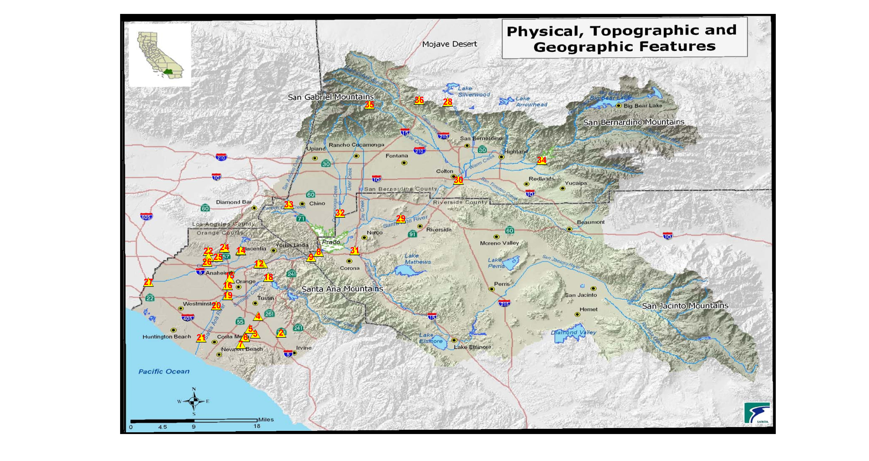
Santa Ana Watershed Basin Study
Water supply projections - Surface Water

Slide 21
Surface Water Hydrology Projections
Outline
Background. Acronyms , definitions, assumptions, and hydrology model overview.
How were the hydrologic projections developed for the Santa Ana Watershed? Detailed description of the hydrologic projections development process, specifically streamflow.
What analysis was done using the hydrology projections? Detailed description of analysis of change and statistics used.
Results. All results are preliminary and draft.
Example analysis. Change in runoff using the hydrologic projections website hosted at Lawrence Livermore National Lab (LLNL).
Summary

Slide 22
Background
Background. Acronyms , definitions, assumptions, and hydrology model overview.
How were the hydrologic projections developed for the Santa Ana Watershed? Detailed description of the hydrologic projections development process, specifically streamflow.
What analysis was done using the hydrology projections? Detailed description of analysis of change and statistics used.
Results. All results are preliminary and draft.
Example analysis. Change in runoff using the hydrologic projections website hosted at Lawrence Livermore National Lab (LLNL).
Summary

Slide 23
Acronyms
VIC – Variable Infiltration Capacity Model. Hydrology model.
BCSD – Bias Corrected and Spatially Downscaled. Statistical method of developing hydrology model inputs (precipitation and temperature) from global climate model (GCM) runs.
CMIP-3 – Coupled Model Intercomparison Project, Phase 3. Most current global climate model runs.
WWCRA – West-Wide Climate Risk Assessments (an activity under Reclamation’s WaterSMART program). First SECURE Water Act report - West-wide effort to develop gridded hydrology.

Slide 24
Definitions
Bias - statistical term meaning a systematic (not random) deviation from the true value.
Ensemble – set of model (e.g., climate or hydrology) runs based on different initial conditions, forcings, and model physics. The result of each model run is called an Ensemble member.
Median - the median is the value that has just as many values above it as below it (50th percentile). Measure of central tendency.
Runoff – for a gridded hydrology model, is the surface flow (surface runoff) or base flow (sub-surface runoff). Total runoff is the sum of surface and sub-surface runoff.
Streamflow – cumulative runoff at a gage location derived by routing water through a channel network.
Ensemble Median – median calculated from all the individual ensemble members.
Re-sampling – replicating sample data based on a specified pattern.

Slide 25
Assumptions
10-year base or reference hydrology period, water years 1990-1999. 1990s.
Three (3) future look ahead periods:
  water years 2020-2029. 2020s.
  water years 2050-2059. 2050s.
  water years 2070-2079. 2070s.

Slide 26
Hydrologic Modeling – VIC Setup, 2 Steps
1.Land Surface Simulation
simulate runoff (and other fluxes) at each grid cell
2. Streamflow Routing
transport runoff from grid cell to outlet

Slide 27
Hydrologic Modeling - VIC
Calibrated to reproduce monthly to annual runoff in large sub-basins.
These models have biases.
Relative change in runoff at monthly to annual time-scales

Slide 28
How were the hydrologic projections developed for the Santa Ana Watershed?
Background. Acronyms , definitions, assumptions, and hydrology model overview.
How were the hydrologic projections developed for the Santa Ana Watershed? Detailed description of the hydrologic projections development process, specifically streamflow.
What analysis was done using the hydrology projections? Detailed description of analysis of change and statistics used.
Results. All results are preliminary and draft.
Example analysis. Change in runoff using the hydrologic projections website hosted at Lawrence Livermore National Lab (LLNL).
Summary

Slide 29
How were the hydrologic projections developed for the Santa Ana Watershed?
Steps in the hydrology projections development process.
  Development of VIC input datasets from the BCSD-CMIP-3 archive
  Identification of key locations in the Basin, sub-basins
  Sub-basin delineation
  Developing the VIC routing models
  Flow routing using WWCRA gridded runoff

Slide 30
Step 1: Development of VIC input datasets from the BCSD-CMIP-3 archive
Daily precipitation (PRCP), minimum temperature (TMIN), maximum temperature (TMAX), and wind speed (WIND) – daily forcings
Source of historical daily forcings (PRCP, TMIN, TMAX, WIND) data - Maurer et al. (2002) [1950-1999], and subsequent extensions.
For each grid cell daily forcing starting on January 1, 1950, and going out to December 31, 2099 developed based on re-sampling of BCSD-CMIP-3 projections from historical daily forcings data (Step 2, above).

Slide 31
Step 2: Identification of key locations in the Basin

Slide 33
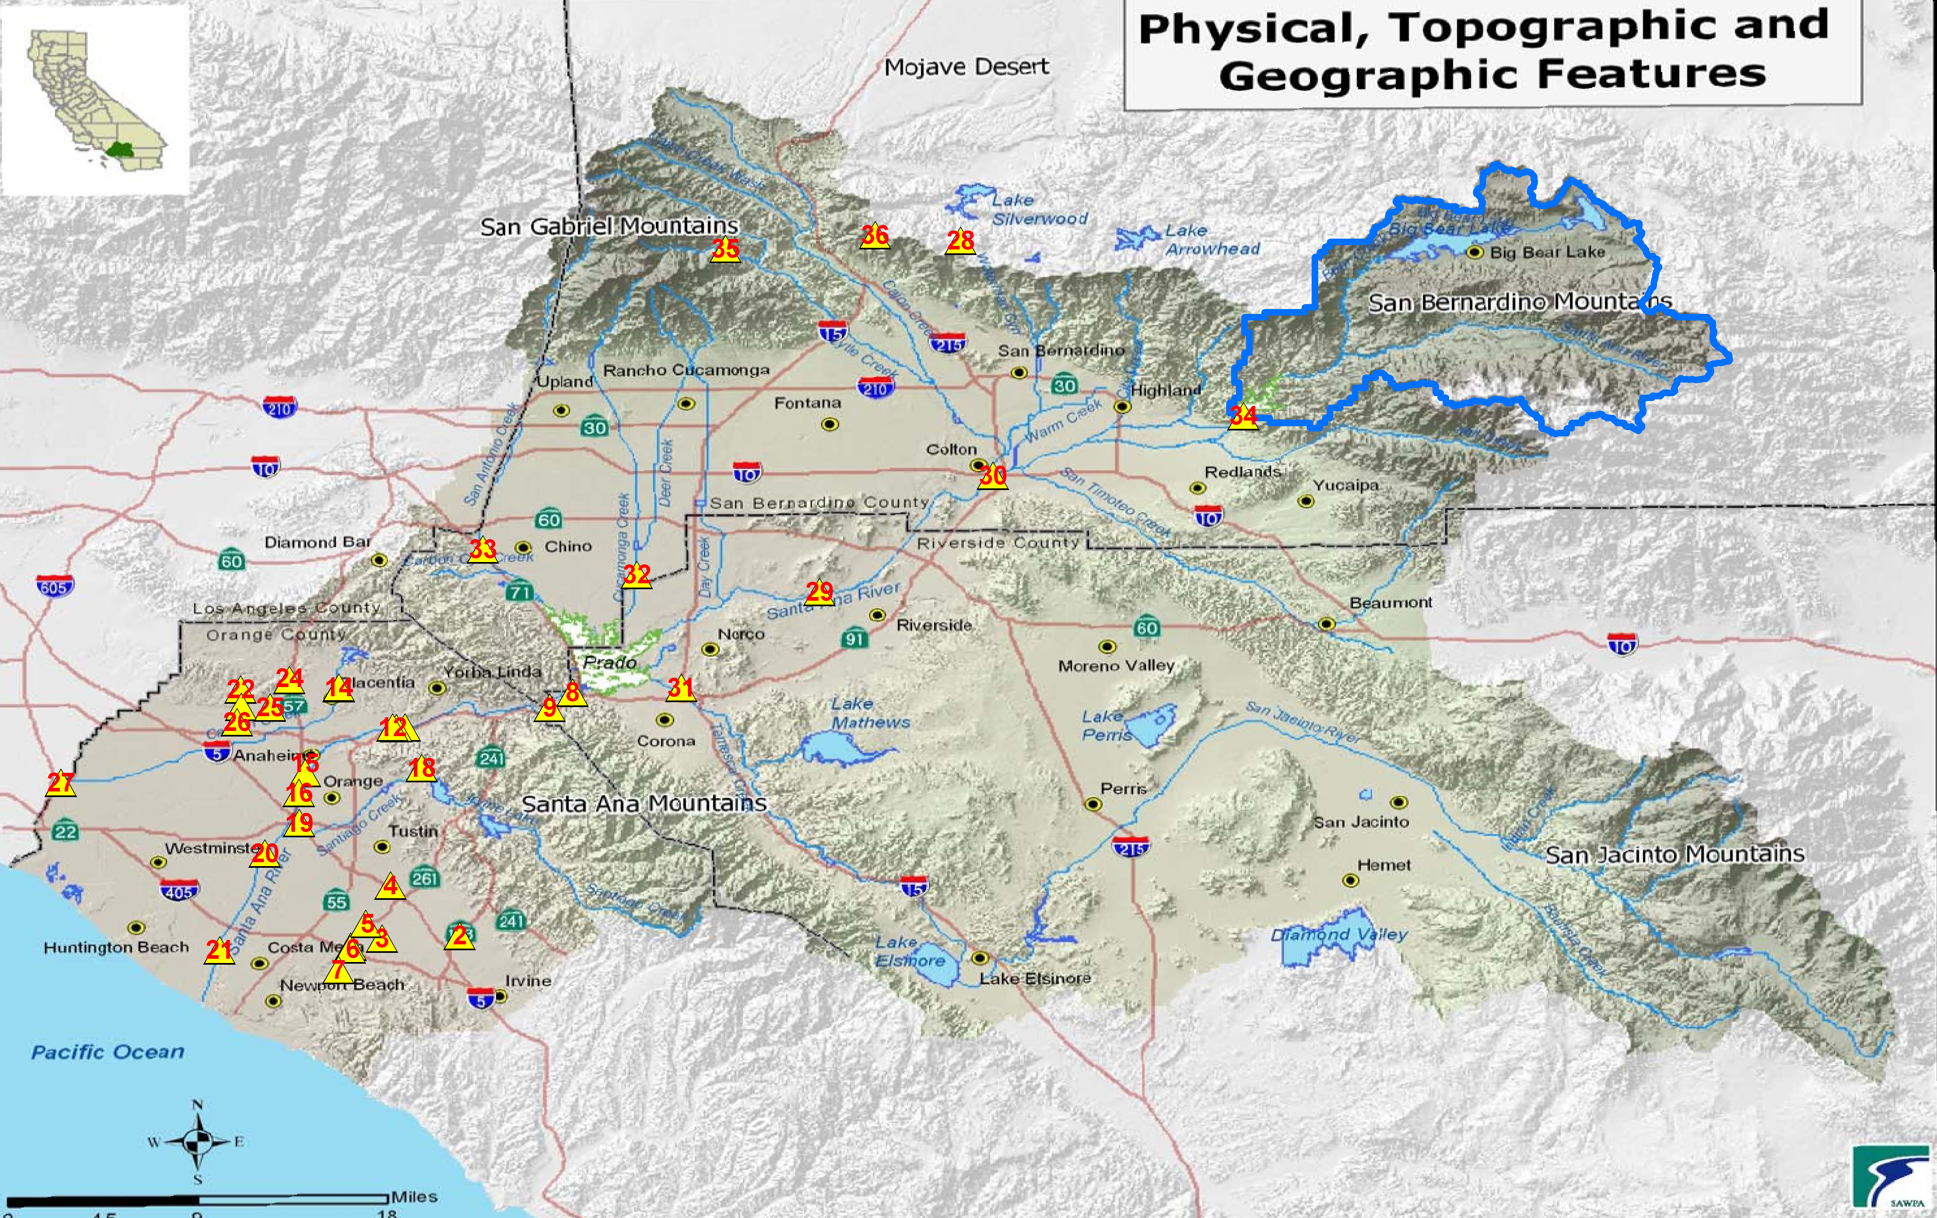
  Step 3: Sub-basin delineation Seven Oaks Dam Outlet

Slide 34
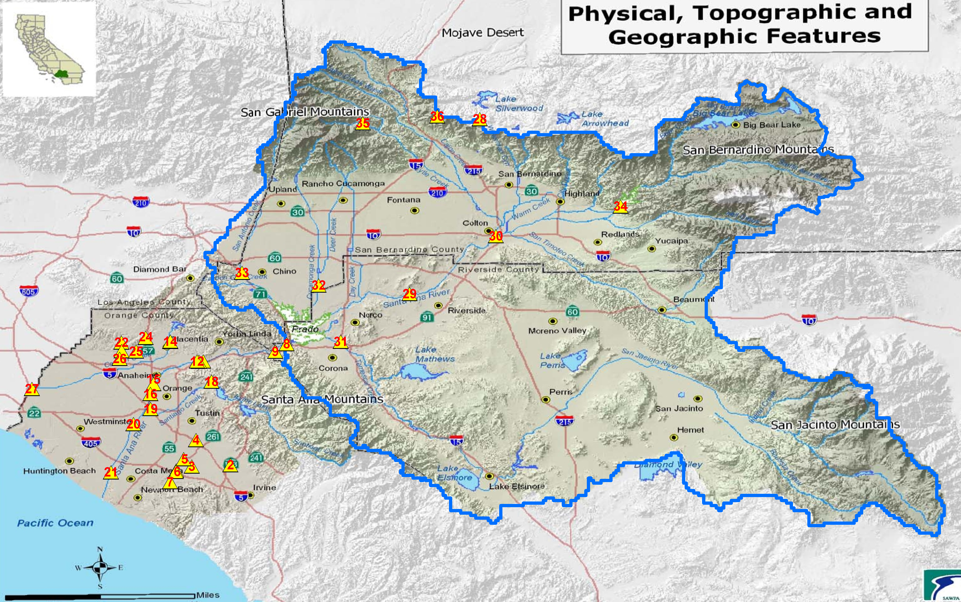
  Step 3: Sub-basin delineation Prado Dam Gage

Slide 35
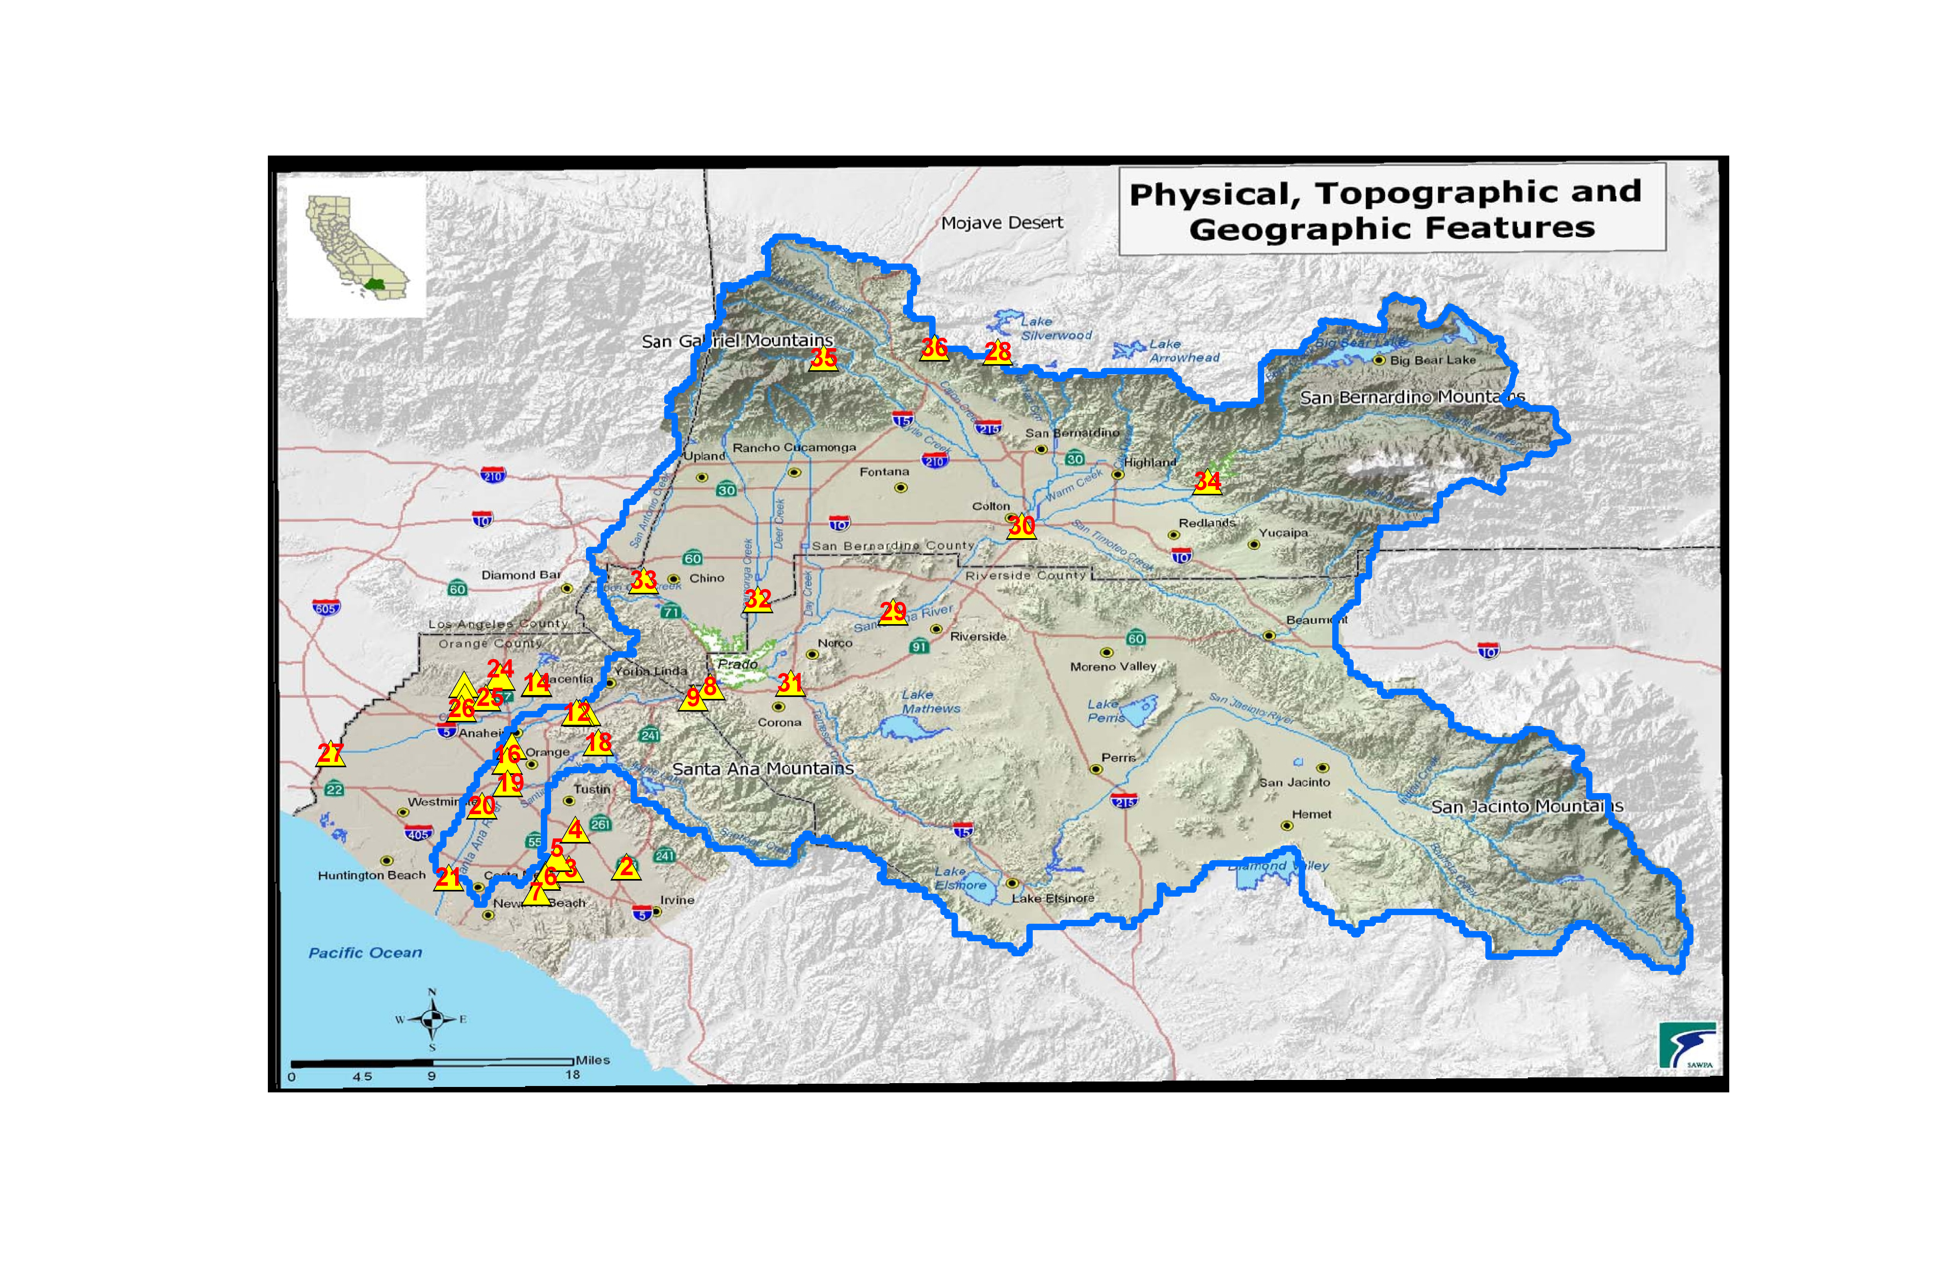
  Step 3: Sub-basin delineation
  Adams Street Gage

Slide 36
Step 4: Developing the VIC routing models
  Consists of two parts
  Developing flow direction files - represent the flow network
  Developing flow fraction files – fraction of grid cell covered by the sub-basin
  Use Santa Ana River Adams Street Gage as the example

Slide 37
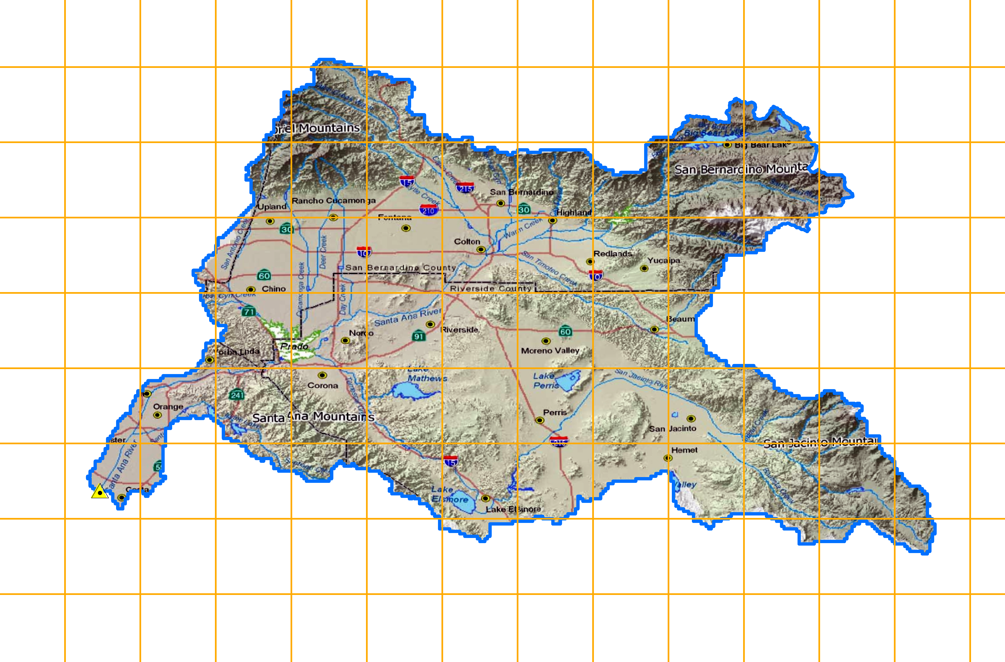
Step 4: Developing the VIC routing models
Adams Street Gage
Developing flow direction files - represent the flow network
Model grid, 1/8th degree x 1/8th degree (lat x lon) ~7 mi x 7 mi or ~ 12 km x 12 km
~7 mi
~7 mi

Slide 38
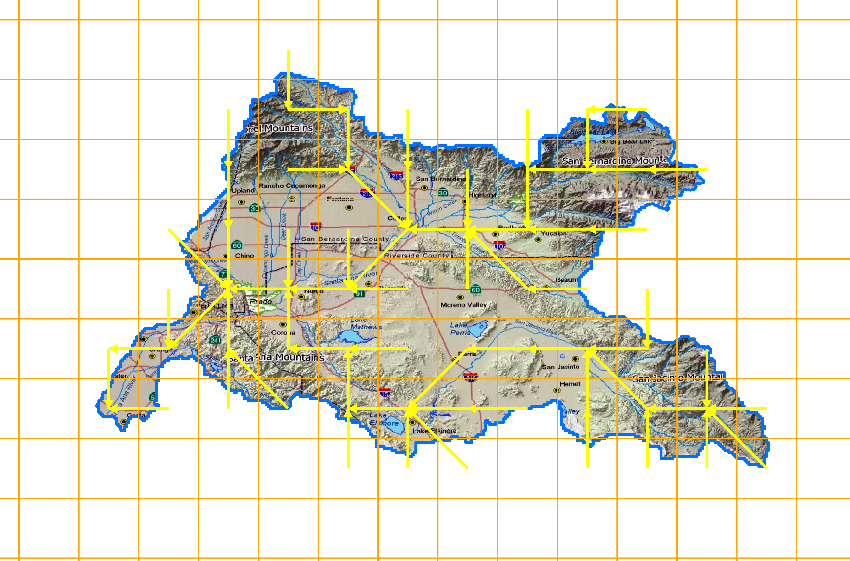
Step 4: Developing the VIC routing models
Adams Street Gage
Developing flow direction files - represent the flow network
Model grid, 1/8th degree x 1/8th degree (lat x lon) ~7 mi x 7 mi or ~ 12 km x 12 km
One of eight (8) flow direction assigned to each grid, USGS HydroSHEDS data, http://hydrosheds.cr.usgs.gov/
~7 mi
~7 mi
~7 mi
~7 mi

Slide 39
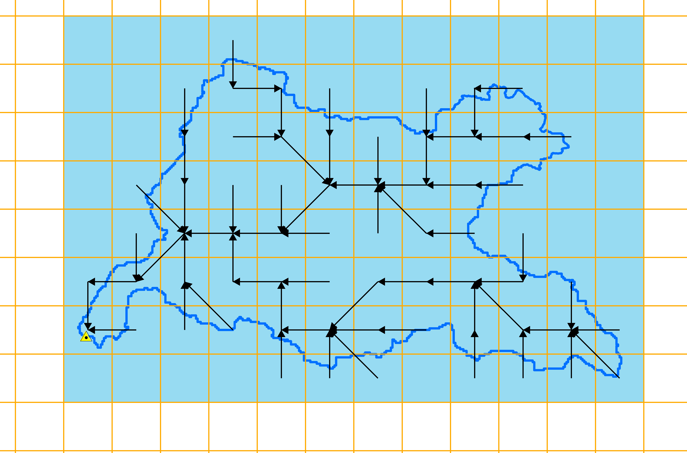
Step 4: Developing the VIC routing models
Adams Street Gage
ncols 12
nrows 8
xllcorner -118.0
yllcorner 33.5
cellsize 0.125
NODATA_value 0
0 0 0 5 0 0 0 0 0 0 0 0
0 0 5 3 5 5 0 5 5 7 0 0
0 0 5 3 4 5 5 5 7 7 7 0
0 4 5 5 5 6 7 7 7 7 0 0
0 5 6 7 7 7 1 8 7 5 0 0
5 7 1 1 7 7 6 7 7 7 5 0 -9 7 1 8 1 7 7 7 1 8 7 7
0 0 0 0 1 1 8 0 1 1 1 8
~7 mi
~7 mi
Basin outlet represented by -9
Similar flow direction files were developed for all
the 36 sites in the Santa Ana River Basin

Slide 40
Step 4: Developing the VIC routing models
  Consists of two parts
  Developing flow direction files - represent the flow network
  Developing flow fraction files – fraction of grid cell covered by the sub-basin
  Use Santa Ana River Adams Street Gage as the example

Slide 41
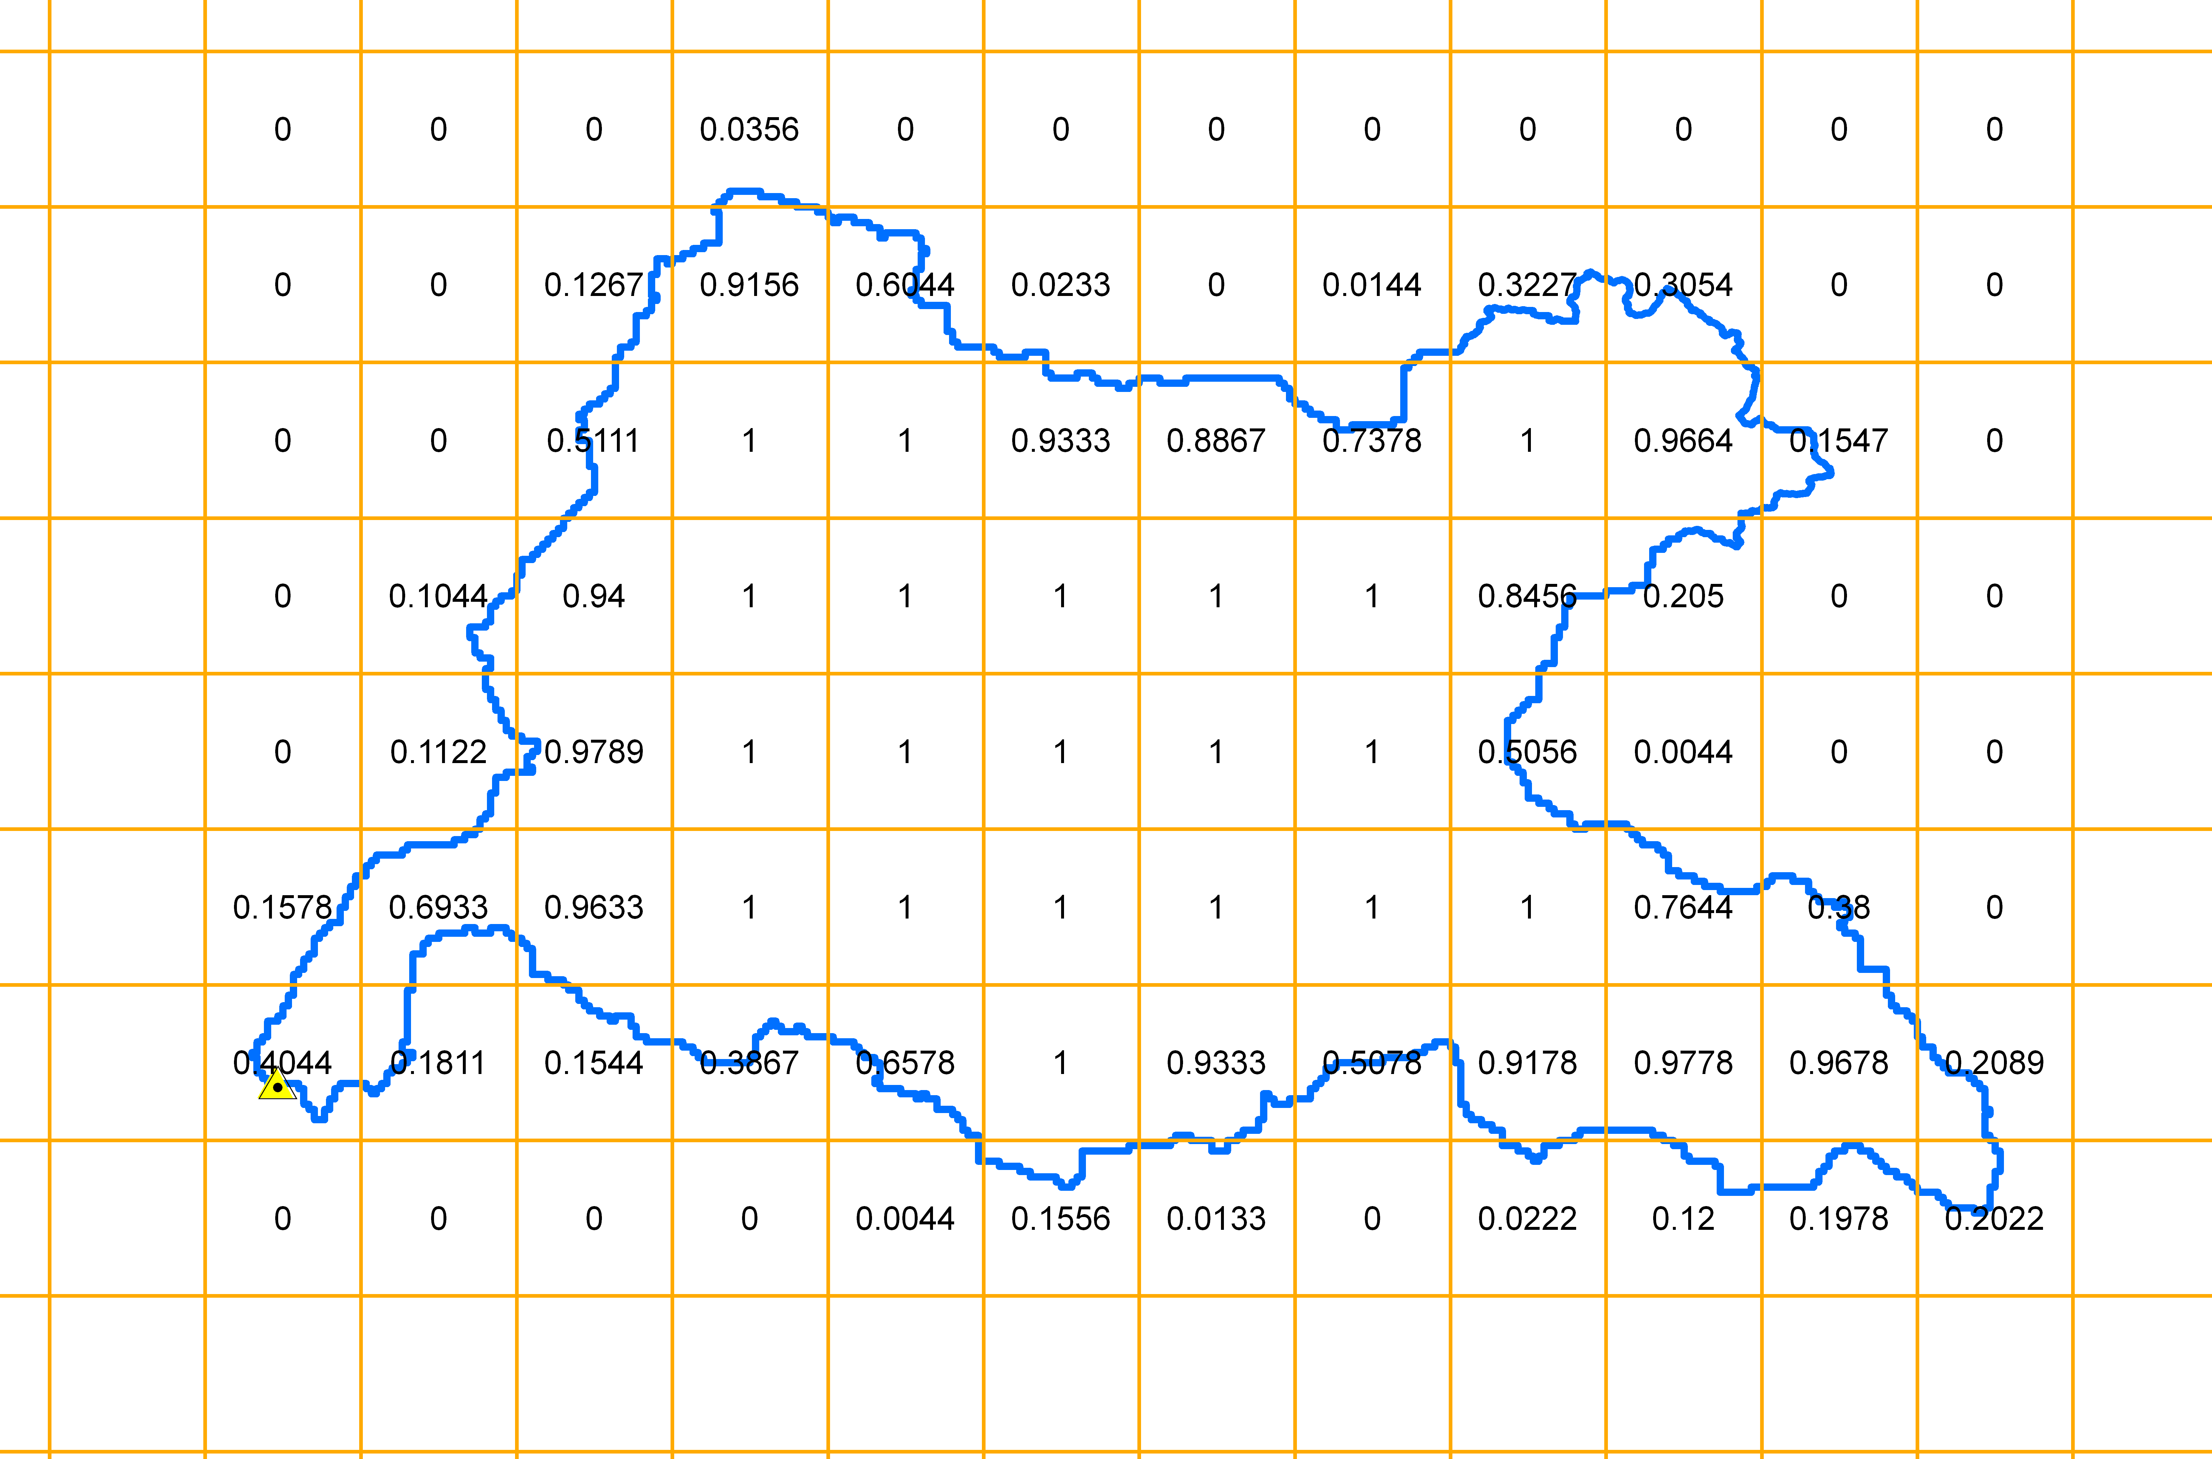
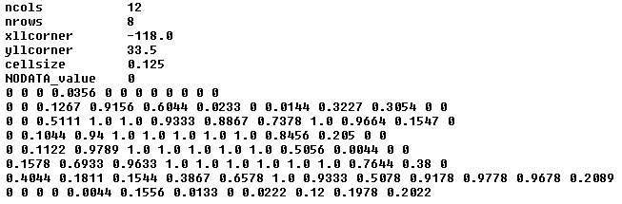
Step 4: Developing the VIC routing models
Adams Street Gage
Fraction of grid cell covered by the sub-basin, total = 40.2063
Similar flow fraction files were developed for all the 36 sites in the Santa Ana Basin

Slide 42

Step 5: Flow routing using the WWCRA gridded runoff
VIC Routing Model
~36,000 grid cells
BCSD Climate and Hydrology Projections Website
http://gdo-dcp.ucllnl.org/downscaled_cmip3_projections/dcpInterface.html
Santa Ana River Adams St. Gage

Slide 43
What analysis was done using the hydrology projections?
Background. Acronyms , definitions, assumptions, and hydrology model overview.
How were the hydrologic projections developed for the Santa Ana Watershed? Detailed description of the hydrologic projections development process, specifically streamflow.
What analysis was done using the hydrology projections? Detailed description of analysis of change and statistics used.
Results. All results are preliminary and draft.
Example analysis. Change in runoff using the hydrologic projections website hosted at Lawrence Livermore National Lab (LLNL).
Summary

Slide 44
Assumptions
10-year base or reference hydrology period, water years 1990-1999. 1990s.
Three (3) future look ahead periods:
  water years 2020-2029. 2020s.
  water years 2050-2059. 2050s.
  water years 2070-2079. 2070s.
All analysis are made using modeled data from 112 BCSD CMIP-3 projections and VIC simulations.

Slide 45
Hydrology Projections
Analysis
  Change analysis between the base period (1990s) and future period (2020s, 2050s, 2070s), how were the changes calculated?
  Precipitation – percentage (%) change. Steps - for example to estimate change in the 2020s from the 1990s. For a given grid cell in the Basin, and given projection [iproj] (recall, total number of projections is 112)
    Calculate decade mean total precipitation (P) for the two decades 1990s (water years 1990-1999, iper=1) and 2020s (water years 2020-2029, iper=2).
    Next , calculate percentage change (pchange) of projection iproj,
    pchange[iproj]=100*((P[iproj, 2] - P[iproj,1])/P[iproj,1])
    Finally, calculate the median change from all the 112 projections - ensemble median change.
    Repeat Steps 1 through 3 for all the grid cells in the Basin.

Slide 46
Hydrology Projections
Analysis
  Change analysis between the base period (1990s) and future period (2020s, 2050s, 2070s), how were the changes calculated?
  Snow Water Equivalent (SWE) – calculations similar to precipitation.
  Temperature (T) – steps similar to precipitation but not percentage change,
    Calculate decade mean temperature (T) for the two decades 1990s (water years 1990-1999, iper=1) and 2020s (water years 2020-2029, iper=2).
    Next , calculate change in decade mean temperature value for projection iproj,
  change = (T[iproj, 2] - T[iproj,1])
    Finally, calculate the median change from all the 112 projections - ensemble median change.
    Repeat Steps 1 through 3 for all the grid cells in the Basin.
  More details/examples during presentation of results in subsequent slides. …

Slide 47
Results
Background. Acronyms , definitions, assumptions, and hydrology model overview.
How were the hydrologic projections developed for the Santa Ana Watershed? Detailed description of the hydrologic projections development process, specifically streamflow.
What analysis was done using the hydrology projections? Detailed description of analysis of change and statistics used.
Results. All results are preliminary and draft.
Example analysis. Change in runoff using the hydrologic projections website hosted at Lawrence Livermore National Lab (LLNL).
Summary

Slide 48
Hydrology Projections
Results
Change analysis between the base/reference period (1990s) and three future periods (2020s, 2050s, 2070s)
  Precipitation
  Temperature
  April 1st SWE
  Flow
Spatial distribution and temporal trends
Santa Ana R. Adams St. Gage

Slide 49
Hydrology Projections
Spatial Distribution of Precipitation (P)
The ensemble- median change shows some increase in prcp over the basin during the 2020s’ decade from the 1990s’ reference.
By the 2050s there is decline in prcp from the 1990s reference decade.
Increased decline in prcp continues through to the 2070s decade from the 1990s reference decade.

Slide 50
Hydrology Projections
Spatial Distribution of Temperature (T)
The ensemble median change for the 2020s’, 2050s’, and 2070s’ decades relative to the 1990s shows an increasing temperature value throughout the Basin.

Slide 51
Hydrology Projections
Snow Water Equivalent (SWE)
Spatial distribution of April 1st SWE – persistent decline through the future decades (2020s, 2050s, 2070s) from the 1990s’ distribution.

Slide 52
Hydrology Projections
P, T, SWE, Flow
Temporal trends – solid line is the median, 5th and 95th percentile bounds.
P – longer-term decreasing trend
T- increasing trend
SWE - decreasing trend
Flow – longer-term decreasing trend

Slide 53
Hydrology Projections
Flow Impacts
Annual and seasonal streamflow impacts
2020s – increase in annual runoff and winter (Dec-Mar) runoff, decrease in spring-summer (Apr-Jul) runoff from the 1990s reference
2050s – decrease in annual, winter, spring-summer runoff from the 1990s reference
2070s - decrease in annual, winter, spring-summer runoff from the 1990s reference

Slide 54
Summary of Impacts
Santa Ana River Adams St. Gage
Similar analysis was done for all the 36 sites in the Santa Ana Basin

Slide 55
Example ANALYSIS
Background. Acronyms , definitions, assumptions, and hydrology model overview.
How were the hydrologic projections developed for the Santa Ana Watershed? Detailed description of the hydrologic projections development process, specifically streamflow.
What analysis was done using the hydrology projections? Detailed description of analysis of change and statistics used.
Results. All results are preliminary and draft.
Example analysis. Change in runoff using the hydrologic projections website hosted at Lawrence Livermore National Lab (LLNL).
Summary

Slide 56
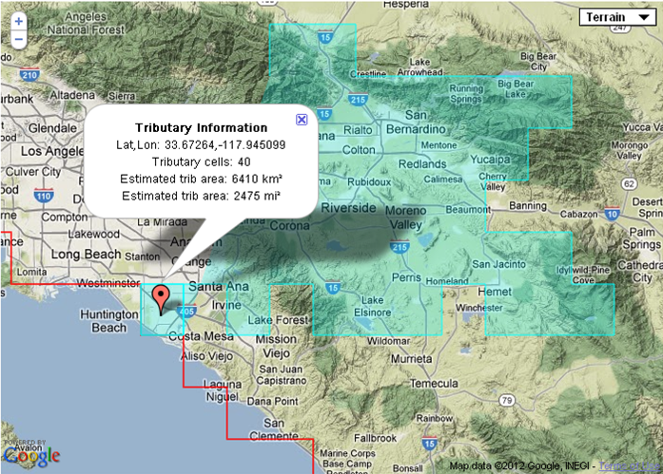
Example: Runoff Impact
Santa Ana R. Adams St. Gage
http://gdo-dcp.ucllnl.org/downscaled_cmip3_projections/dcpInterface.html

Slide 57
Summary
Background. Acronyms , definitions, assumptions, and hydrology model overview.
How were the hydrologic projections developed for the Santa Ana Watershed? Detailed description of the hydrologic projections development process, specifically streamflow.
What analysis was done using the hydrology projections? Detailed description of analysis of change and statistics used.
Results. All results are preliminary and draft.
Example analysis. Change in runoff using the hydrologic projections website hosted at Lawrence Livermore National Lab (LLNL).
Summary

Slide 58
Summary
Developed hydrologic projections from climate change projections for the Santa Ana Watershed. 36 sites across the Santa Ana Basin.
Analyzed the hydrologic projections to support updating of the IRWMP plan, i.e. OWOW 2.0.
Example analysis on how runoff impacts can be calculated from the WWCRA gridded hydrology.

Slide 59
Santa Ana Watershed Basin Study
Water supply projections - Groundwater

Slide 60
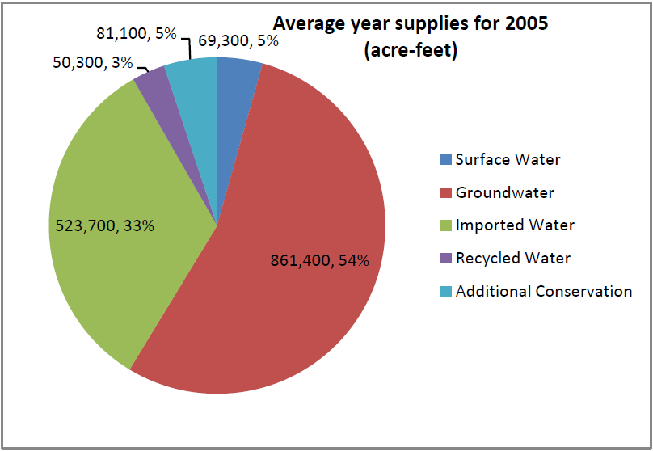
Introduction
Groundwater is the single largest water source within the Santa Ana Watershed
SAWPA 2010

Slide 61
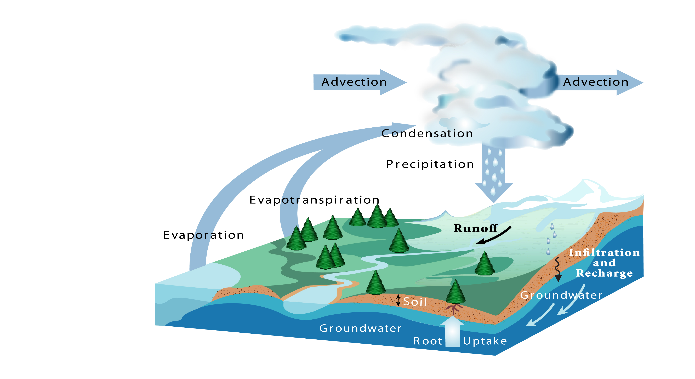
Introduction
Climate change will affect the hydrologic processes that govern water resources – including groundwater

Slide 62
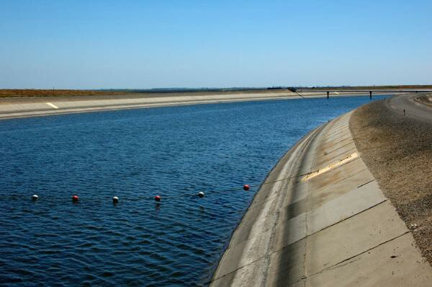
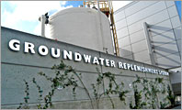
Introduction
The objective of this work is to
Develop a simplified modeling framework for evaluating climate change impacts on groundwater levels
Apply this framework to evaluate potential impacts of climate change, as well as mitigation/adaptation alternatives

Slide 63
Outline
Brief overview of “traditional” groundwater modeling
Development of simplified modeling framework
Model input data and pre-processing
Preliminary results
Ongoing work

Slide 64
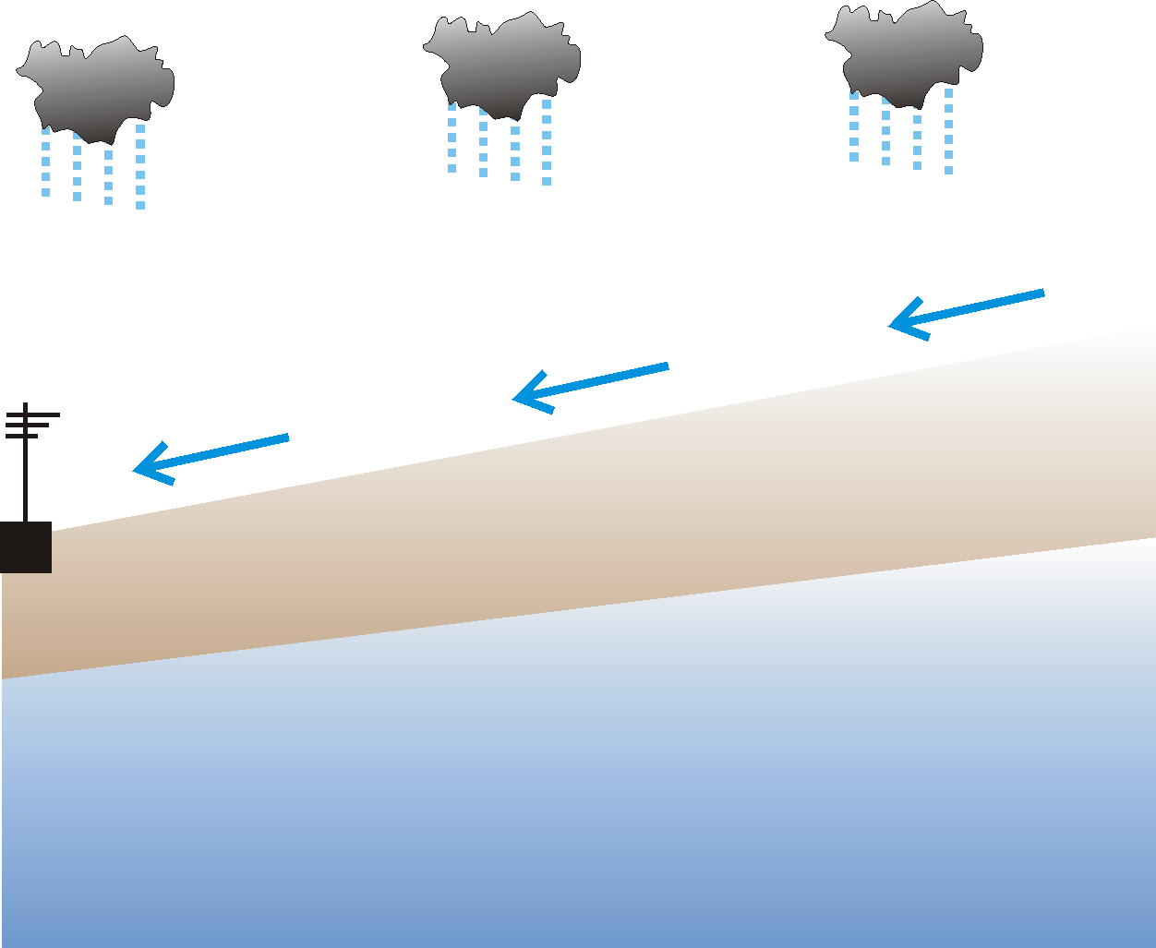
“Traditional” Groundwater Modeling
Climate
Streamflow
Vegetation, Root Zone, Vadose Zone
& Managed Recharge
Abstraction
Recharge
Sub-surface
Parameters +
Boundary Conditions
Groundwater
(Flow, Storage, Head, Etc.)

Slide 65
“Traditional” Groundwater Modeling
Advantages
  Explicitly considers all groundwater inflows and outflows – e.g., recharge, loss, abstraction, etc.
  Spatially distributed (gridded) information – e.g., change in water table distribution
Disadvantages
  Data requirements – spatially distributed climate, vegetation, land cover/use, soils, geology, etc., etc.
  Computational expense – pre-processing to compute recharge, model calibration, simulation of 2D/3D flow
  Accumulation of uncertainties during each step

Slide 66
Simplified Modeling Framework
Supply (Inputs)
Precipitation
Streamflow
Imports
Demand (Outputs)
M&I
Agriculture
Potential ET
Change in Water Table Elevation
Storage

Slide 67
Simplified Modeling Framework
ΔS = Inputs - Outputs
f{Precipitation}
+
f{Streamflow}
+
f{Imports}
f{Potential ET}
+
f{M&I Demand}
+
f{Ag Demand}
Change in Basin-Average GW Elevation
=
-

Slide 68
Simplified Modeling Framework
ΔS = Inputs - Outputs
ΔS ≈ Change in Basin-Average Groundwater Elevation
Fluctuation in groundwater levels represents change in groundwater storage
But…
Does not require specific information regarding soil properties (porosity, permeability, specific yield)
Does not require actual volume of groundwater gains (recharge) and losses (abstraction, baseflow, ET, etc.)

Slide 69
Simplified Modeling Framework
ΔS = Inputs - Outputs
Inputs ≈ f{precipitation}
+ f{streamflow}
+ f{imports}
Precipitation – contributes to recharge within basin;
reduces GW abstraction for irrigation
Streamflow – may contribute to recharge within basin;
SW use reduces GW abstraction;
SW may be used for recharge
Imports – imports reduce GW abstraction;
imports may be used for managed recharge

Slide 70
Simplified Modeling Framework
ΔS = Inputs - Outputs
Outputs ≈ f{Potential ET}
+ f{M&I Demand}
+ f{Ag Demand}
Potential ET – high evaporative demand increases water use by natural, landscaping, & agricultural; reduces recharge
M&I Demand – high demand increases abstraction; decreases SW available for recharge
Ag Demand – high demand increases abstraction; decreases SW available for recharge

Slide 71
Simplified Modeling Framework
Representative Quantities
Inputs ≈ f{precipitation}
+ f{streamflow}
+ f{imports}
Outputs ≈ f{Potential ET}
+ f{M&I Demand}
+ f{Ag Demand}
The use of standardized representative values – rather than actual volumes – for each term significantly reduces data collection and pre-processing requirements and provides a more flexible modeling framework

Slide 72
Simplified Modeling Framework
Model Formulation:
Autoregressive + Multiple Linear Regression

Slide 73
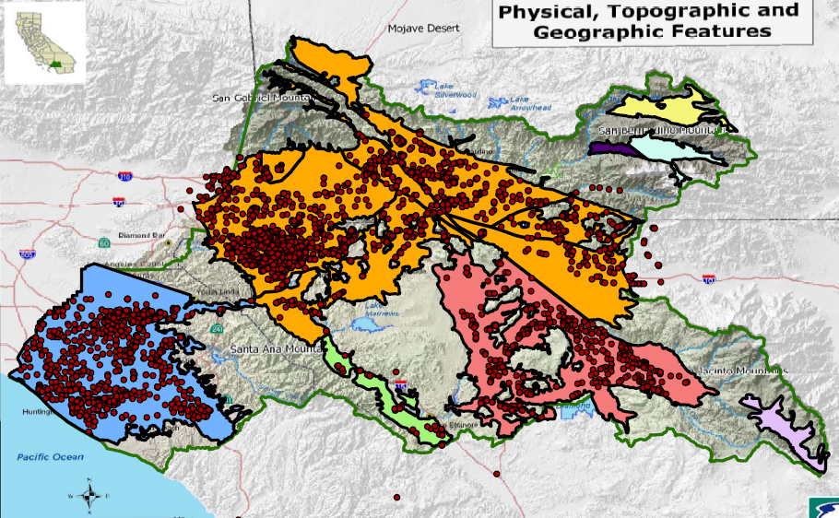
Data Collection & Pre-Processing
Groundwater Elevation
  Source: SAWPA groundwater database

Slide 74
Data Collection & Pre-Processing
Groundwater Elevation
  Eliminate records with greater than 50% missing (by month)
  Eliminate individual outlier points
  Compute monthly mean GW levels for all months in record
  Interpolate to fill missing data (no extrapolation)
495 well records over
four groundwater basins

Slide 75
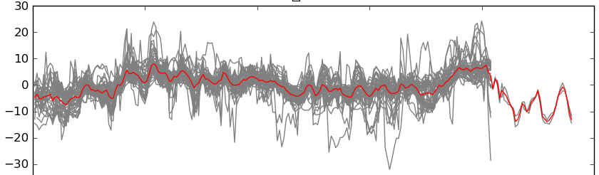
Data Collection & Pre-Processing
Groundwater Elevation
  Clustering routine to identify wells with similar behavior
1990
1995
2000
2005
2010

Slide 76
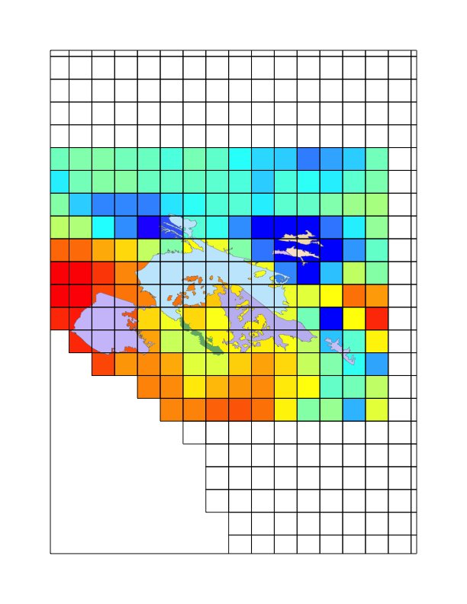
Data Collection & Pre-Processing
Basin-Average Precipitation & Potential ET
  Weighted average of gridded historical datasets over individual groundwater basins
  Source: Maurer et al. (2002) gridded climate dataset;
  Reclamation (2011) hydrologic simulations (PET)

Slide 77
Data Collection & Pre-Processing
Streamflow
  Simulated natural streamflow at selected locations
  Source: Reclamation (2011) hydrologic simulations

Slide 78
Data Collection & Pre-Processing
M&I Demand
  Population x Per Capita Demand
  Sources: population – Census tract data;
  per capita demand – 2000 & 2010 UWMPs

Slide 79
Data Collection & Pre-Processing
M&I Demand
  Population x Per Capita Demand
  Sources: population – Census tract data;
  per capita demand – 2000 & 2010 UWMPs
Population Growth
Conservation

Slide 80
Data Collection & Pre-Processing
Agricultural Demand
  Irrigated acreage as surrogate for irrigation water demand
  Source: SCAG land use database

Slide 81
Data Collection & Pre-Processing
Augmented Supplies – Imports & Reuse
  Incomplete…Ongoing …
  Source: 2000 & 2010 UWMPs (insufficient data)

Slide 82
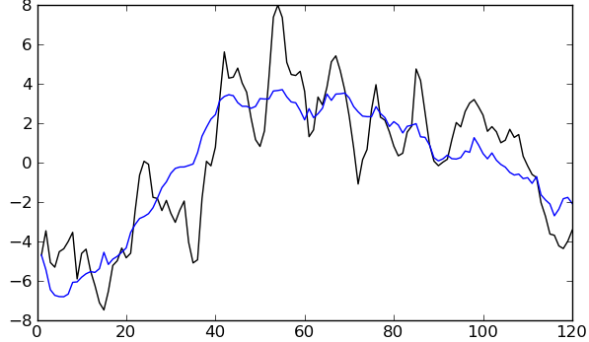
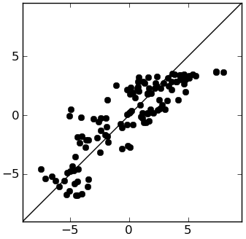
Preliminary Results
8-1: Coastal Plain of Orange County
  199 wells
  20 independent well clusters (1-51 wells/cluster)
Cluster 01 (N=51)
R² = 0.74
GW Anomaly (mm)
Simulated
Time (months since 01/1990)
Observed

Slide 83
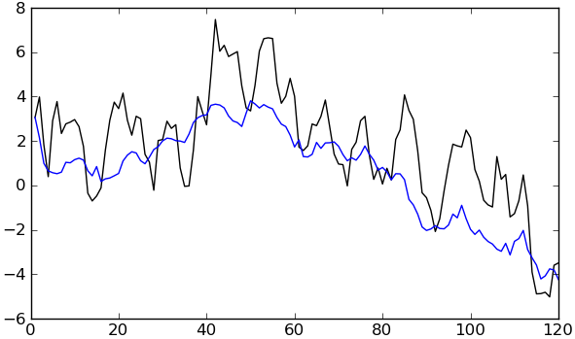
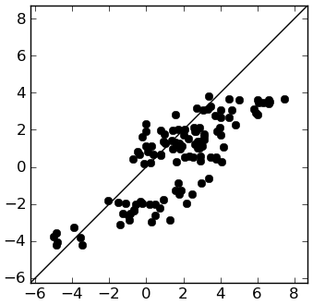
Preliminary Results
8-1: Coastal Plain of Orange County
  199 wells
  20 independent well clusters (1-125 wells/cluster)
Cluster 02 (N=42)
R² = 0.64
GW Anomaly (mm)
Simulated
Time (months since 01/1990)
Observed

Slide 84
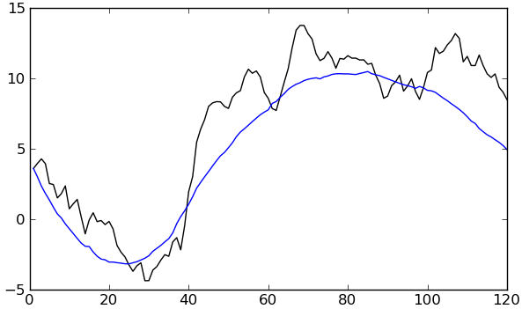
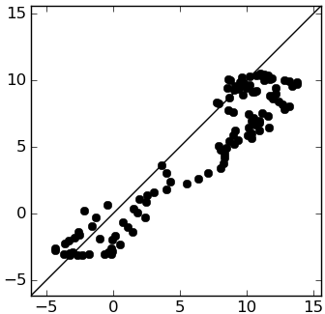
Preliminary Results
8-2: Upper Santa Ana Valley
  284 wells
  10 independent well clusters (1-125 wells/cluster)
Cluster 01 (N=125)
R² = 0.88
GW Anomaly (mm)
Simulated
Time (months since 01/1990)
Observed

Slide 85
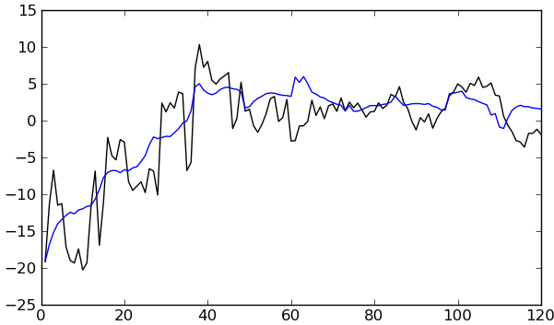
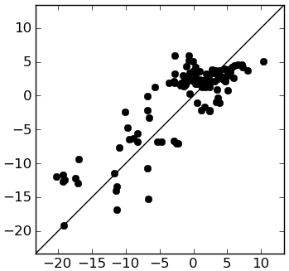
Preliminary Results
8-2: Upper Santa Ana Valley
  284 wells
  10 independent well clusters (1-125 wells/cluster)
Cluster 02 (N=20)
R² = 0.90
GW Anomaly (mm)
Simulated
Time (months since 01/1990)
Observed

Slide 86
Preliminary Results
Summary
  Developed a simplified modeling framework
  Collected and pre-processed large amount of data
  Identified well clusters in each groundwater basin with similar behavior
  Fit regression models for each well cluster
Initial results demonstrate that the simple modeling framework developed here is able to reproduce key features of year-to-year variations in observed GW levels

Slide 87
Next Steps
Implement within decision support system
  Projections
  Evaluate changes in GW level under projected climate, M&I demand, agricultural acreage, etc.
  Trade-off analysis
  Given projected changes in climate, population, & land use
  … what changes in per capita demand, water imports, and water re-use are required to maintain GW above a given level?

Slide 88
Reclamation Hydroclimate Datasets and Tools
West-Wide Climate Risk Assessments (WWCRAs) - foundation for Basin Studies
Santa Ana Watershed Basin Study – surface water and groundwater hydrologic projections
Reclamation Hydroclimate Datasets and Tools - PMO and S&T

Slide 89
Institutional Layout
Program Management Office (PMO)
WWCRAs
Basin Studies
Technical Service Center (TSC)
Research and Development Office (RDO)
S&T Program
Directed Research

Slide 90
Online Data Access
  http://gdo-dcp.ucllnl.org/downscaled_cmip3_projections

Slide 91
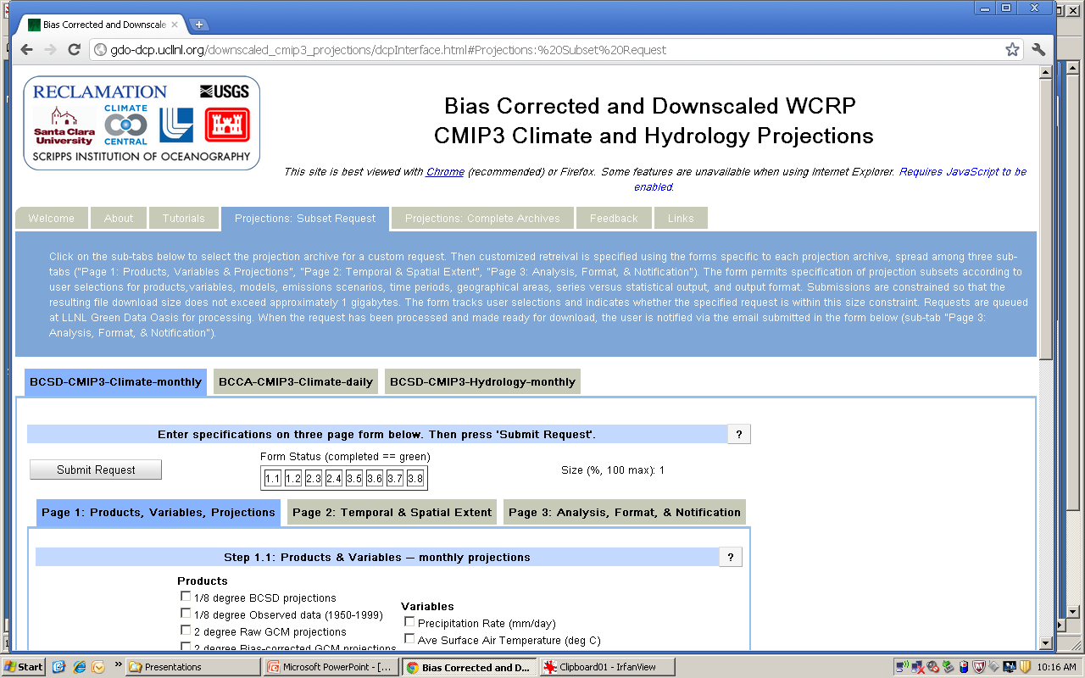
Online Data Access

Slide 92
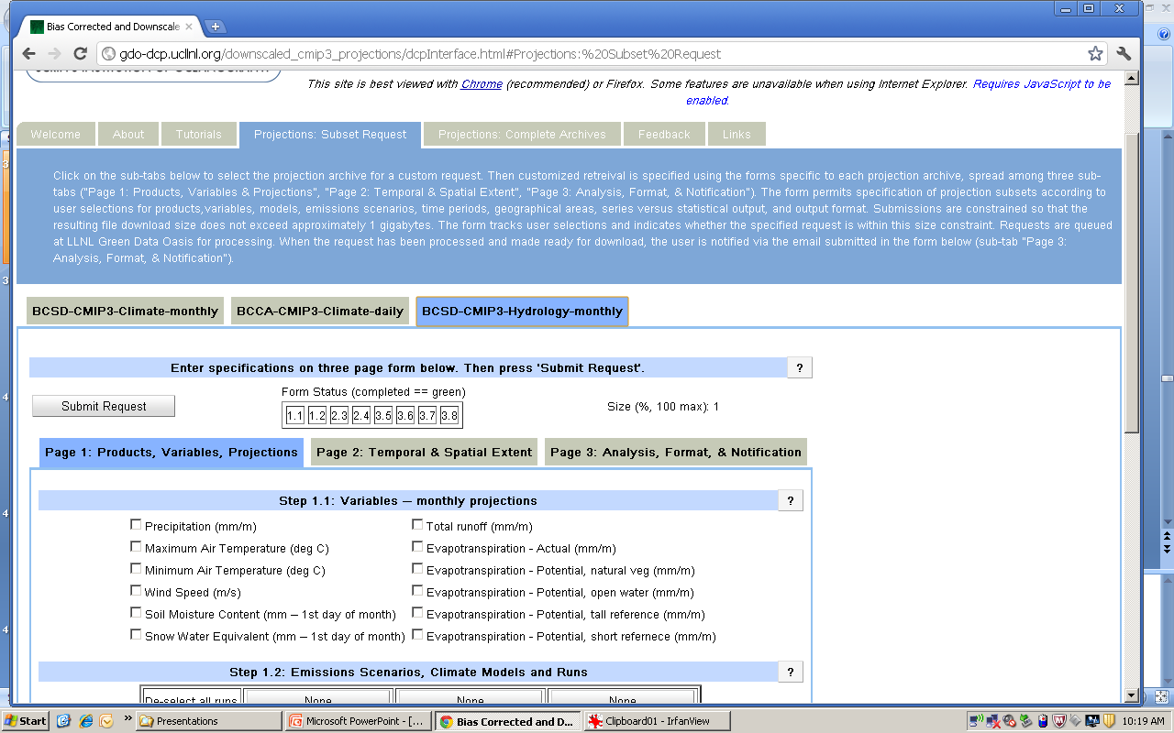
Online Data Access

Slide 93
VIC Applications With Routing Locations
Red triangles – WWCRA Locations (total 43)
Blue triangles – USGS/HCDN locations (total 152)

Slide 94
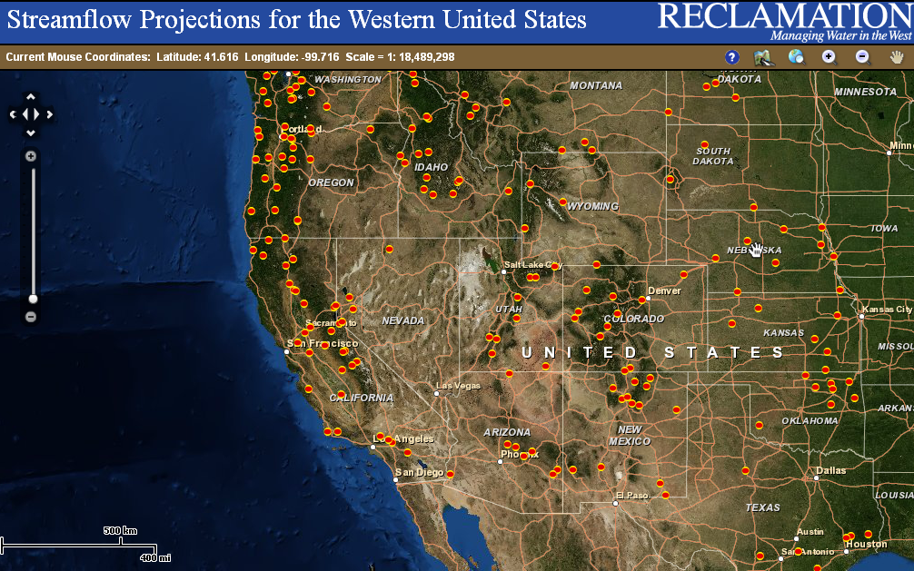
Online Data Access
Daily and Monthly Streamflow Projections
Jan 1, 1950 – Dec 31, 2099
195 locations West-Wide
  http://gis.usbr.gov/streamflow_projections/

Slide 95

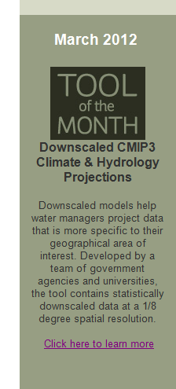
Carpe Diem West is a non-profit 501(c)(3) organization that engages a broad-based network of experts, advocates, decision makers and scientists to address the profound impacts the growing climate crisis is having on water in the American West.
The Science and Technology Program and WaterSMART Basin Studies Program funded Technical Resource Employees Tom Pruitt, Subhrendu Gangopadhyay and Levi Brekke to pull together and lead the multi-agency/university collaboration that developed this downscaling tool.
The tool is not only well recognized and used outside of Reclamation, but is a vital tool used in Reclamation’s SECURE Water - Basin Studies and West-wide Risk Assessments

Slide 96
Questions?
Hydrology of Climate Change: Telling the LOCAL Story Using Global Climate Models
May 23, 2012, Los Angeles, CA
Jack Simes, SCAO/Temecula, jsimes@usbr.gov
Subhrendu Gangopadhyay, TSC/Denver, sgangopadhyay@usbr.gov

