Slide 1

You Can Have the Best of Both Worlds:
Promoting Water Use Efficiency While Enhancing Revenue Stability
Southern California Water Dialogue
January 25, 2012

Slide 2
Agenda
Water Agencies’ Current Challenges
Water Rate Evolution
Revenue Stability & Conservation
Developing the Conservation Rate Structure that Resolves the Challenges and Meets Agencies’ Goals & Needs

Slide 3
Water Enterprise - Current Challenges
New Regulatory Requirements
  SB x7-7: 20% reduction by 2020
Increased Volatility of Water Supply and Demand
  Weather
  Economy
  Regulatory
  MWD Allocation & Conservation Program
Increased Pressure for Conservation Rate Structure

Slide 4
Water Management Challenges
Given these challenges, how will your agency address these concerns?
The key is to develop a Conservation Rate Structure that
  Ensures the compliance with new regulatory requirements by aggressively promoting conservation and efficient water use
  Equitably allocates water supply to customers
  Enhances revenue stability
  Meets the Agencies’ Goals, Objectives & Needs
Notes:
Animation for each bullet on at time

Slide 5

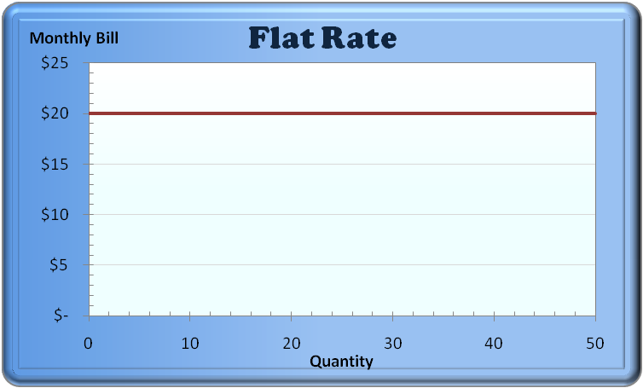
Water Rate Structure Evolution
Revenue Mechanism
Flat Rate: $xx / month regardless of usage
Pros: Revenue stability, easy to understand
Cons: Inequitable, no conservation signal, not affordable for essential use

Slide 6
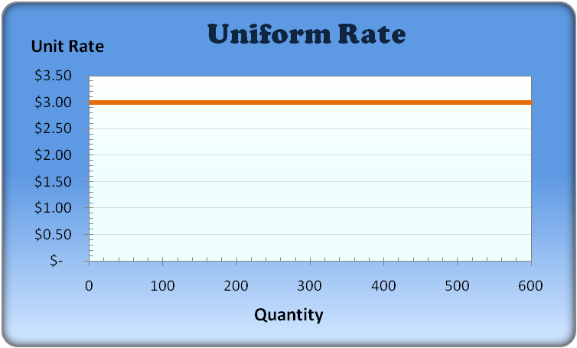

Water Rate Structure Evolution
Revenue Mechanism
Price Information
Uniform Rate: $xx / hcf
Pros: Revenue stability, administrative ease, easy to understand
Cons: Weak conservation, not affordable for essential use

Slide 7
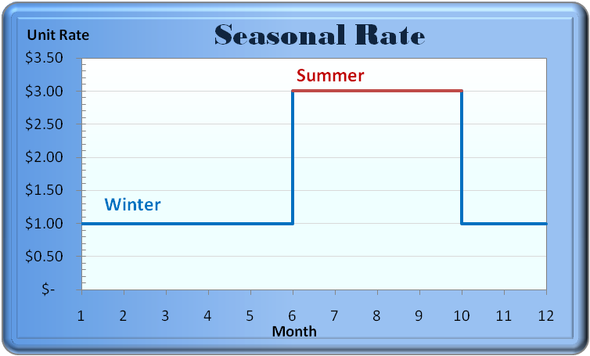

Water Rate Structure Evolution
Revenue Mechanism
Price Information
Behavior Change
Seasonal Rate: $ xxx / hcf in Summer, $ x/hcf in Winter
Pros: Promote water conservation in the summer, easy to administer
Cons: Revenue instability, not affordable for essential use

Slide 8
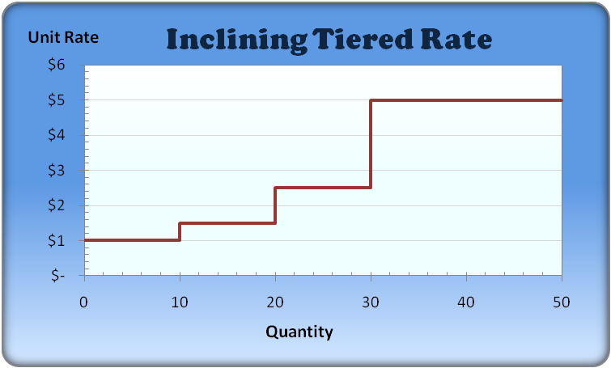

Water Rate Structure Evolution
Revenue Mechanism
Price Information
Behavior Change
Inclining Tiered Rate:
Pros: Promote conservation, affordable for essential use, easy to administer, easy to understand
Cons: Penalize large users

Slide 9
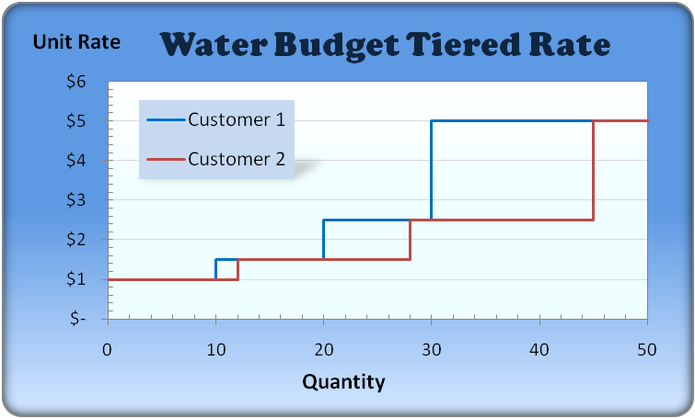

Water Rate Structure Evolution
Revenue Mechanism
Price Information
Behavior Change
Water Budget Tiered Rate:
Pros: Promote water efficiency, equitable, affordable for essential use, drought allocation tool, revenue stability
Cons: High administrative cost, harder to understand
Water Resource Management

Slide 10
Options for Developing an Appropriate Rate Structure
Fixed Cost = Fixed Revenue (1)
Cover all water agency costs in the fixed monthly revenue
The variable cost includes expenditures for producing and purchasing imported water
Hedge away the risk of lower water sales
Fixed Cost on Reliable Water Sales (2)
Determine the amount of water that will be sold under SBx7-7 and develop a revenue strategy based on that portfolio

Slide 11
Other Considerations
Other factors to be considered:
  Customer understanding
  Administrative ease
  Affordability for low water users and essential uses
    Under Proposition 218, a lifeline rate is not an option
  Equity associated with peaking costs
  Encourage conservation / water use efficiency
    Who should cut back and by how much?

Slide 12
Equity
Water is one of the most capital intensive commodities
Customers do not pay for water - they pay for the transportation and treatment of water
Water demand is highly seasonal
  Water system is designed for the hottest day + fire
  This creates idle capacity in the system during the colder months
Who should pay for this idle capacity?
  Everyone?
  Only the customers that use additional water during the summer?

Slide 13
Option I: Fixed Cost = Fixed Revenue
Cover all water agency costs in the fixed monthly revenue
The variable rate includes the cost to produce and purchase imported water
  Hedge away the risk of lower water sales

Slide 14
Option 2: Fixed Cost based on the Reliable Sales of Water
Determine the amount of water sales within the requirements of SBx7-7
Collect the remaining fixed costs from usage in the lower tiers
    Customers who are above their allocation will be asked to reduce their consumption
    The rate structure is aligned with the goals of meeting SBx7-7 compliance
    Inclining rate structures focus on larger water users
    Water budget rate structures focus on inefficient water users

Slide 15
Conservation & Efficiency
Water
Conservation
Reducing water usage
Restricting water use
Lifestyle adjustments
Water
Efficiency
Reducing water waste
Appropriate water use
No change in lifestyle
Notes:
Left to right in animation

Slide 16
Conservation Rate Structures
Inclining Block
  Pros
  +Easy to administer
  +Sends clear conservation signal
  +Addresses affordability for basic needs
  Cons
  - Targets larger water users and doesn’t focus on efficient use of water
    High water use = wasteful water use
  - Equity concerns
    Penalizes large families / lots
    Exacerbated during drought pricing
Water Budget
  Pros
  + Provides water efficiency targets
    Addresses equity concerns for large families / lots
  + Properly allocates drought penalty rates
  + Addresses affordability for basic needs
  Cons
  - Higher administrative costs
    How is efficiency defined?
    Billing system update required
    Proactive Public outreach
    Increases staff for customer service (implementation phase)
Notes:
Change + and - (animation top and bottom)

Slide 17
Water Budget Rates
The tier widths are individualized for each account
A typical water budget takes into account:
  An indoor allocation based on household size
  An outdoor allocation based on the landscaped area and weather conditions
  Example:
    Indoor: 4 people per household & 60 gallons per capita per day = 10 hcf per month
    Outdoor: Historical weather and 30% of lot size

Slide 18
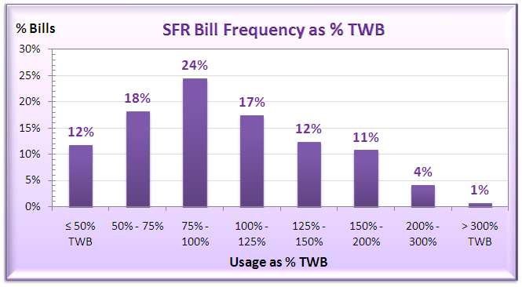
Who Should Cut Back?
Total Water Budget is based on 4 per household, 60 gpcd, & 30% of lot size

Slide 19
Case Study:
El Toro Water District (ETWD)
Tiers | FY 2010 Rates | FY 2011 Rates
 |  | Water Supply | Delivery | Conservation | Offset | Total
Indoor Use | $1.89 | $1.86 |  |  | ($0.06) | $1.80
Outdoor Use | $1.89 | $1.86 | $0.34 |  |  | $2.20
Inefficient Use (50% of total budget) | $1.89 | $3.80 | $0.34 | $0.24 |  | $4.38
Excessive Use | $1.89 | $5.70 |  | $0.24 |  | $5.94

Slide 20
Water Budget Rate Structure in Southern California
Coachella Valley WD
Corona, City of
Eastern MWD
El Toro WD
Elsinore Valley MWD
Irvine Ranch WD
Los Angeles DWP
Monte Vista WD
Moulton Niguel WD
Palmdale WD
Rancho California WD
San Clemente, City of
San Juan Capistrano, City of
Valencia Water Company
Western MWD

Slide 21
Which Criteria Do You Care About?
Criteria | Fixed Cost = Fixed Revenue | Inclining Rate -Fixed Cost on Reliable Sales | Water Budget – Fixed Cost on Reliable Sales
Customer Understanding
Easy to Administer
Revenue Stability
Affordability
Equity
Encourage Conservation

Slide 22
Discussion

Slide 23

Contact Info
Sanjay Gaur
Senior Manager
Raftelis Financial Consultants
201 S Lake Av. Ste 301
Pasadena, CA 91101
Cell: 213 327 4405
Fax: 626 583 1411
Email: sgaur@raftelis.com

