Slide 1
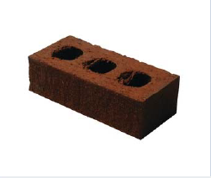
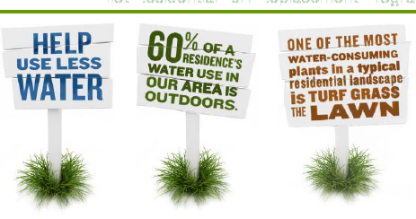
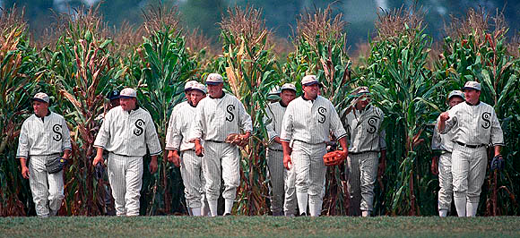
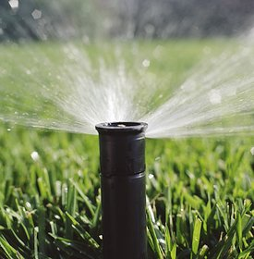
Demand-Side Measures for Addressing water scarcity and Drought: What do we know…
Kurt A. Schwabe
Associate Professor of Environmental Economics
Associate Director, Water Science and Policy Center
University of California-Riverside
MWD (1990): 208 gpcd
MWD (2013): 175 gpcd
Urban GPCD elsewhere…
Israel: 84
Spain: 76
Australia: 80 to 130
(Hanak et al. 2011)

Slide 2
Objectives/Outline
Highlight recent findings from studies of water conservation
Comparison of price vs. nonprice approaches
Effectiveness of nonprice approaches
Persuade you we know very little about the effectiveness of any particular program
Highlight need for more systematic program evaluations to move forward cost-effectively
Discuss UCR’s approach for evaluating water conservation program (high efficiency sprinkler nozzle program)

Slide 3
Water Conservation: Demand-side Management
Two Approaches to Demand-side Management to reduce water use
(not mutually exclusive)
Price-based approaches (e.g., volumetric pricing)
Alter behavior through changes in relative prices
Water use must be metered
Nonprice-based approaches (directly & indirectly alter behavior)
Technological adoption (often with rebates)
Often motivated by environmental attitudes rather than cost savings
Voluntary appeals, mandatory restrictions, information, & education
Rationing
School programs
Flyers
Moral suasion (e.g., “Serious Drought. Help Save Water”)
Social-Norm Messaging

Slide 4
Water Conservation: Prices vs. All Comers…
How do price-based measures compared to other approaches?
Timmons (2003). Compared mandatory low-flow appliance regulation vs modest water price increase using data from 13 groundwater dependent California cities
Prices almost always more cost-effective than technology standards
Brennan et al. (2007). Studied sprinkler restrictions in Perth, Australia
Restrictions on use of sprinklers leads to more overwatering from hand-held hoses resulting in little water savings but additional costs
Grafton and Ward (2008). Compare effectiveness of mandatory restrictions to water prices in Sydney, Australia
Find that mandatory water restrictions to result in costly and inefficient responses relative to prices
Baerenklau, Schwabe, and Dinar (2014). Budget-based Tiered Water Rates reduced water use by 10-15% in EMWD

Slide 5
technology-based Rebate Program Effectiveness
Water savings from rebates programs often smaller than initially supposed (Olmstead and Stavins, 2007)
Mostly due to incorrect assumptions regarding behavior (rebound effect)
Examples: (Dupont, 2014; Mayer et al. 1998; Davis 2008)
Low-flow showerheads result in longer showers
Low-flow toilets result in more flushing
Front load clothes washers result in more cycles
Studies of households fit w/ low flow fixtures get mixed results
Low-flow toilets save 6.1 to 10.6 gpcd in some studies vs. no savings in others
Low-flow showerheads save from 0 to 9% across studies

Slide 6
Cost-effectiveness of rebate programs
Issue of Additionality: Would customers participate without rebates?
Bennear and Taylor (2013). N.C. Rebate Program for low-flush toilets
Did rebate program increase # of hh’s using low-flush toilets and was it cost-effective? (Answer: no)
Used agency hh-level info and hh survey on toilet replacement
Result: water savings from toilet program approximately 7% annually
Only 33% of this attributed to rebate program
Program cost $11 to $15/1000 gal.
Other programs cost $7/1000 gal
If target people who required rebate only, program cost is $4/1000 gal

Slide 7
Social Norm-based Messaging
East Bay Municipal Utility District’s Pilot of WaterSmart Home Water Reports (Mitchell and Chestnutt 2013)
5.6% reduction on average at end of 1 year pilot study relative to control
Greater response by higher water users (no “boomerang” effect)
Increase participation in other programs (“uplift” or “channeling”)
Atlanta, GA Water Utility’s Pilot of Social Norm Messaging in 2007
(Ferraro et al. 2011; Bernardo, Ferraro and Price, 2014).
100,000 households in Atlanta using control and three treatments
Technical advice suggesting ways to reduce water use
– no reduction
(a) with letter from GM appealing for water savings
-- 2.7% reduction
(b) with Social Norm Comparison
-- 4.8% reduction
Greater response by higher water users
Effectiveness reduced: 30% after 4 months / 50% following year
If focus on those above medium user…
88% of the savings for 66% of the costs

Slide 8
Turf Grass Removal / Cash for Grass
Question: How much can replacing grass w/ more drought tolerant plants help?
Answer: It depends… Addink (2014) reviews experiments in…
North Marin Water District (1989). 46 single family homes.
$0.50 / SF turf removed with irrigation system improvements and xeriscape plantings
Estimated savings: 33 gallons/SF
Albuquerque, N.M. Conversion Program since 1996
Initially $0.20/SF that doubled in 2004 to replace bluegrass w/ xeriscape
Required to replace sprinklers with more efficient systems (e.g., drip, soaker, bubbler, hand)
Estimated savings: 19 gallons/SF (although 17% found they use more water)
Southern Nevada Water Authority
Offering $1.50/SF to replace mostly tall fescue with xeriscape and maintain for 5 years
Estimated water savings: 62 gallons/SF
El Paso, Texas (2004): 385 participants
Estimated Water Savings: 18 gallons/SF

Slide 9
Turf Grass Removal / Cash for Grass
Issues:
Cost/AF saved ranged from $512 (California) to $1,834 (El Paso)
El Paso did not require participants install more efficient irrigation systems
Savings mostly derive from improving irrigation efficiency
2/3rds of savings from improving irrigation system; 1/3rd from changing plant requirements
In Nevada study, water use for same landscape could be reduced by nearly 30% with more efficient irrigation
Additionality
In North Marin Water District, half of participants were to remove turf anyway
Comparisons across user groups
Most experiments have been with single-family residences.
No accounting of old vs. newer systems, business vs. HOA vs. single-family
People like their green grass
Conversion to turfgrass has about a 5% acceptance rate (Martin 2003)
70% of homeowners surveyed in Phoenix prefer green lawns

Slide 10
Summary and concerns
Rebate conservation programs are attractive yet fall short of initial estimates
Cost-effectiveness depends on “rebound” and “additionality” issues
Volumetric price-based conservation program shown to be effective
Have little idea how to achieve a successful program nor how various programs interact
Notes:
Rebate conservation programs are attractive yet fall short of initial estimates
Cost-effectiveness depends on “rebound” and “additionality” issues
Some studies suggest rebound effects are small – more research required
If understand “additionality,” can significantly improve cost-effectiveness
If considering long-run programs, need to implement program-specific evaluations --- could save money and water
Volumetric price-based conservation program shown to be effective
Elasticities differ across seasons, socio-economic factors, and in relation to different types of nonprice alternatives (complementary effects)
Suggests benefits from targeted program and consideration of complemetarities across programs
Poor water pricing leads to excessive scarcity and costly policies in short run (e.g., drought) and likely unsustainable land-use patterns in long run
Detail matters – program, household type, pricing, timing, etc.

Slide 11
Are Water Conservation Programs Effective? An Evaluation of the High Efficiency Sprinkler Nozzle Program
A Preliminary Investigation of EMWD Phase II Voucher Redemption
Kurt Schwabe, Ken Baerenklau, and Ariel Dinar
Water Science and Policy Center
University of California Riverside
Objectives/Goal
What factors are correlated with redeeming vouchers?
Do those who redeem vouchers use less water relative to what they used before and, if so, by how much?

Slide 12
Other Project Collaborators…
Tim Barr
Water Use Efficiency Manager, Western Municipal Water District
Maureen Erbeznik
CEO, Maureen Erbeznik & Associates
Drew Atwater
Moulton Niguel Water District / graduate student
Eastern Municipal Water District
Western Municipal Water District
With acknowledgement of financial support from:
Western Municipal Water District
Metropolitan Water District
University of California Riverside
World Water Forum College Grants Forum
United States Bureau of Reclamation

Slide 13
Statistical model of “participation”
Employ a probability-based multivariate statistical model (logit)
Monthly water use data on 91,151 households from 4/2009 to 9/2012
Voucher data on 1,211 (1.3%) households that redeemed vouchers between 10/2011 to 6/2012
---------------------------------------------------------
Probability (Participation) = f (explanatory factors)
Explanatory factors (data):
ET (microzone-level)
Property value (census track level)
HH size
Season (relative to winter)
Other programs
Income (census track level)
Landscape area
Distance to distributor (miles)

Slide 14
Characteristics of Phase II Redeemers: Who Redeems?
Total Accounts/Total Redeeming: 91151 / 1211
Notes:
Income < 46607
Income > 46607 and < 60984
Income > 60984 and < 75583
Income > 75580

Slide 15
General Summary of who redeems
Households that redeemed vouchers tended to have a statistically significant relationship with….
higher incomes
more family members
similar, if not slightly lower, ET values
higher water usage rates
larger landscapes
proximity to distributor

Slide 16
Water Use Pre- and Post Phase II for Adopters and non-adopters (CCF)
 | Average Monthly Water Use (CCF)
Pre (2010) | No Voucher | Voucher
3 month (July-Sept) | 20.08 | 26.13
Post (2012)
3 month (July-Sept) | 21.74 | 25.91
Differences: Post(2012) – Pre(2010)
3 month (July-Sept) | 1.66 (8%) | -0.22 (-0.8%)
Difference in Difference (Voucher – No Voucher)
3 month (July-Sept) | -1.88 (-9%)

Slide 17
Statistical model of “demand”
Employ a discrete-continuous choice (DCC) econometric model
Use subsample from EMWD water rate study (Baerenklau et al.)
13,665 accounts / 121 redeemers from April 2009 to September 2012
---------------------------------------------------------
Monthly Water Use = f (explanatory factors)
Explanatory factors:
Redeemed vouchers (from previous model)
Education (census-track level)
HH size
Season (relative to winter)
Income (census track level)
Irrigated Area
Price of water (tier/marginal)
Time Trend
ET (mm; by micro-zone)
Restrictions on water use

Slide 18
Statistical model of demand: Results
Scenarios for analyzing effects of redeeming vouchers
Assuming installation in month of redeeming vouchers: 0.7% reduction
Savings: 0.16 CCF per month or 1.9 CCF per year
If savings occur only during summer: 2.8% reduction in summer months
Assuming installation 2 months after redeeming vouchers: 3.1% reduction
Savings: 0.51 CCF per month or 6.1 CCF per year
If savings occur only during summer: 8.9% reduction in summer months
Assuming installation 4 months after redeeming vouchers: 1.7% reduction
Savings: 0.28 CCF per month or 3.4 CCF per year
If savings occur only during summer: 4.9% reduction in summer months
_________________________
Average monthly (summer months) water use: ~16.5 (~23) CCF / ~406 gpd (~565 gpd)

Slide 19
Summary of Initial Findings
Socio-economic and environmental differences across households seem to explain decisions to redeem
Results might “suggest” that households redeeming vouchers reduce summertime water use somewhere between 3 to 9% per month
Assumptions regarding relationships between redeeming and both if and to the extent to which nozzles are installed correctly are important
Need more information to make an accurate assessment

Slide 20
Conclusions
Prices are both effective and cost-effective at reducing demand
Structure likely matters…yet very little information on this
(Cost)-Effectiveness of any conservation approach depends on numerous factors
Biophysical, socio-economic, demographic, institutional, seasonal…
Implementation of other programs
Price and pricing structure (Smith and Zhao, 2014)
Future gains, especially cost-effective gains, will require a better understanding of the how and why people respond to price and nonprice instruments
Data does likely exist!

Slide 21
“Let me explain something to you…this business requires a certain amount of finesse” Jake Gittes Chinatown (1974)
Thank you

